Slide 1
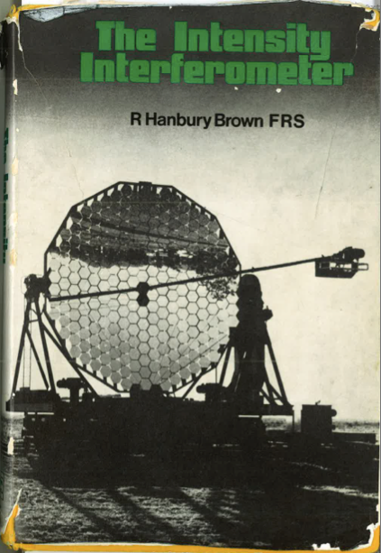
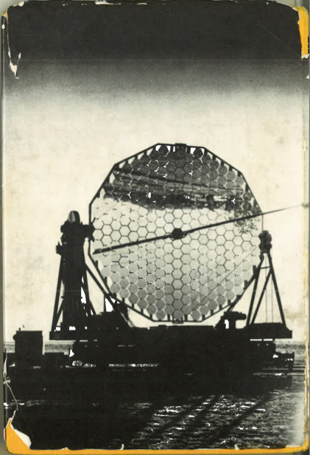
Concluding remarks

Slide 2
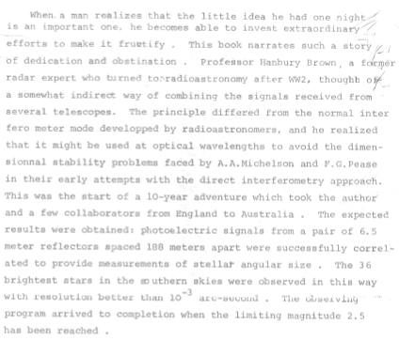
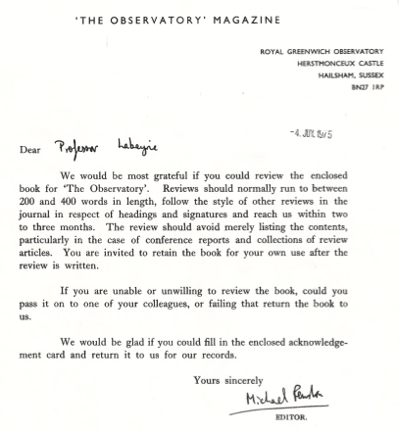
Science is adventure!

Slide 3
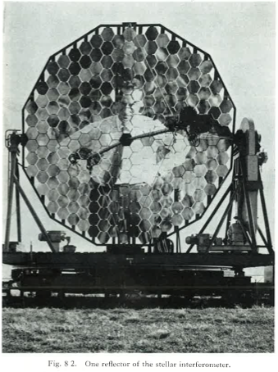
… of one man (or a woman) …

Slide 4
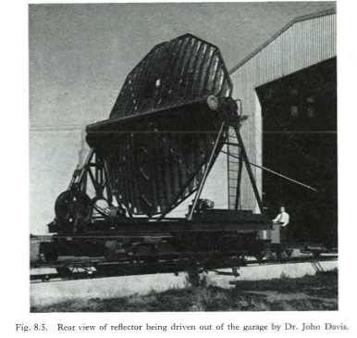
… pushing a team’s achievements …

Slide 5
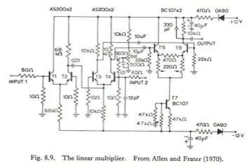
… with proper technology …

Slide 6
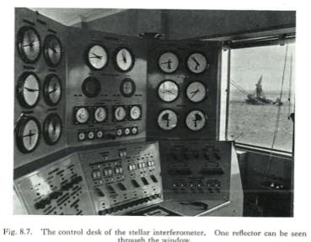
… and control + signal processing …

Slide 7
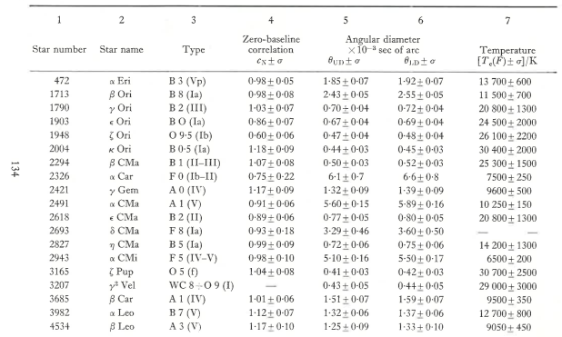
… and most of all rewarding: 1st “systematic“ study of stellar fundamental parameters

Slide 8
Modern HBT can be Nice!
HESS and VERITRAS are … and CTA will be there: kilometric baseline crowded array => imaging.
SII becomes possible thanks to the progress in quantum optics theory and practice + technology => a quantum leap is being taken!
A multidisciplinary domain: brings astrophysics, physics, engineering science and signal processing …. To a same paradigm
Interesting educational aspects (iMOOCs, i.e. under development at OCA: start 2014-2015) with “hands in the mud“.
J.P. Berger ESO Workshop (see OLBIN forum)

Slide 9
As for the present and … ending workshop!
Many thanks to the Doeblin interdisciplinary federation (P. Chossat, CNRS, UNS and OCA) for its support to the meeting.
To the speakers and participants
And mostly to Paul Nuñez and his colleagues for the organization
Hope to see you at 100µarcs resolutions!

