Slide 1


Intensity interferometry for imaging dark objects
Dmitry Strekalov, Baris Erkmen, Igor Kulikov, Nan Yu
Jet Propulsion Laboratory, California Institute of Technology
Quantum Sciences and Technology group

Slide 2
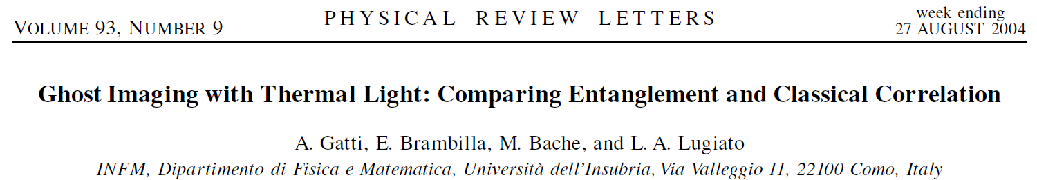
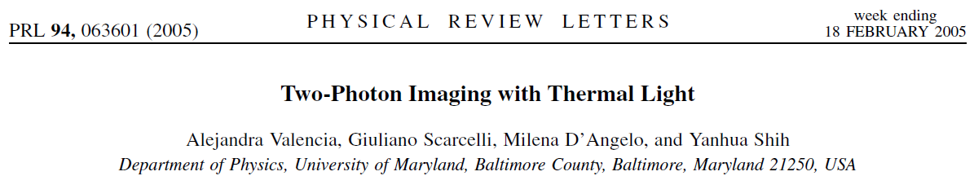
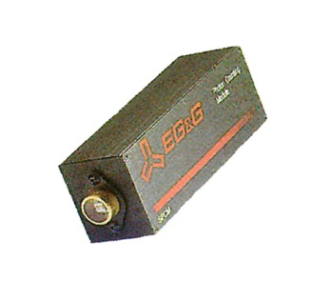
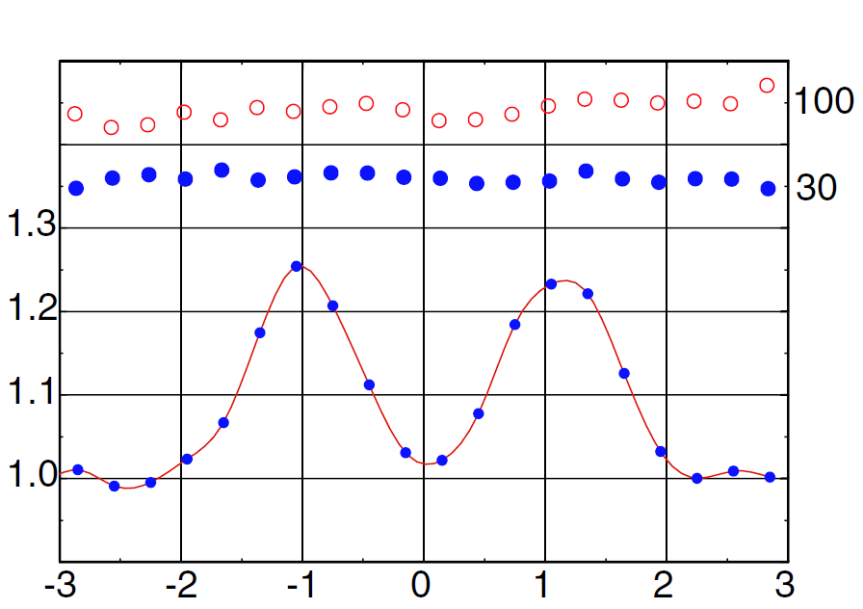

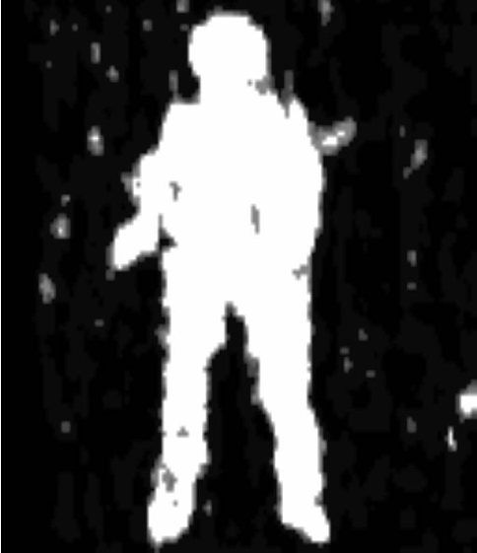
Ghost Imaging with thermal light
Theory: Experiment:
Object
50/50
beam splitter
Image
Transverse mode (speckle) size

Slide 3
Can an object replace the beam splitter?
x'
x₁
Object
Image
x₂
Notes:
Corfunction will carry the information of the object’s optical properties, though a general analysis is complicated.

Slide 4

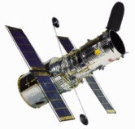
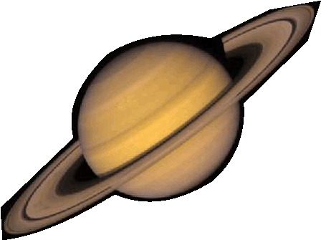
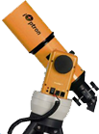
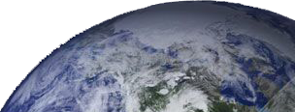
This enables two possible observation scenarios
Source
Source
Object
Object

Slide 5
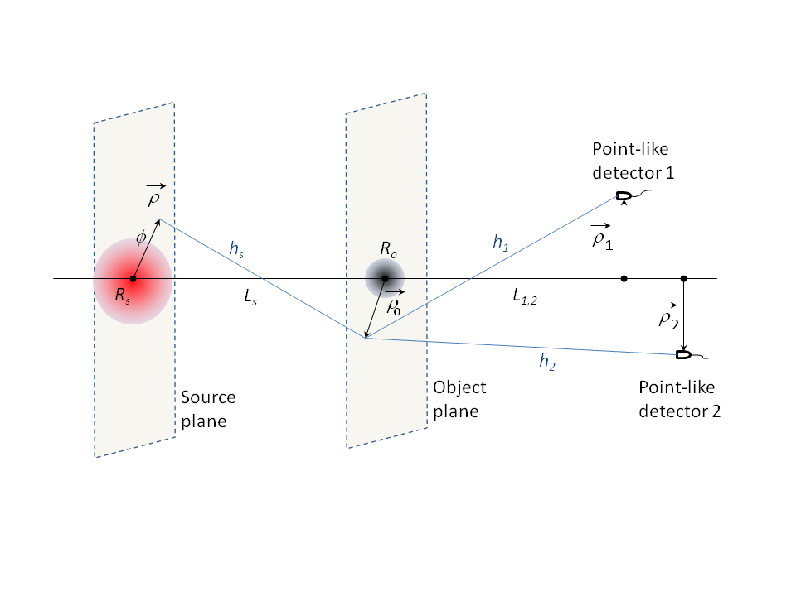

Our model and approach
Key assumptions:
Paraxial approximation
Flat source and object
Gaussian distribution
of source luminosity
and object opacity
[D.V. Strekalov, B.I. Erkmen, and N. Yu, Phys. Rev. A, 88, 053837 (2013)]

Slide 6

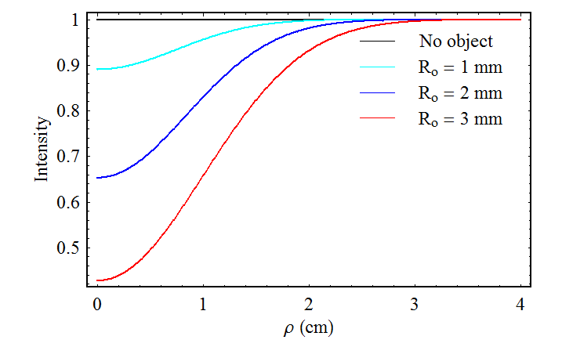
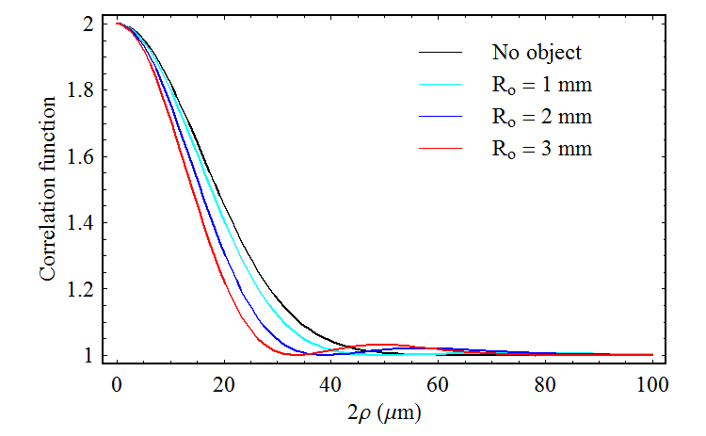
Gaussian absorber on the line of sight
R_{o} = 1, 2, 3 mm
R_{s} = 1 cm
50 cm
ρ
ρ
50 cm
Speckle
width
A small absorbing object has little effect on the speckle shape, but affects its width.

Slide 7
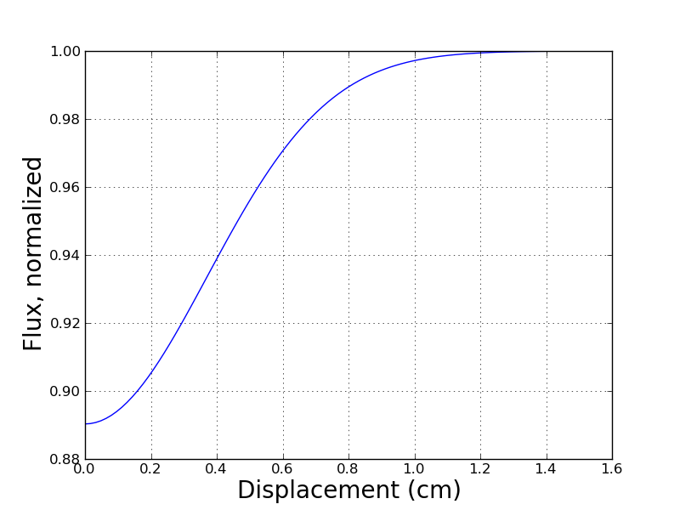
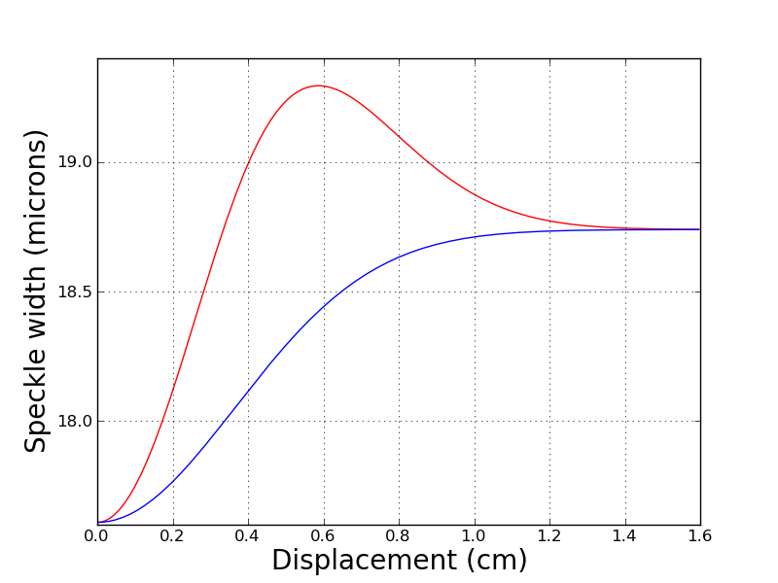
Gaussian absorber crossing line of sight
R_{s} = 1 cm
50 cm
ρ
ρ
50 cm
R_{o} = 1 mm
Parallel
Perpendicular
9%
9%
6%
Transition direction matters! “Stereoscopic vision”

Slide 8

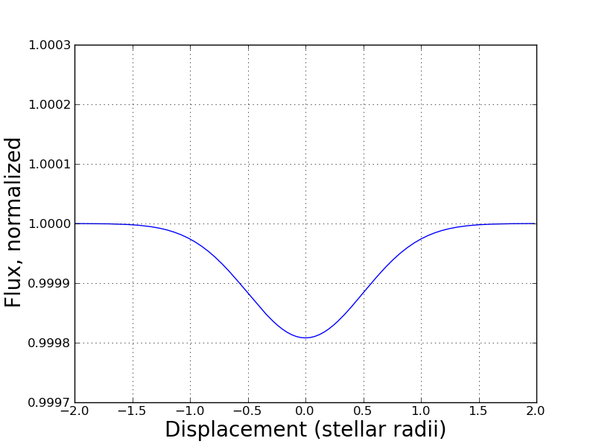
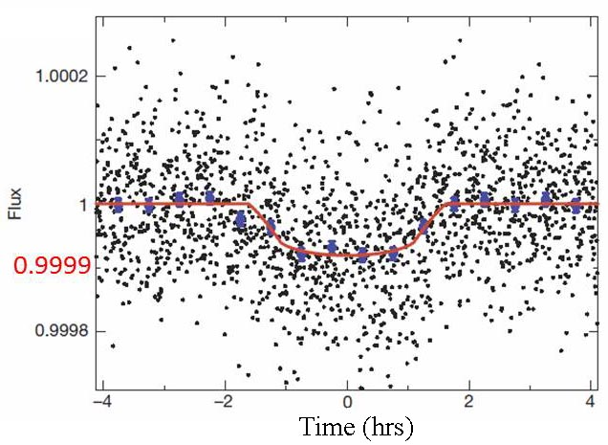
Kepler 20e, intensity measurement
Source: R_{s} = 0.94R , L_{s} = 12 R_{s}, angular size 1.5e-10 radians
Object: R_{o} = R_{Earth}, L = 290 pc, angular size 1.2e-12 radians
Object appears smaller than the source; speckle smaller than the object;
speckle smaller than the shadow
Francois et al.
Nature 482
195-198 (2012)
1.9 10⁻⁴
x

Slide 9
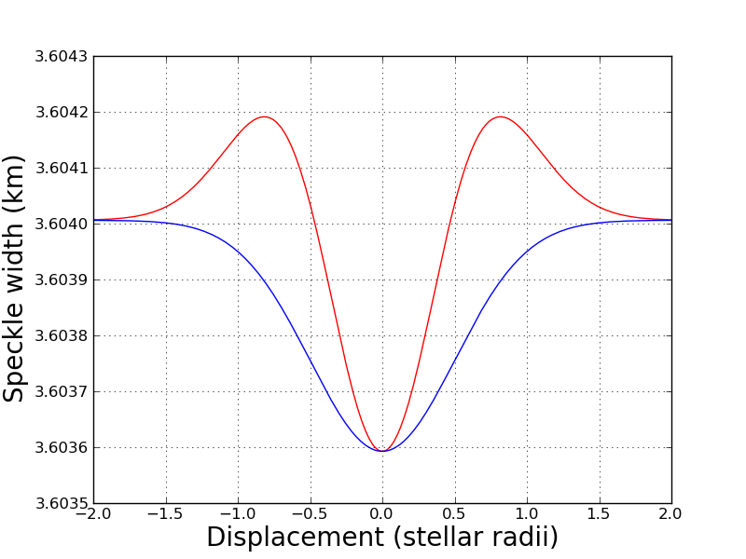
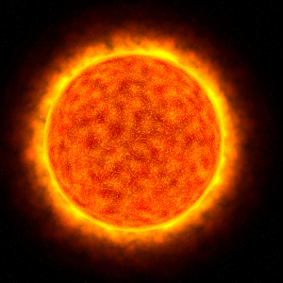
Kepler 20e, speckle width measurement (hypothetical)
1+5.5 10⁻⁵
x
1
Max fractional
width variation
Detectors base
1.7 10⁻⁴
x
1-1.1 10⁻⁴
x
We could determine the transient direction!

Slide 10
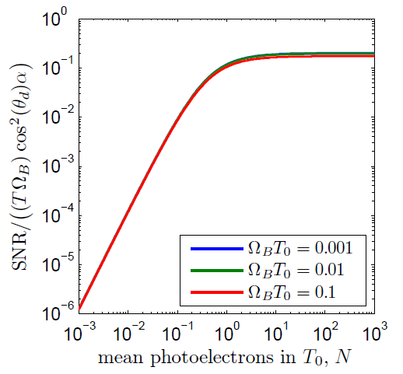
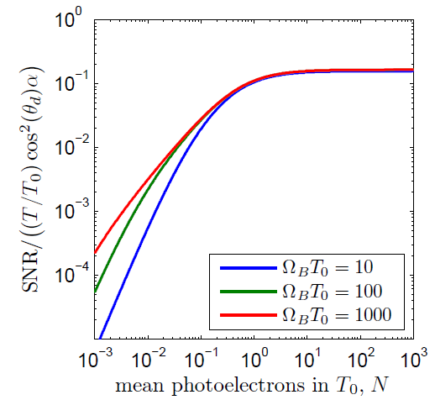
What SNR should we expect from a real thermal light source?
Broadband detection Narrow-band detection
Full optical bandwidth and power of the source; g⁽²⁾ contrast reduced due to multimode detection.
Reduced optical bandwidth and power of the source; full contrast of g⁽²⁾ due to single-mode detection.
Ω_{B} detection bandwidth
T₀ coherence time
T integration time
Table-top pseudo- thermal
Astronomy stellar
In the low spectral brightness regime (e.g., faint black body radiation), these two scenarios yield similar SNR. For spectrally resolved observation (e.g., a specific atomic transition), narrowband detection provides an advantage! In any case, large Ω_{B} is beneficial.
[D.V. Strekalov, B.I. Erkmen, and N. Yu, Phys. Rev. A, 88, 053837 (2013)]

Slide 11
How is the object’s signature encoded in the correlation function
source
If the source speckle upon the object
is smaller than the object feature,
Introducing and (symmetric configuration)
or approximately
(large source, small object)
Fourier-transform of the source luminosity (van Cittert–Zernike theorem)
The source luminosity
Fourier-transform of the object opacity

Slide 12
Gerchberg-Saxton algorithm for dark objects
FT
Corfunction constraint
Correlation function (observed)
FT⁻¹
Object constraint
Object’s profile (reconstructed)
Correlation function constraint: the absolute value must match the observation
Object absorption constraint: 1. A is Real
2. 0<A<1*
3. Size limitation (not expected to be larger than…)
4. Often we know that the object is solid: A = 0 or A = 1*
5. Using low-resolution “support” image
*) These constraint are specific to our approach

Slide 13
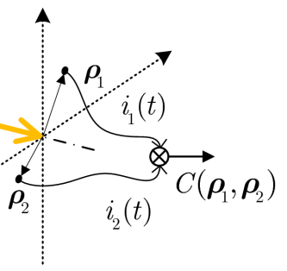


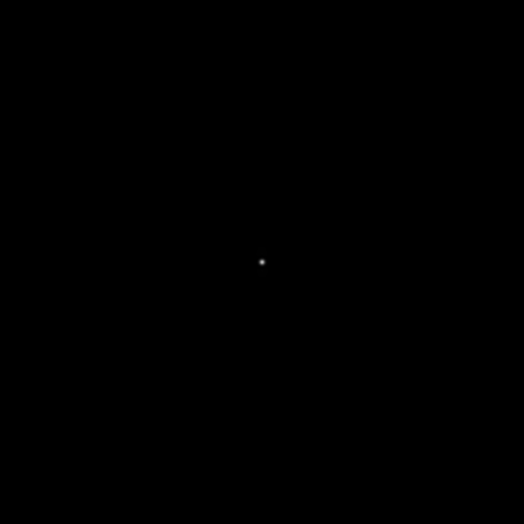
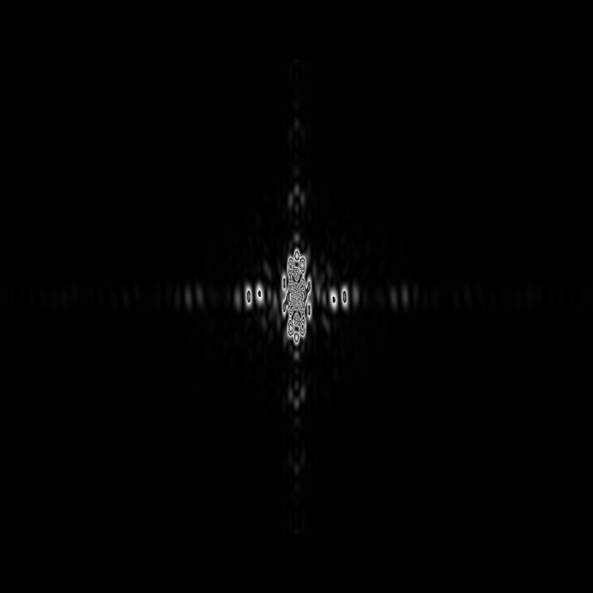
Image reconstruction example
(numerical simulation on the lab scale)
Source:
R = 2 mm,
λ = 532 nm,
Gaussian
luminosity
distribution
Detectors array to measure
the correlation function
36 cm
Object
36 cm
In this geometry, the object produces no tell-tale shadow!
2 mm
X 1000
brightness amplification
6.4 mm
6.4 mm
The source speckle observed in the correlation function measurement (on the left) is modified by the presence of the object. By artificially increasing its brightness (on the right) we can clearly see a structure encoding the spatial distribution of the object’s opacity, which is to be recovered.

Slide 14
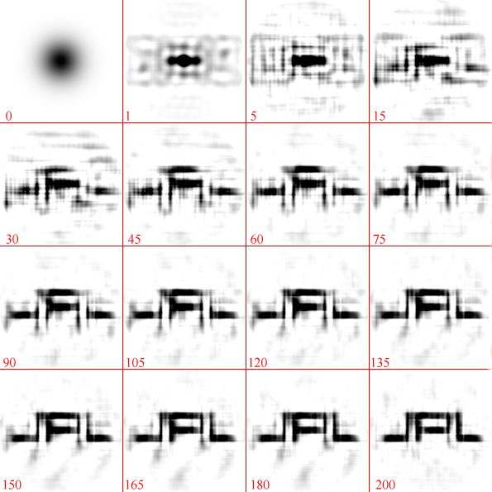
The reconstruction results
(not using the “solid object” A = 0 or A = 1 constraint)
[D.V. Strekalov, I. Kulikov, and N. Yu, to appear in Optics Express (2014)]

Slide 15

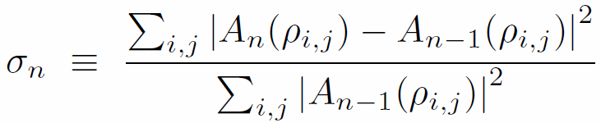
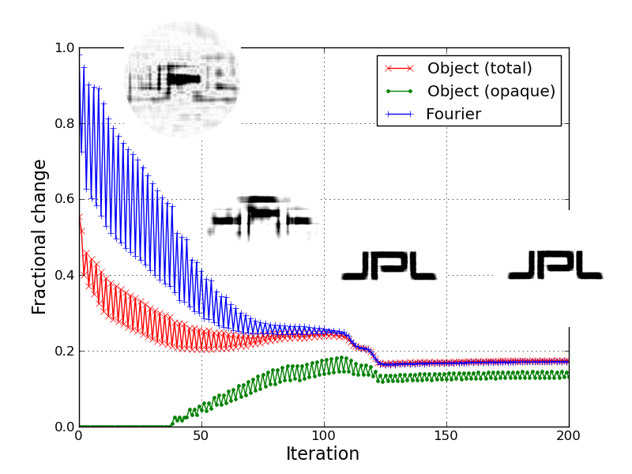
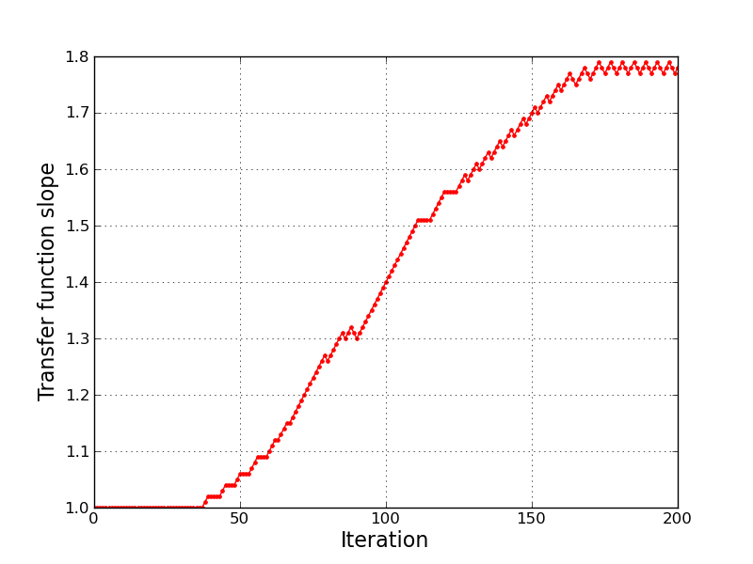
Handling solid (A = 0 or A = 1) objects
1
1
1
0.5
0
1
0
0.5
1
0
0.5
1

Slide 16
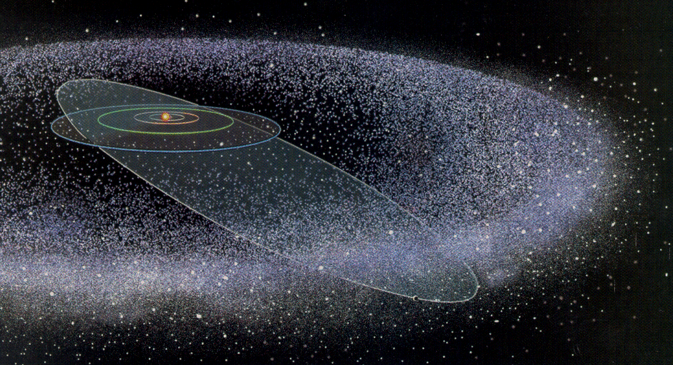
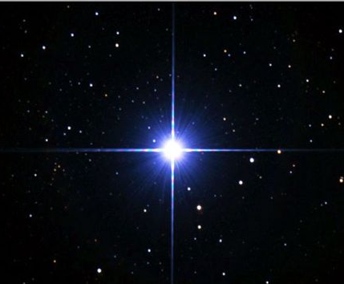

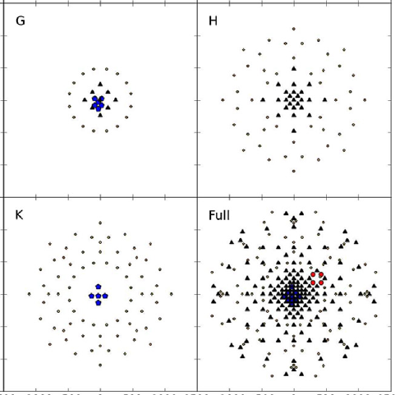
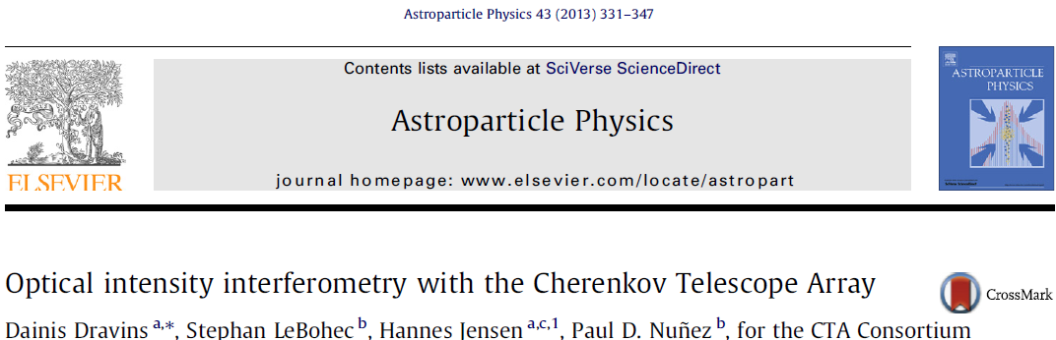
Astrophysics example:
a hypothetical Earth-size planet in the Oort cloud
Sirius
1 ly
8.6 ly
arc sec
arc sec
with two 1000 km moons
0.7 % flux reduction
Detectors array: 2000 x 2000, 1m-spaced, 532 nm
Detectors array are so large in order to capture the source speckle and the object/pixel speckle at the same time. Can we avoid insanely large arrays?

Slide 17












The reconstruction results
Iteration # 0 (initial guess) 1 10 20
Iteration # 30 40 50 60
Iteration # 70 80 90 100

Slide 18
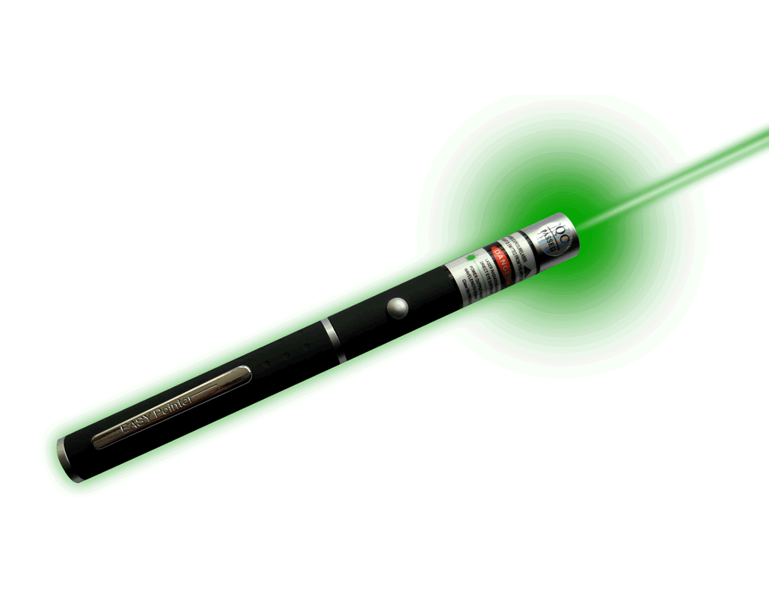
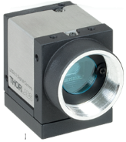
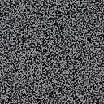

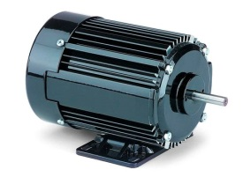
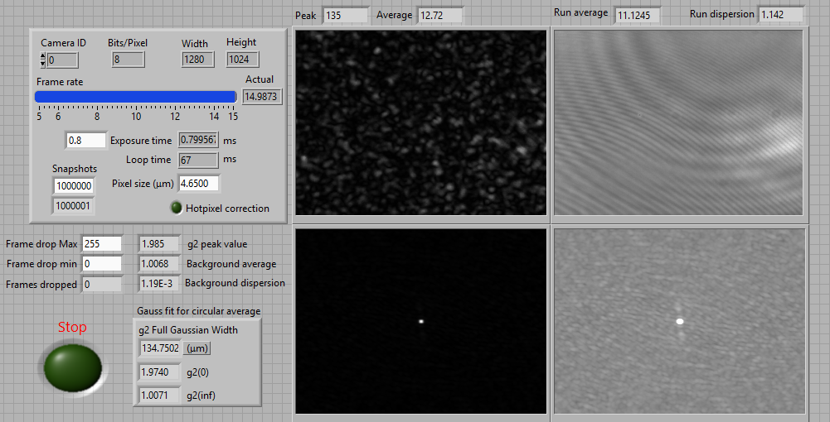
Experimental demonstration with a pseudo-thermal light source
Correlation observable:
I_{xy}
I_{yx}

Slide 19
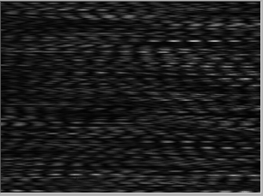


Experiment 1. Double slit
R_{s}= 2.15 mm
Gaussian spot
60 cm
90 cm
I_{x}
I_{-x}
Slits width 0.22 mm,
distance between centers 1.01 mm
X (mm)
Notes:
From 04 16 2014 ss4 no lens

Slide 20
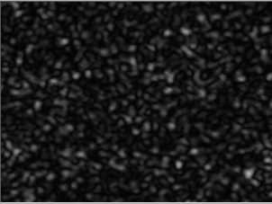
Experiment 2. Double wire
R_{s}= 2.15 mm
Gaussian spot
58 cm
89 cm
Wires diameter 0.32 mm,
distance between centers 1.4 mm
X (mm)
Notes:
From 04 17 2014 Dbl wire 1

Slide 21
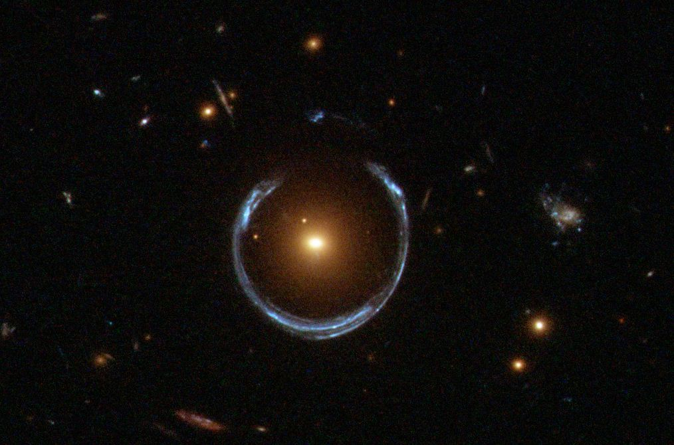
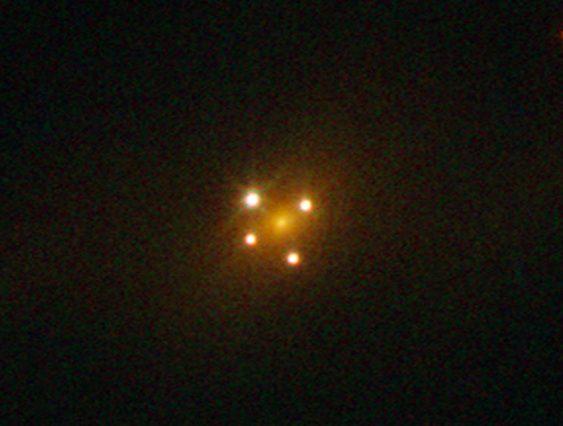
There are many phase objects in space!
(Gravitational lensing and microlensing)
A luminous red galaxy (LRG 3-757) has gravitationally distorted the light from a much more distant blue galaxy. Photo by Hubble.
The Einstein Cross: four images of a distant quasar Q2237+030 appear due to strong gravitational lensing caused by a foreground galaxy. Photo by Hubble.

Slide 22
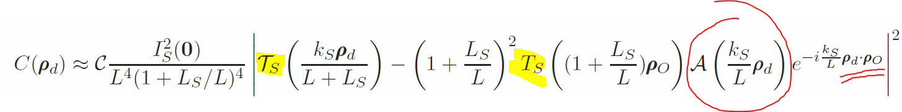
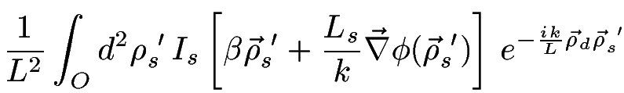



Intensity-interferometric imaging of a phase object
isn’t good enough; need higher-order terms
Phase contribution
Where I_{s}[…] is the intensity of the source, and is the gradient of phase.
Example: a parabolic lens ;
when I_{s}[…] = I_{s}[0] = const, and

Slide 23
Phase object reconstruction steps:
Use Gerchberg-Saxon algorithm to recover the source function with modified argument
Invert I_{s}[…] to recover
Keep this piece,
remove the rest
of the lens
50 cm
50 cm
f = 11.36 cm
Encoding
into
Restoring
after
correlation
function
500
iterations
Original phase object
Restored phase object
cm
cm

Slide 24
Summary
A dark object in the line of sight affects a light source correlation function, imprinting upon it its own optical properties. This phenomenon may be used for intensity-interferometric imaging of this object.
This technique may be promising for high-resolution observation of a variety of space objects and phenomena, e.g.
  Exoplanets
  Neutron stars
  Kuiper Belt / Oort cloud objects
  Dark matter
  Gas or dust clouds
  Gravitational lensing and microlensing
SNR in the intensity-interferometric imaging of dark objects is not favorable but may be suitable in narrow-bandwidth measurements.

Slide 25
Backup slides

Slide 26
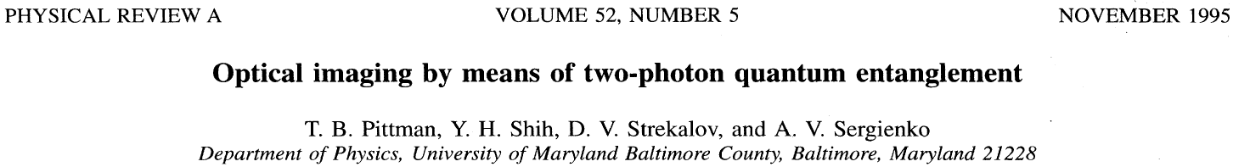
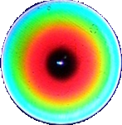
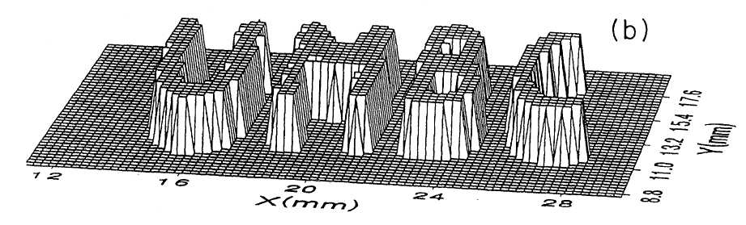
The UMBC Ghost Imaging experiment
f
b
Photon pairs
source
a₁
UMBC
(x,y)
a₂
(photon energy conservation)
Background suppression
Imaging of difficult to access objects
Dual-band imaging
Relaxed requirements on imaging optics
(photon momentum conservation)
Notes:
It all started…

Slide 27
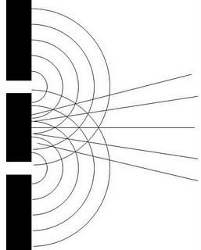

Statistics of photon detections
Glauber correlation function
Laser light: g⁽²⁾(0) = 1 Poisson statistics (random process)
Pulsed light: g⁽²⁾(0) > 1 “Bunching”
Amplitude-squeezed light: g⁽²⁾(0) < 1 “Anti-bunching” (quantum!)
Single-mode thermal light: g⁽²⁾(0) = 2 “Bunching”
“UR”
“UMBC”
???
Notes:
Light propagets as a wave, but emitted and absorbed as particles. Statistics of photodetections, e.g. the corfunction, provides info about light source

Slide 28
Two-coordinate correlation function can be introduced likewise
x₁
x₂
Observed by means of photodetections coincidences. In practice, one measures
with single-photon measurements, or
with photocurrents measurements
Notes:
Two-coordinate corfunctions can also be introduced.

Slide 29
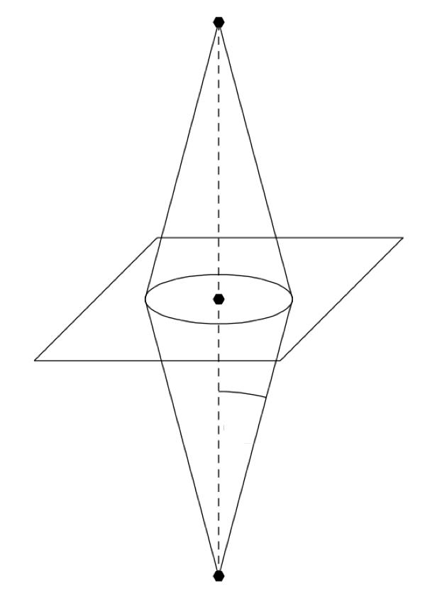

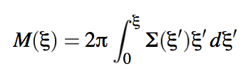
Phase objects models for Gravitational Lensing
Gravity plane
α
grad φ
Source
Detector
where
We consider three common* models for mass distribution:
Gravity plane of constant surface mass-density Σ=const. This model corresponds to the constant mass distribution of the matter near the symmetry axis.
The surface mass-density of the plane Σ ~ 1/ξ. This model is a simple realization of spatial distribution of matter in galaxies, clusters of galaxies, etc.
A point mass. This model corresponds to a black hole or another very compact space object.
*) “A Catalog of Mass Models for Gravitational Lensing”, arXiv:astro-ph/0102341v2

Slide 30
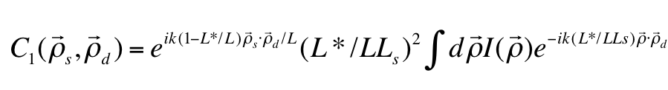

(0) Free-space propagation.
Gravity plane of constant surface mass-density Σ=const.
where the modified length L* depends on the surface mass density.
This is equivalent to free-space propagation over a greater distance.
(b) The surface mass-density of the plane is inversely proportional to impact parameter ξ.
where δ₀ depends on the total mass.
This multiplies the correlation function by an unobservable phase factor.
The off-axis configuration may lead to observable effects and needs to be analyzed.

Slide 31
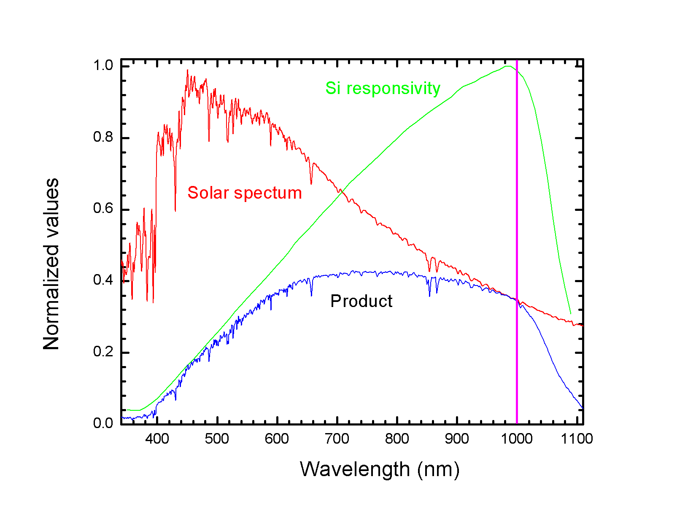
The cost of narrow-band detection
1 ps timing resolution 3.3 nm bandwidth @ λ = 1 μm.
Loss relative to maximally wide-band intensity measurement is 23 dB
(again, much less for a color-resolved measurement)

Slide 32



Kuiper Belt
30-50 AU from the Sun.
Roques F., et al., Astron. J., 132, 819–822 (2006):
Chang H., et al., Nature, 442, 660–663 (2006):
Notes:
Get parameters from papers, model speckles. AU = 149,597,870,700 meters

