Slide 1
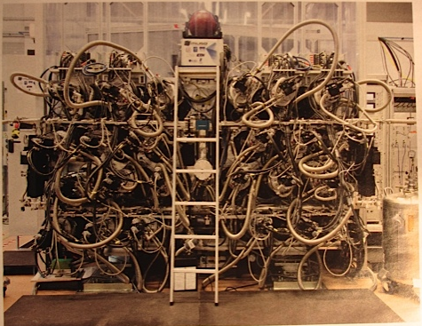
Towards quantum telescopes.
Can Quantum Optics serve astronomy?
Aglaé Kellerer,
Durham University
Notes:
MUSE

Slide 2
Stimulated emission depletion microscopy (STED)
Atoms are excited
Back into ground state through stimulated emission
Atoms emit spontaneously
λ/D
λ/D
<< λ/D
E₁
E₀
The diffraction limit is routinely overcome in microscopy

Slide 3
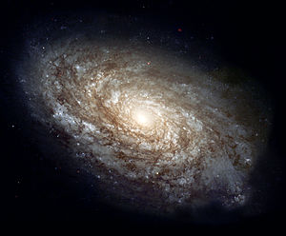
Origin of the diffraction limit
Δx • Δp_{x} > ħ
telescope aperture
detector
The diffraction limit is rooted in the Heisenberg uncertainty principle

Slide 4
Origin of the diffraction limit
Δx • Δp_{x} > ħ
telescope aperture
detector
The diffraction limit is rooted in the Heisenberg uncertainty principle

Slide 5
Origin of the diffraction limit
Δx • Δp_{x} > ħ
telescope aperture
detector
The diffraction limit is rooted in the Heisenberg uncertainty principle

Slide 6
Origin of the diffraction limit
Δx • Δp_{x} > ħ
telescope aperture
detector
B
A
Distorted wavefront: knowledge of photon position is improved

Slide 7
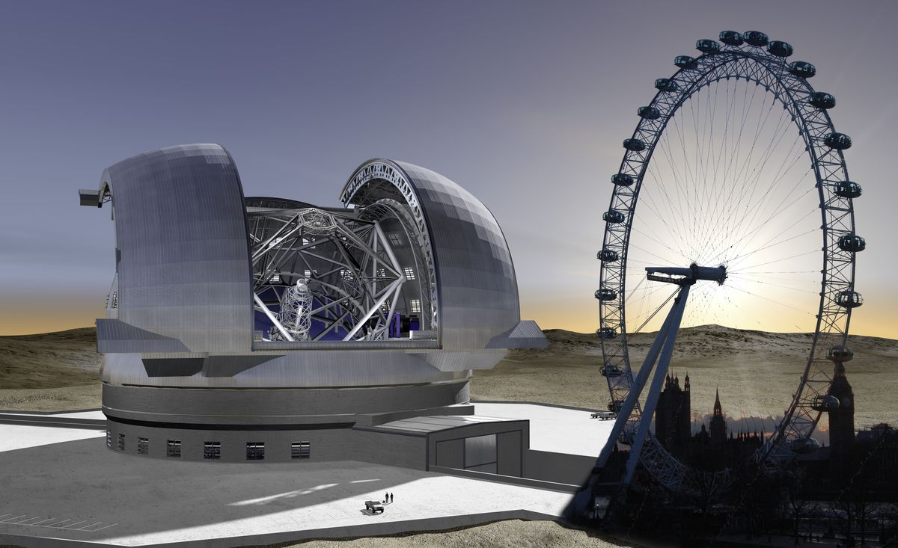
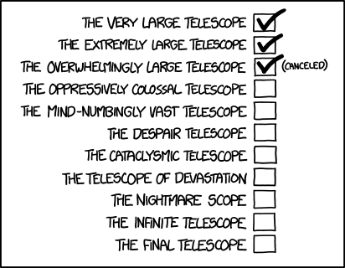

Slide 8
No-cloning theorem
Coincidence
detector
Amplifier medium
See: Milonni & Hardies, Phys. Lett. A 1982
Wootters & Zurek, Nature 1982
Mandel, Nature 1983

Slide 9
No-cloning theorem
Coincidence
detector
Together
Amplifier medium
Can photon cloning be used to beat the diffraction limit of a telescope?
See: Milonni & Hardies, Phys. Lett. A 1982
Wootters & Zurek, Nature 1982
Mandel, Nature 1983

Slide 10
No-cloning theorem
Coincidence
detector
Together
Amplifier medium
Can photon cloning be used to beat the diffraction limit of a telescope?
No! Huge noise contribution from spontaneous emissions
See: Milonni & Hardies, Phys. Lett. A 1982
Wootters & Zurek, Nature 1982
Mandel, Nature 1983

Slide 11
Kellerer “Beating the diffraction limit in astronomy via quantum cloning” A&A 2014
Kellerer “Quantum telescopes” A&G in press
Heralded photon cloning
Together
Quantum non-demolition measurement
Detector read-out conditioned on trigger-signal
The contribution from spontaneous emissions is minimized through use of a trigger signal

Slide 12
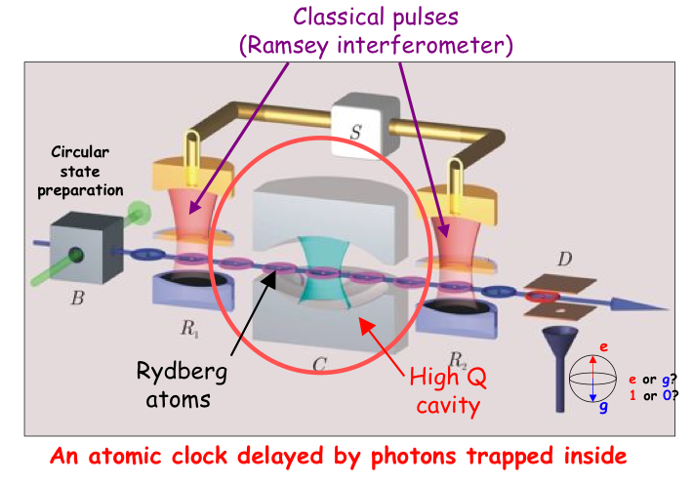
Quantum non-demolition measurements
Not applicable to astronomy: the photon is trapped inside the cavity

Slide 13
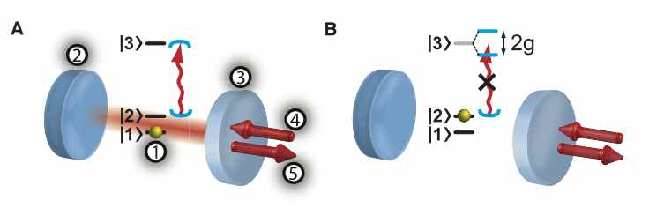
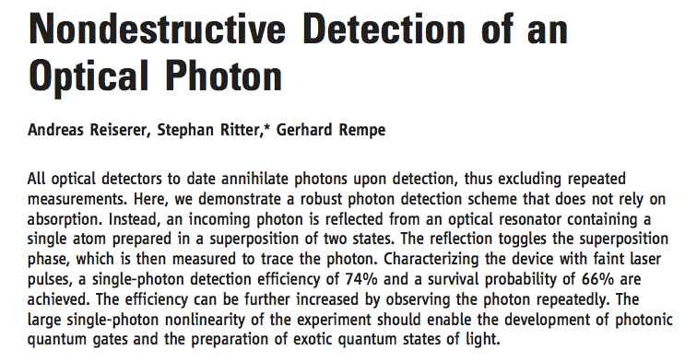
Quantum non-demolition measurements
^{Science 342, 1349 (2013);}
In this experiment the photon is not trapped inside the cavity

Slide 14
Towards quantum telescopes:
Some questions for the discussion
Other approaches to overcome the diffraction limit behind a telescope?
What medium and cavity are required to amplify a single photon?
Quantum non demolition measurements on single photons from an astronomical source?

