Slide 1
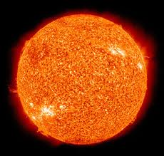
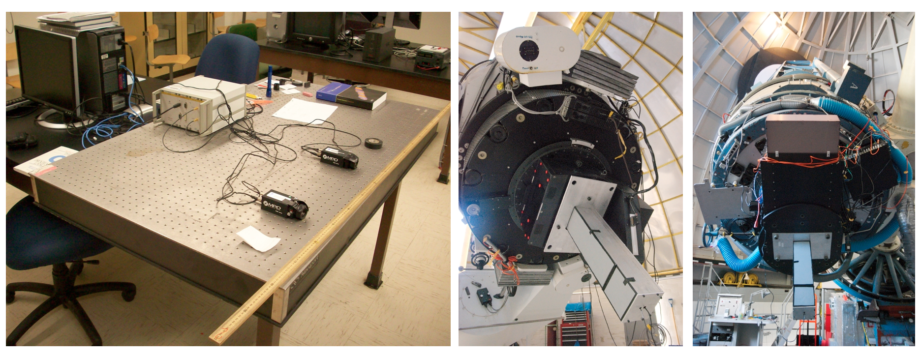
Intensity Interferometry at Southern Connecticut State University
WORKING TOWARD THE INTERFEROMETER
IN A SUITCASE
Elliott Horch,
Southern Connecticut State University

Slide 2
Collaborators
SCSU Undergraduates:
  Matthew Camarata, now at Boston University
  A.J. Guerra
Gerard van Belle (Lowell Observatory)
Joe Ritter (University of Hawaii)
Russ Genet (CalPoly)
Bruce Holenstein (Gravic, Inc.)

Slide 3
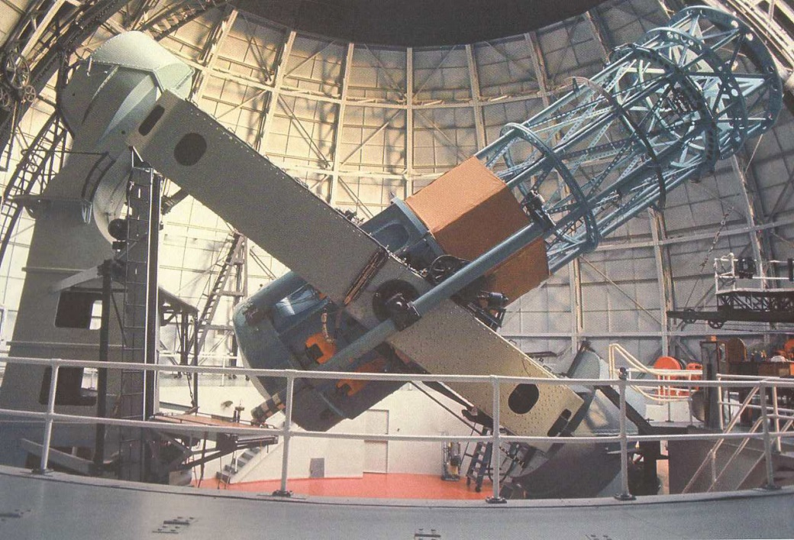
Origins of Stellar Interferometry
1920’s: Albert Michelson builds first stellar interferometer by using two sub-apertures of Mt. Wilson 100-inch telescope.
Measured several stellar diameters.
Tried to extend the baseline, but mechanical issues prevented progress.

Slide 4
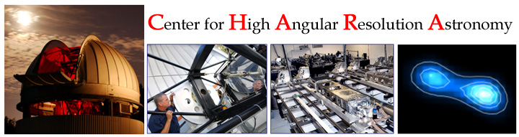
How Optical Interferometry is Done Today…
Light is made to interfere prior to detection.
(Michelson Interferometry).
Higher signal-to-noise, but expensive. Certainly NOT portable.
~300 m baselines. Much Larger? Hmmm…

Slide 5
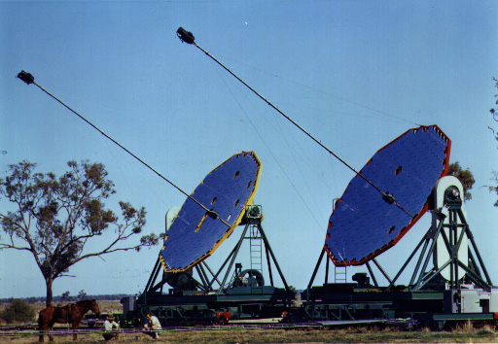
Intensity Interferomety
There is a weak correlation in the arrival times of photons when viewed by two different detectors. “Wave Noise.”
Related to beat frequencies, in the most extreme case.
This effect was used in astronomy in the 1970’s to measure diameters of bright stars.
One configuration of the two telescopes yields one Fourier component of the image
(well, |γ|²).
But, huge collectors were needed to detect this weak signal on the photomultiplier tubes of the day.
Photo: J. Davis
Sydney University Stellar
Interferometer
P.S.: Only two stations,
So no imaging!

Slide 6
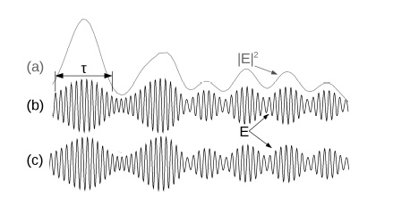
“Wave Noise”

Slide 7
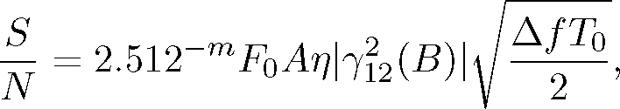
A lot has changed since 1974!
S/N in Intensity Interferometry depends on telescope size AND speed of electronics.
Timing capabilities today are about 1000x what they were in the 70’s.
Can achieve the same result today with a much smaller telescope! (Portable Instrument!)

Slide 8
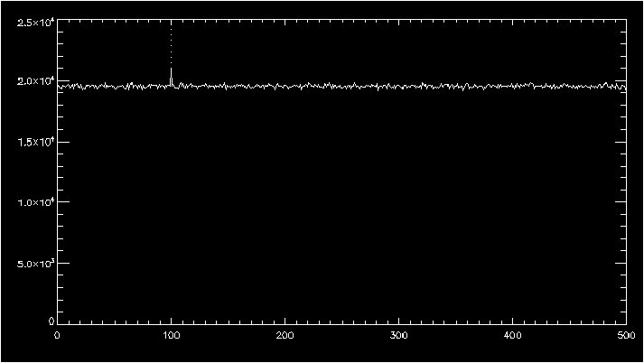
Simulation Data
∼|γ|²
Random Correlations
Data “Frames” ~0.4 μs long
(8192 elements)

Slide 9

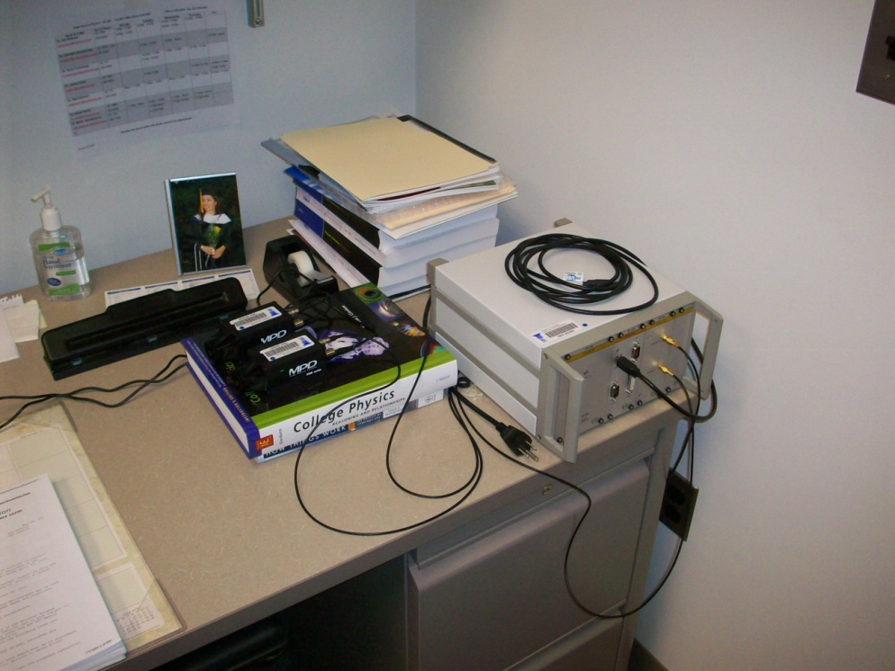
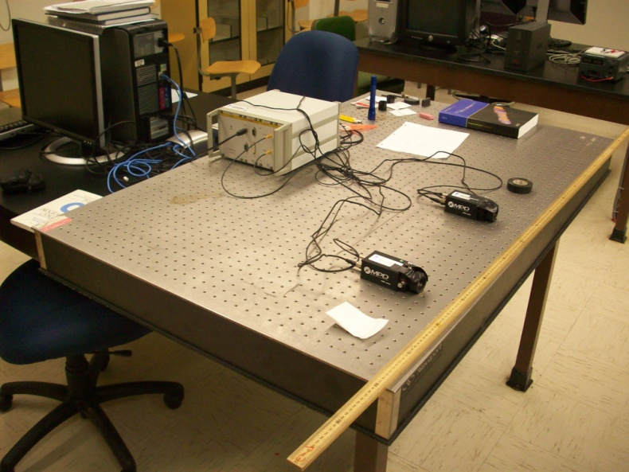
Intensity Interferometry Revisited
Picoquant Picoharp 300
timing module.
Two SPAD detectors
Issues: Small size, dead time.

Slide 10
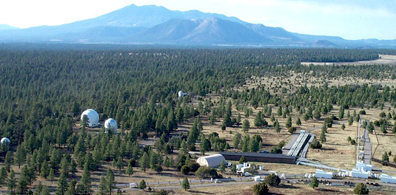
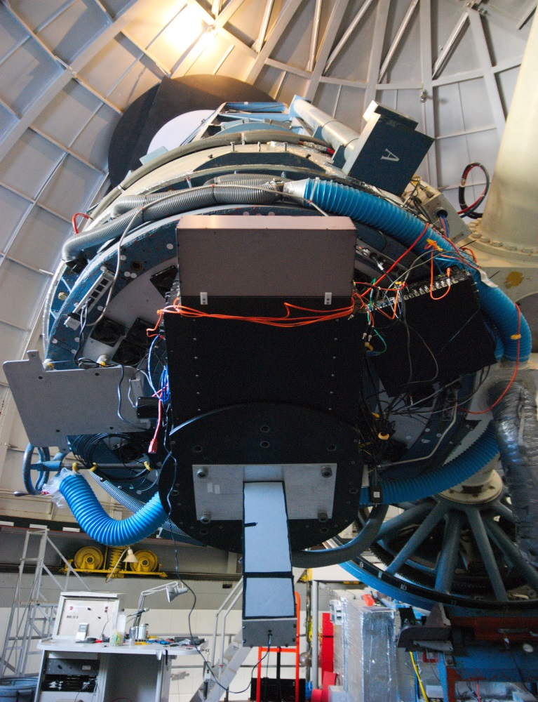
Truly Portable
Anderson Mesa
(Lowell Observatory)
Perkins Telescope
53-m baseline
SPAD
Two runs: Dec 2011 & June 2012
Issues: Focus, Sky Position, Temp.

Slide 11
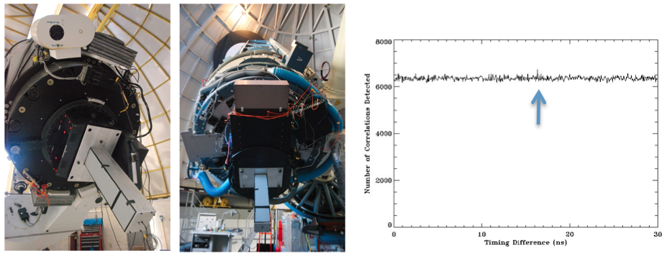
Lowell Set-up and Data

Slide 12
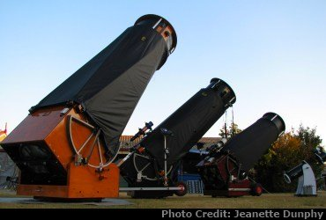
Big Glass is getting cheap!

Slide 13
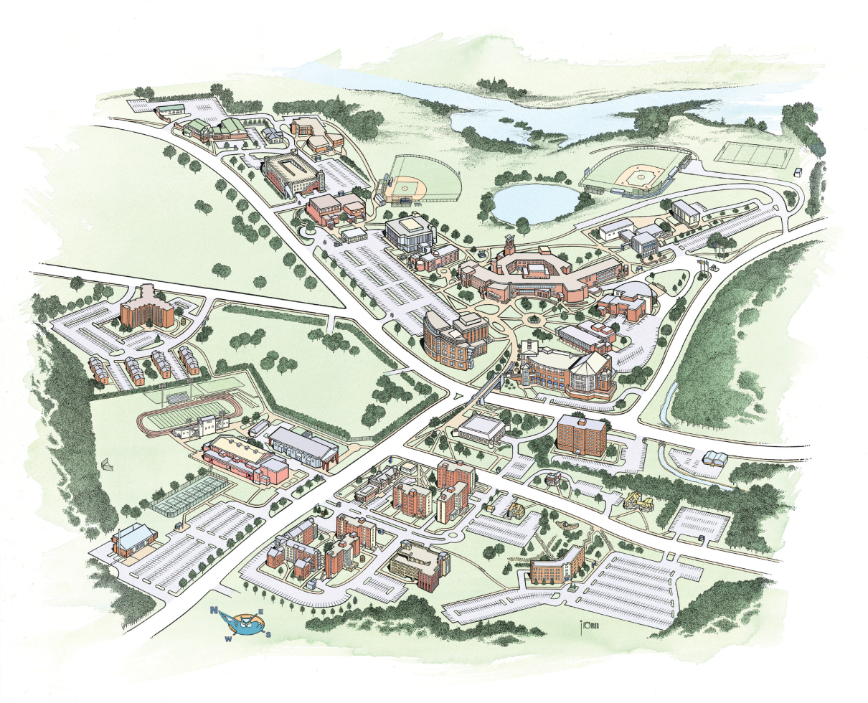
Three-Station Wireless Interferometer at SCSU
GPS
Computer
Cards:
~0.5μs
synchronization

Slide 14
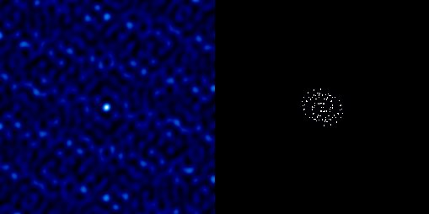
Dirty Beam Simulation
FWHM ~ 0.1 mas
uv-plane coverage
6-hour observation

Slide 15
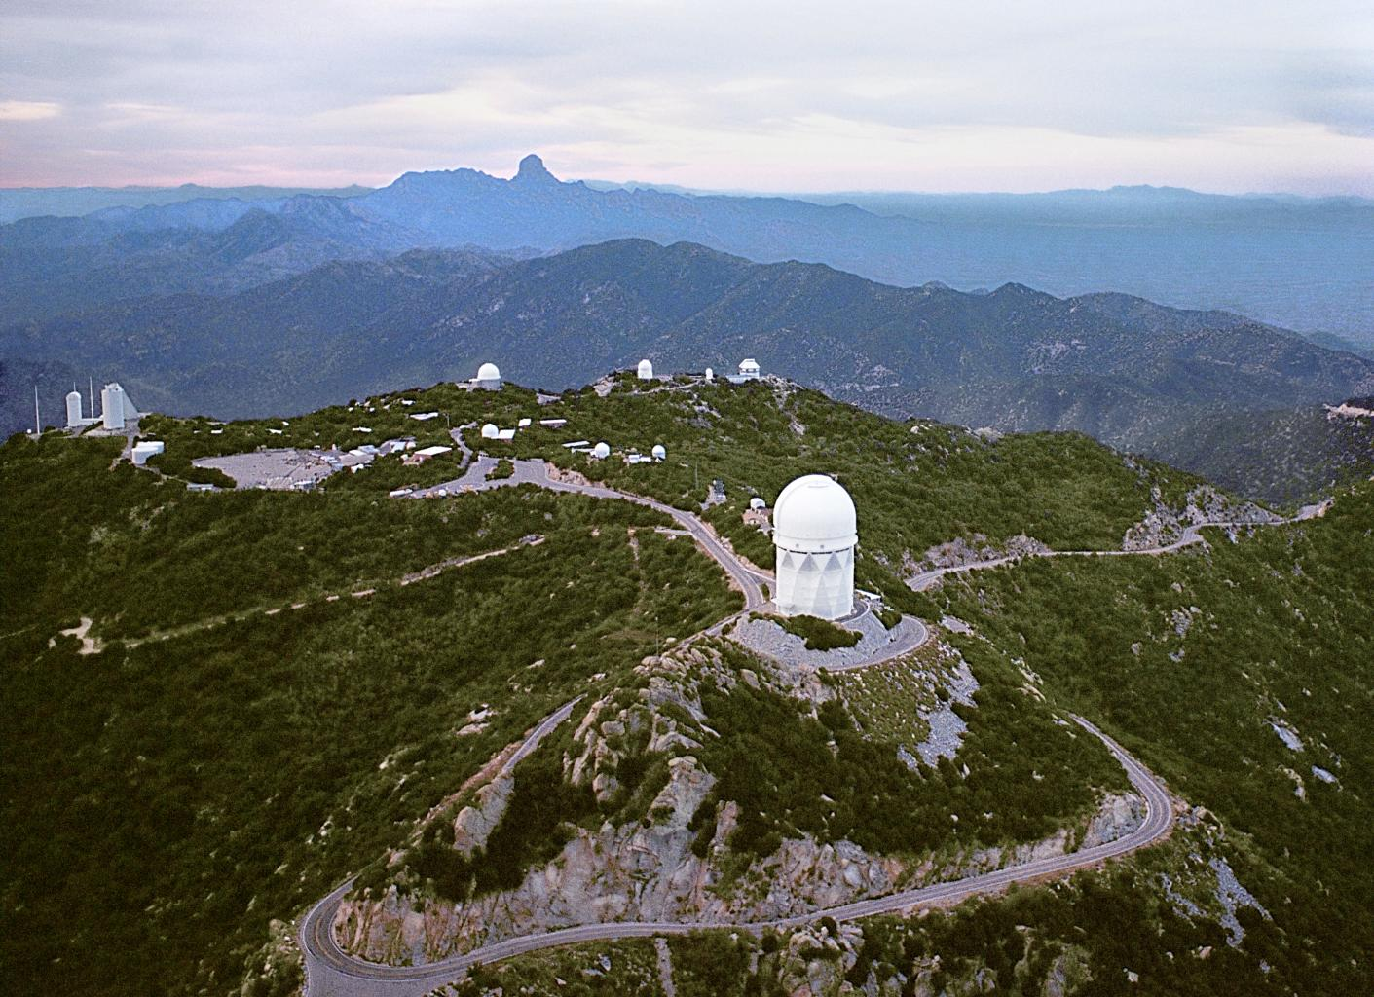
Kitt Peak: Another Possibility?
Mayall+WIYN
(3.8m + 3.5m)
~700m baseline

Slide 16
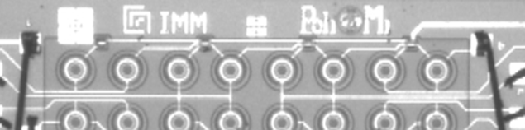
SPAD Arrays
Deadtime and small size can be mitigated if you have many SPADs all looking at the same source.
Development of SPAD arrays is being started, e.g. the SPADlab at Everyphotoncounts.com

Slide 17
Optics Package for an 8-channel station
Grating
Flat
Reimager
Coll.
Lens
Filter
SPAD Array
Flat

Slide 18
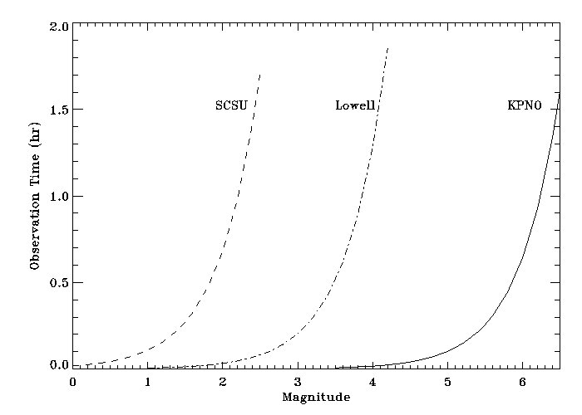
Observation Time

Slide 19
Conclusions
Intensity Interferometry Opportunity Today
  We’ve got intereting instrumentation for intensity interferometry: SPADs, Picoharp
  Large Dobsonian Telescopes are affordable for on-campus observing.
  Need to explore GPS Technology/atomic clocks for wireless operation.
  Take timing correlator and the SPAD detectors to larger telescopes. “Interferometer in a suitcase.”
    Lowell: Already doing this.
    Kitt Peak: A possibility for the future.
Science:
  Imaging close binaries, stellar surfaces
  Imaging an exoplanet transit? (One fine day…)

