Slide 1
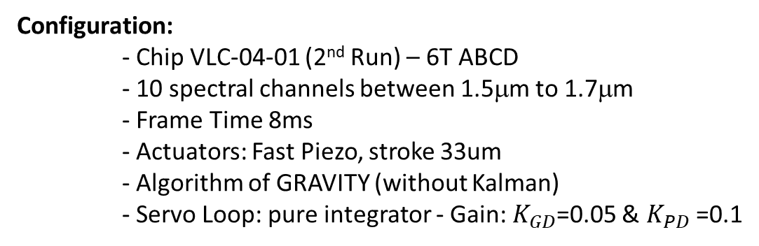
Last Results from the 6T Fringe Tracker Test Bench
Configuration:
- Chip VLC-04-01 (2nd Run) – 6T ABCD
- 10 spectral channels between 1.5μm to 1.7μm
- Frame Time 8ms
- Actuators: Fast Piezo, stroke 33um
- Algorithm of GRAVITY (without Kalman)
- Servo Loop: pure integrator - Gain: $K_{GD}$=0.05 & $K_{PD}$=0.1
Results:
- Instrumental Phase Closure +/-4μm (above the specification +/-1μm)
        See plot GD Closure
- We can close the full loop (GD+PD)
        See plots PD-RefPD GD-RefPD
Next Steps:
- Inject perturbations in the system (directly on the fast piezo)
- Determine the good gains
- Test the code with MIRCx in lab (STS)
- Test the code on Sky with MIRCx and SPICA-FT

Slide 2
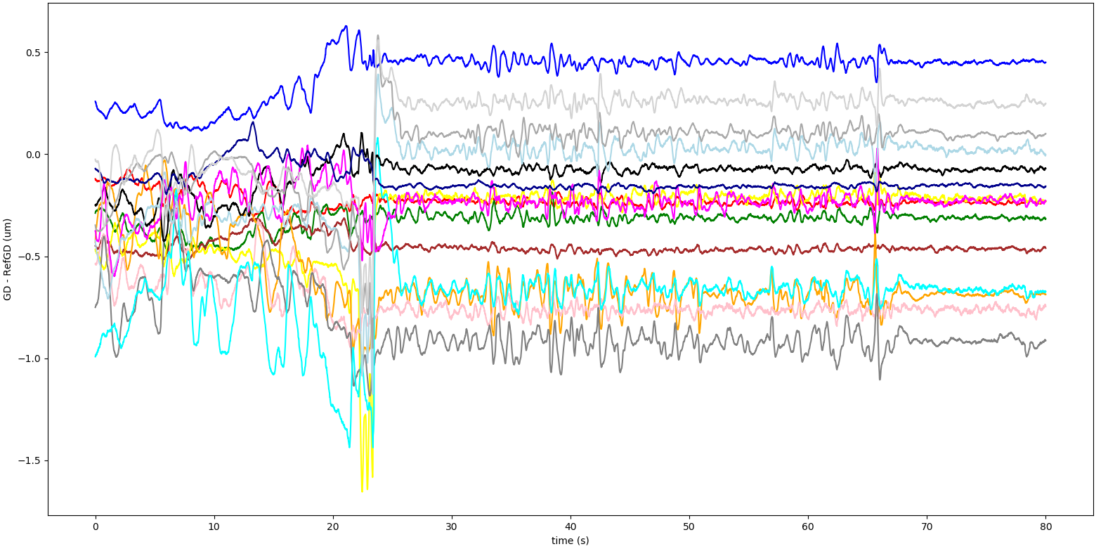
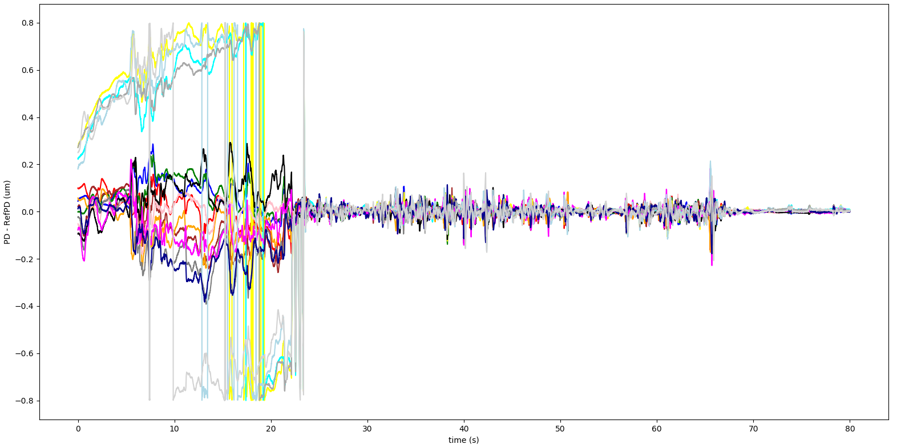



$K_{GD}$=0.05 & $K_{PD}$=0
$K_{GD}$=$K_{PD}$=0
$K_{GD}$=0.05 & $K_{PD}$=0.1

Slide 3
