Slide 1


Optical study of the spectrograph
Requirement | Values
Number of telescopes | 6, linear non redundant configuration
Spectral range | 600 nm – 900nm (guaranty 650 – 850nm)
Spectral resolution | 140, 3000, 10000
Photometry needed | Photometric channels are needed to correctly process the visibilities.
Fringe measurement | We want to measure the complex visibilities of the 15 interferometric patterns.
Cyril Pannetier
SPICA-VIS Design Review, July 23-24, 2020
Notes:
Objective: measure the fringes of the 15 baselines due to the 6 telescopes. For that, we align the six fibers in direction and we disperse it in the other direction. We’ll do it with three spectral resolutions: 140, 3000and 10000. And we need a calibration for both telescope flux, so we need a photometric channel on the same detector than the interferometry. We observe a spectral range which goes from 600nm to 900nm. Due to the classical limit of throughput close to 650nm for optical elements, we want to guaranty 650nm (H-alpha ray) until 850nm (calcium triplet).

Slide 2
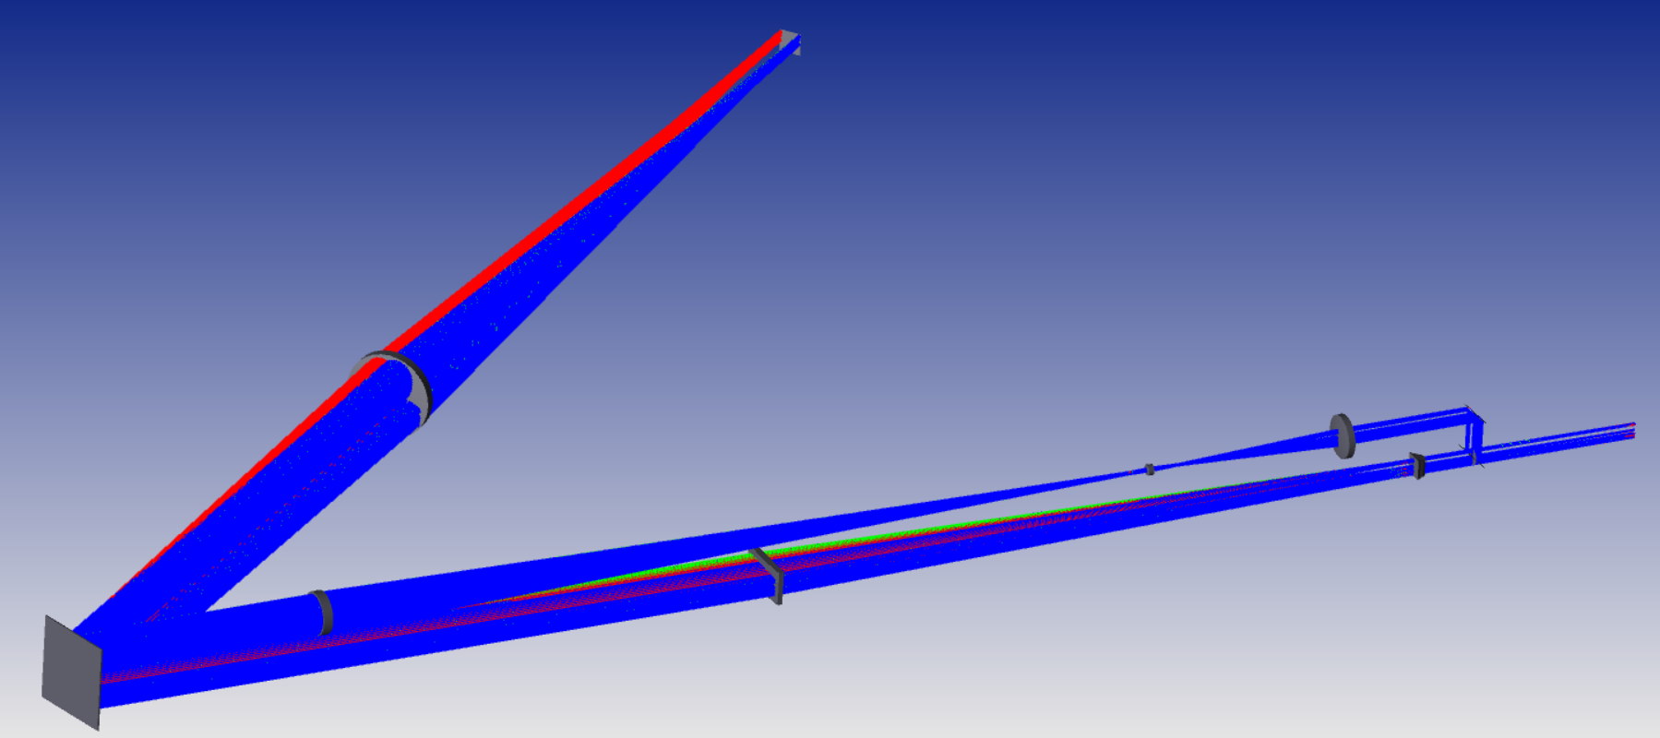
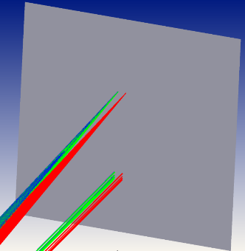
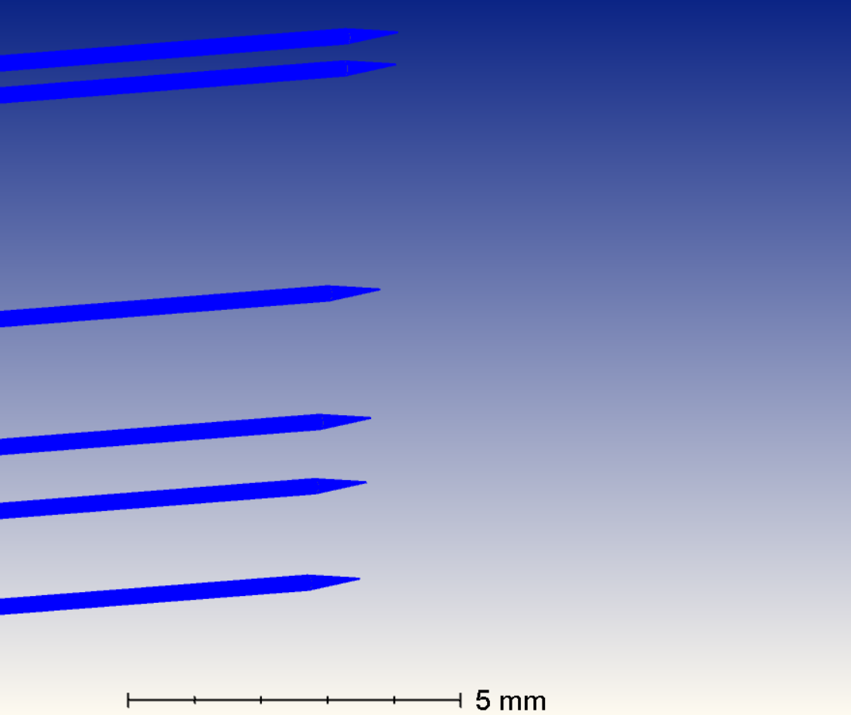
Optical study of the spectrograph
Detector
50mm
Imaging lens CAO
FSL
V-groove
Pupil plane
SSL
TSL collimating lens
FCL
Beam splitter
10/90
SCL
Detector
Fibers outputs
Fringes in focal plane
V-groove output
Image of the µlenses
Cyril Pannetier
SPICA-VIS Design Review, July 23-24, 2020
Notes:
Both arm is approximatly 1meter-long.
The light is first split in to parts by a 10/90 beam splitter and then both channel see different optical elements until reaching the dispersing part, which means from the diffracting grating to the detector.
At the top, we have the photometric channel: with the achromatic lens FLS and the SLS whose role is to reimage the fibers output behind L2 with the sizes that we want on the detector. Then the achromatic lens L3, with the achromatic lens L4 play the role of the collimator of the spectrograph.
At the bottom, the interferometric channel sees only two optical elements. The first FCL cylindrical lens creates an image that the Second Cylindrical Lens collimates before the spectrograph dispersion. This pair of cylindrical lenses performs the anamorphosis necessary for reaching a good sampling on the detector and the second cylindrical lens plays the role of the collimator of the spectrograph.
Here I show you the high resolution mode so the spectrograph is only composed of a diffraction grating and an imaging lens CAO.
For the low resolution mode, the grating is replaced with a flat mirror and a dispersin double prism makes the dispersion.
We are considering adding a tip-tilt mirror in order to make the alignment easier.

Slide 3






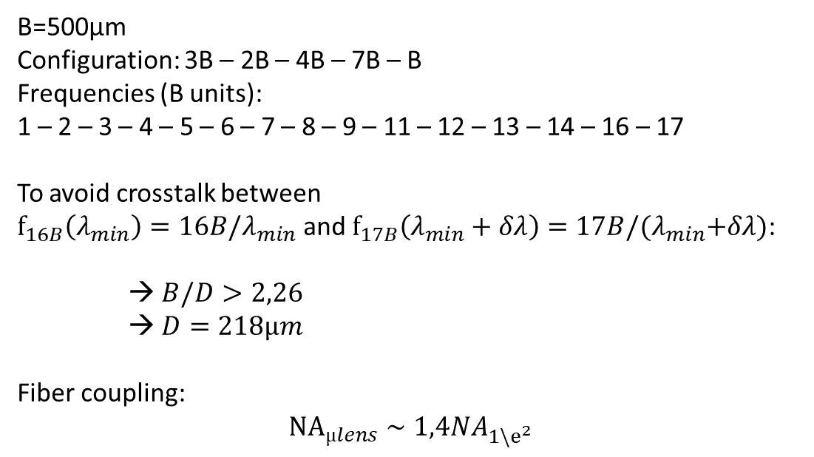


Optical study of the spectrograph
Fibers output – V-groove configuration
B
No crosstalk
D
$$f_{16B}\left(\overline{λ_{min}}\right)$$
$$f_{17B}\left(\overline{λ_{min}}\right)$$
B=500µm
Configuration: 3B – 2B – 4B – 7B – B
Frequencies (B units):
1 – 2 – 3 – 4 – 5 – 6 – 7 – 8 – 9 – 11 – 12 – 13 – 14 – 16 – 17
To avoid crosstalk between
$f_{16B}\left(λ_{min}\right)=16B/λ_{min}$ and $f_{17B}\left(λ_{min}+δλ\right)=17B/{(λ}_{min}+δλ)$:
→ $B/D>2,26$
→ $D=218µm$
Fiber coupling:
$${NA}_{µlens}∼1,4{NA}_{1\backslash e^{2}}$$
$$f_{16B}\left(λ_{min}\right)$$
$$f_{17B}\left(λ_{min}+δλ\right)$$
Crosstalk
$$f_{17B}\left(\overline{λ_{min}}\right)$$
$$f_{16B}\left(\overline{λ_{min}}\right)$$
$$f_{17B}\left(λ_{min}+δλ\right)$$
$$f_{16B}\left(λ_{min}\right)$$
Cyril Pannetier
SPICA-VIS Design Review, July 23-24, 2020
Notes:
The camera we will use is a EMCCD (electron-multiplied couple-charge detector) with 1024x1024 pixels of 13µm size. With the design I presented, we reach sampling on the detector with 100 pixels per 1024 for the photometry, around 400 x 1024 for the interferometry. This enables us to keep a good readout rate (20Hz) which means 50 images/s, tipically the minimum readout rate to keep good contrast when fringe tracking is not working. At the bottom right we see the gaussian field propagation performed with Zemax.
Concerning the fringe sampling, the shortest one is around 2,94 pixels. The longest one on 65 pixels. The sampling in the sepctral direction and both direction for the photometric channel is around 2 pixels for the FWHM (full-width at half maximum).

Slide 4
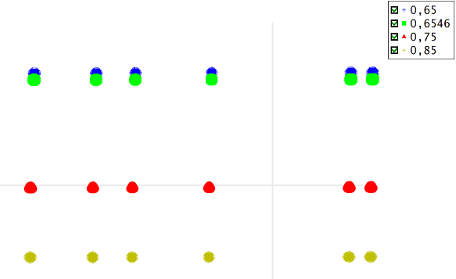
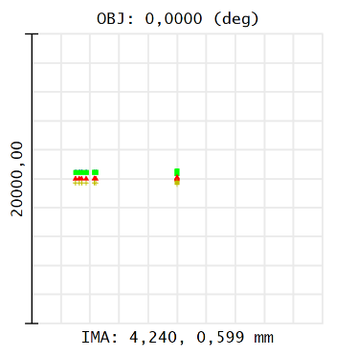
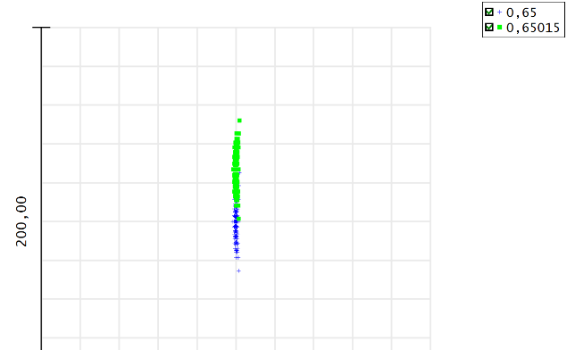
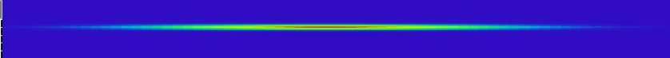
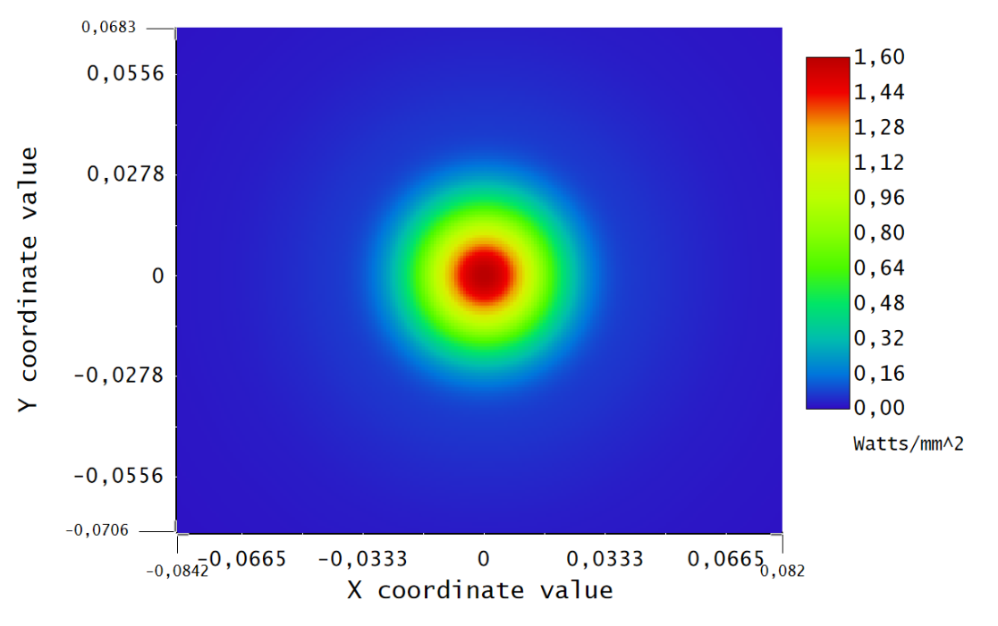
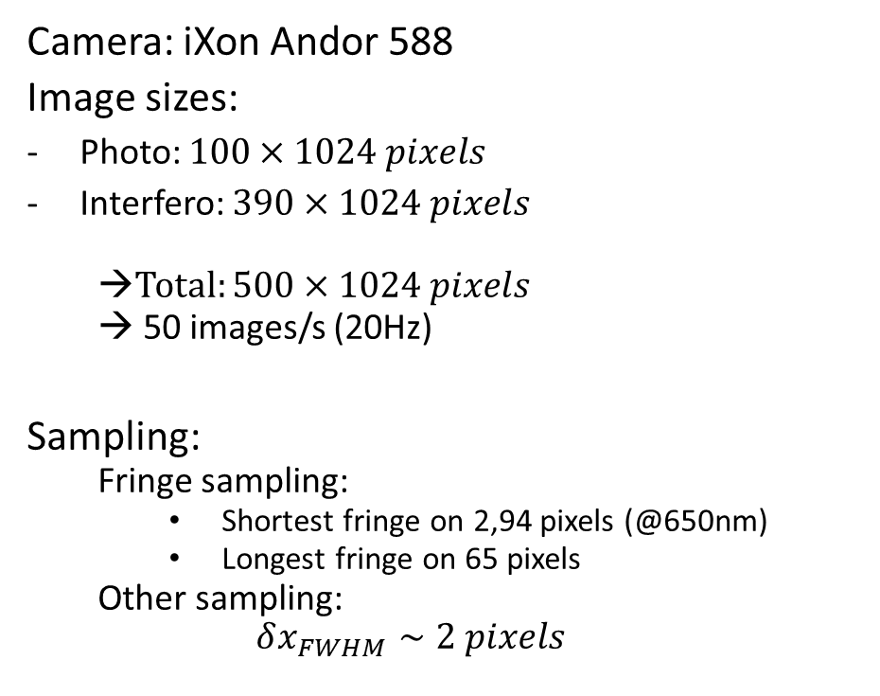
Optical study of the spectrograph
Sampling on the detector
Spot Diagram des 12 voies
Photo
Camera: iXon Andor 588
Image sizes:
Photo: $100×1024 pixels$
Interfero: $390×1024 pixels$
  →Total: $500×1024 pixels$
  → 50 images/s (20Hz)
Sampling:
  Fringe sampling:
    Shortest fringe on 2,94 pixels (@650nm)
    Longest fringe on 65 pixels
  Other sampling:
  $$δx_{FWHM}∼2 pixels$$
Photo
Interfero
100pix
384pix
Interfero
Interferometry:
Photometry:
Cyril Pannetier
SPICA-VIS Design Review, July 23-24, 2020
Notes:
The camera we will use is a EMCCD (electron-multiplied couple-charge detector) with 1024x1024 pixels of 13µm size. With the design I presented, we reach sampling on the detector with 100 pixels per 1024 for the photometry, around 400 x 1024 for the interferometry. This enables us to keep a good readout rate (20Hz) which means 50 images/s, tipically the minimum readout rate to keep good contrast when fringe tracking is not working. At the bottom right we see the gaussian field propagation performed with Zemax.
Concerning the fringe sampling, the shortest one is around 2,94 pixels. The longest one on 65 pixels. The sampling in the sepctral direction and both direction for the photometric channel is around 2 pixels for the FWHM (full-width at half maximum).

Slide 5
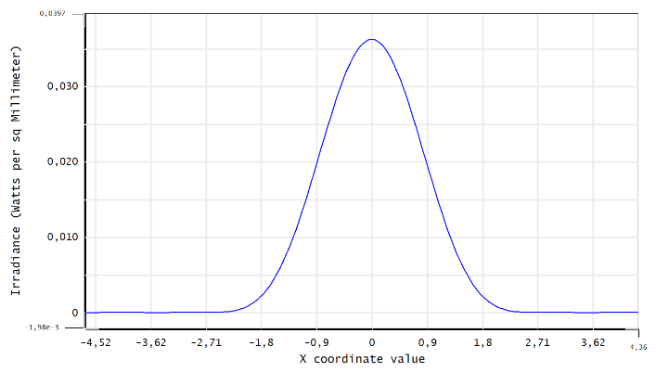
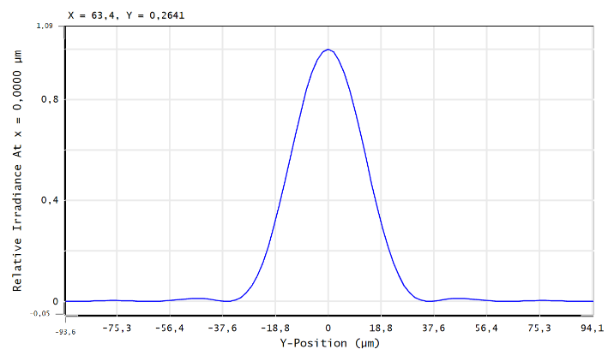
Optical study of the spectrograph
Interferometric channel
310 pixels @95%E
2 pixels @FWHM
Image patterns of the interferometric channel in the spatial (left) and spectral (right) directions.
Cyril Pannetier
SPICA-VIS Design Review, July 23-24, 2020
Notes:
Here is what the gaussian propagation simulation on Zemax predicts for the interferometric channel. We expect that 95% of the energy is spread over 310 pixels.

Slide 6
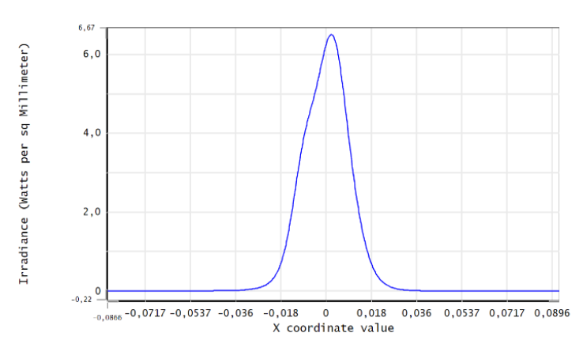
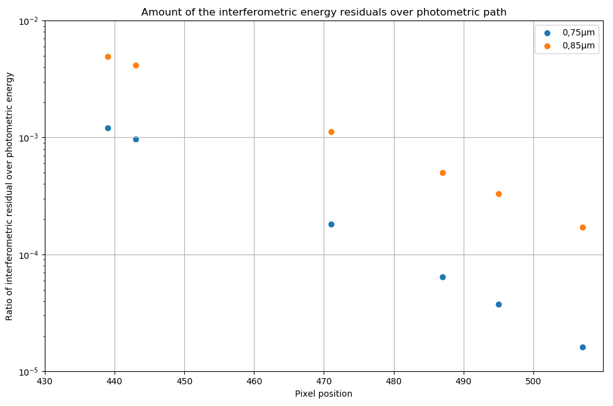

Optical study of the spectrograph
Photometric channel
Expected position of the closest photometric beam
4 pixels
4 pixels
Interferometric pollution:
< 0,5% of the photometric energy
$$\left(\frac{S_{phot}}{S_{interf}}>200\right)$$
Cyril Pannetier
SPICA-VIS Design Review, July 23-24, 2020

Slide 7
Optical study of the spectrograph
Mechanical implantation
Heavy proposition
R3000
R10000
R140
Prism on the wheel
→ Automatic selection of the low spectral resolution
Lentille imageante
~320mm
50mm
capteur
Cyril Pannetier
SPICA-VIS Design Review, July 23-24, 2020

Slide 8
Optical study of the spectrograph
Mechanical implantation
Heavy proposition
R3000
R10000
R140
Prism on the wheel
→ Automatic selection of the low spectral resolution
Lentille imageante
~320mm
50mm
capteur
Cyril Pannetier
SPICA-VIS Design Review, July 23-24, 2020

Slide 9
Optical study of the spectrograph
Mechanical implantation
Light proposition
R140
Prism outside the wheel
R3000
R10000
→ Manual selection of the low spectral resolution
~220mm
Lentille imageante
50mm
capteur
Cyril Pannetier
SPICA-VIS Design Review, July 23-24, 2020

Slide 10
Optical study of the spectrograph
Mechanical implantation
Medium proposition
R140
Prism on the wheel
R3000
R10000
→ Automatic selection of the low spectral resolution
~280mm
Lentille imageante
50mm
capteur
Cyril Pannetier
SPICA-VIS Design Review, July 23-24, 2020

Slide 11
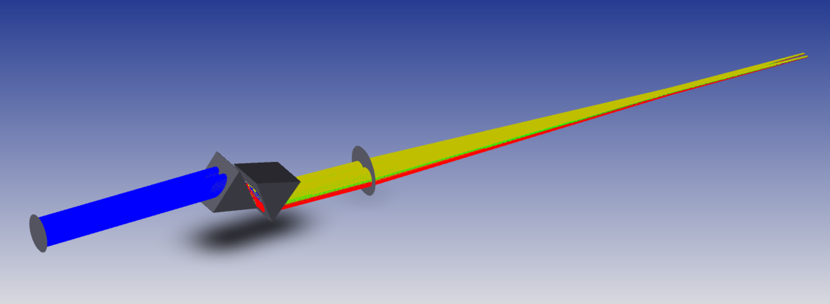
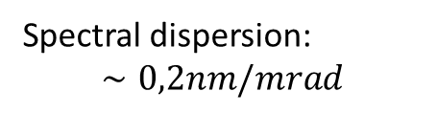
Optical study of the spectrograph
Low spectral resolution: R=140
Two commercial equilateral dispersing prisms made of F2: D=50mm
Spectral dispersion:
$$∼0,2nm/mrad$$
Cyril Pannetier
SPICA-VIS Design Review, July 23-24, 2020

Slide 12
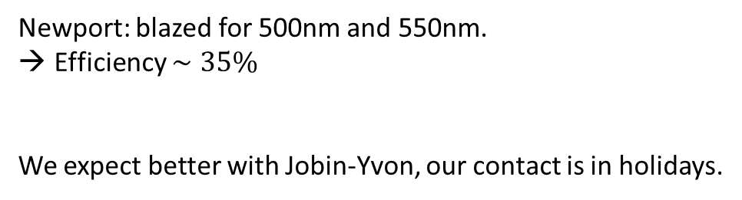
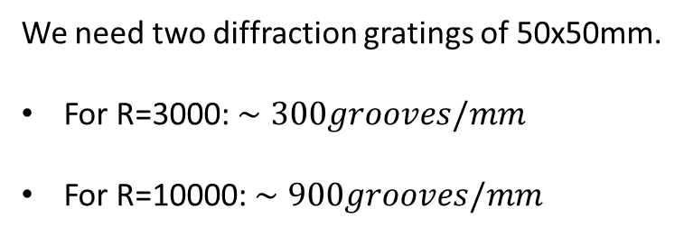
Optical study of the spectrograph
Medium and High spectral resolution
We need two diffraction gratings of 50x50mm.
For R=3000: $∼300grooves/mm$
For R=10000: $∼900grooves/mm$
Newport: blazed for 500nm and 550nm.
Efficiency $∼35\%$
We expect better with Jobin-Yvon, our contact is in holidays.
Cyril Pannetier
SPICA-VIS Design Review, July 23-24, 2020

Slide 13
Optical study of the spectrograph
Fiber Back Illumination
100mm
Toward photometric chanel
Back-propagating beams
Movable mirror
Toward interferometric chanel
Back-propagating beam shape
Collimated anamorphosed laser source
Figure 23: Optical concept of the back fiber injection system
Cyril Pannetier
SPICA-VIS Design Review, July 23-24, 2020

Slide 14
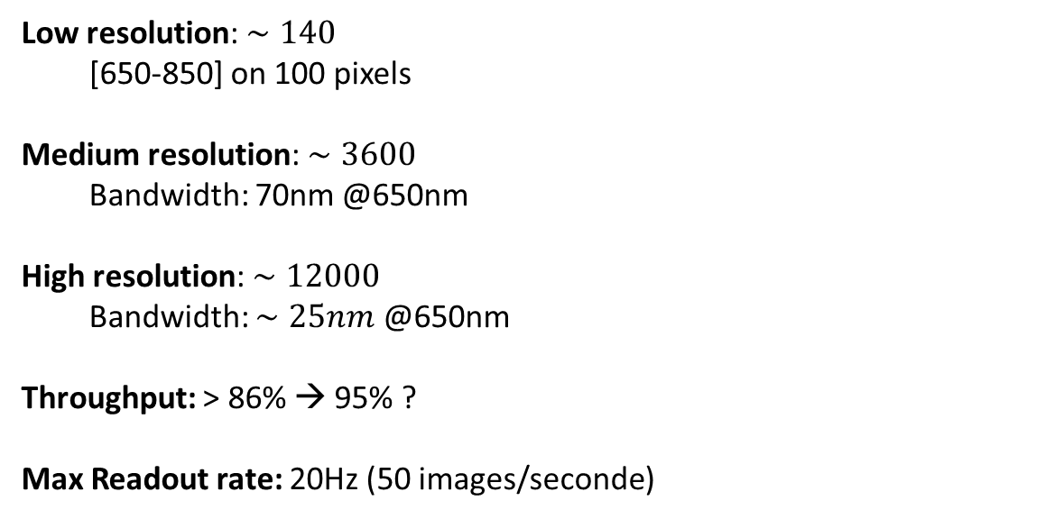
Optical study of the spectrograph
Performances
Low resolution: $∼140$
  [650-850] on 100 pixels
Medium resolution: $∼3600$
  Bandwidth: 70nm @650nm
High resolution: $∼12000$
  Bandwidth: $∼25nm$ @650nm
Throughput: > 86% → 95% ?
Max Readout rate: 20Hz (50 images/seconde)
Cyril Pannetier
SPICA-VIS Design Review, July 23-24, 2020

Slide 15
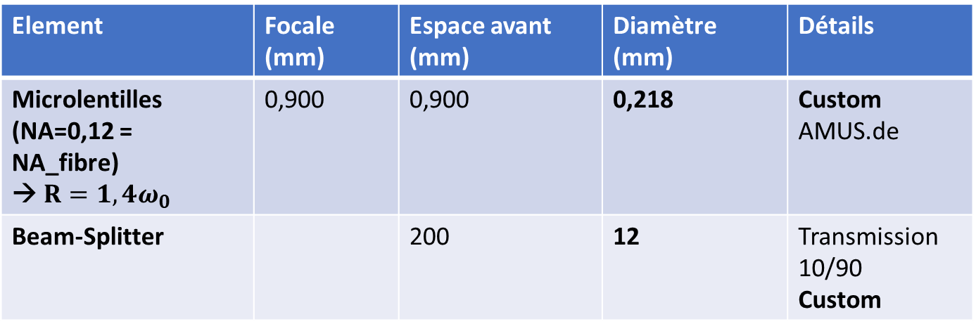
Optical study of the spectrograph
Dimensioning of the system
Element | Focale (mm) | Espace avant (mm) | Diamètre (mm) | Détails
Microlentilles (NA=0,12 = NA_fibre) → $R=1,4ω_{0}$ | 0,900 | 0,900 | 0,218 | Custom AMUS.de
Beam-Splitter |  | 200 | 12 | Transmission 10/90 Custom
Cyril Pannetier
SPICA-VIS Design Review, July 23-24, 2020

Slide 16
Optical study of the spectrograph
Dimensioning of the system
Element | Focale (mm) | Espace avant (mm) | Diamètre (mm) | Custom ?
Miroir M1 |  | 35 | 12 | Coating
L1 | 100 | 65 | 25,4 | x
L2 | 15 | 115 | 6,25 | x
L3 | 500 | >500 | 25,4 | x
Cyril Pannetier
SPICA-VIS Design Review, July 23-24, 2020

Slide 17
Optical study of the spectrograph
Dimensioning of the system
Element | Focale (mm) | Espace avant (mm) | Diamètre (mm) | Custom ?
L1 cyl | 9,69 | 30 | L=12; H=10 | Non
L2 cyl | 400 | >400 | L=20; H=40 | Oui
Cyril Pannetier
SPICA-VIS Design Review, July 23-24, 2020

Slide 18
Optical study of the spectrograph
Dimensioning of the system
Element | Focale (mm) | Espace avant (mm) | Diamètre (mm) | Custom ?
Miroir M2 (ou réseau) | - | 50 | 50,8 | Coating
Prisme | - | 100 | 50,8 | Oui
Lentille imageante L4 | 500 | 50 | 50,8 | Oui
Cyril Pannetier
SPICA-VIS Design Review, July 23-24, 2020

