Slide 1


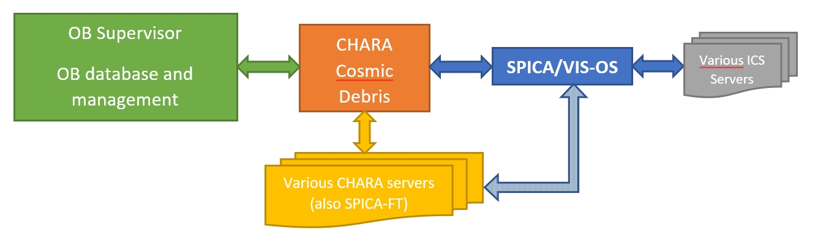
SPICA-VIS Instrument Control Software and Observing Software
1. General principles and architecture
Global architecture
- CHARA Cosmic Debris is the highest client (including SPICA-FT server)
- OB supervisor for observation information (TBC -> Science Survey Management presentation)
- OS observation information from CD
- OS control of all SPICA-VIS devices thru servers
Frédéric Morand
SPICA-VIS Design Review, July 23-24, 2020

Slide 2
SPICA-VIS Instrument Control Software and Observing Software
1. General principles and architecture (continued)
SPICA-VIS Instrument Control Software (ICS)
- ICS is implemented as CHARA client/server applications (one per group of devices)
- Each server is registered to CHARA sockman
- An engineering GUI is available for each application
- Power control of each group of devices with remote controlled switches (power server)
SPICA-VIS Observing Software (OS) :
- Registers on CD messages
- Must be able to run on local control network or on Remote Observing Facility in Atlanta
Use of standard CHARA library and general encoding principles :
- Based on C language and GTK toolkit
- Use of CHARA messages architecture
Frédéric Morand
SPICA-VIS Design Review, July 23-24, 2020

Slide 3
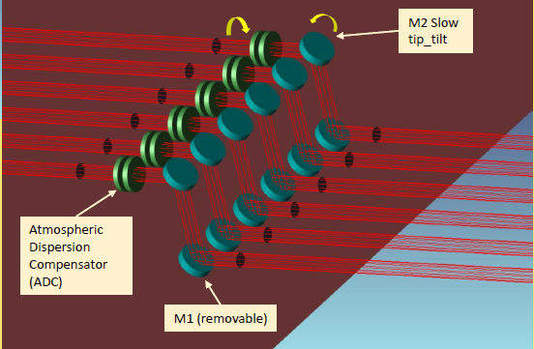
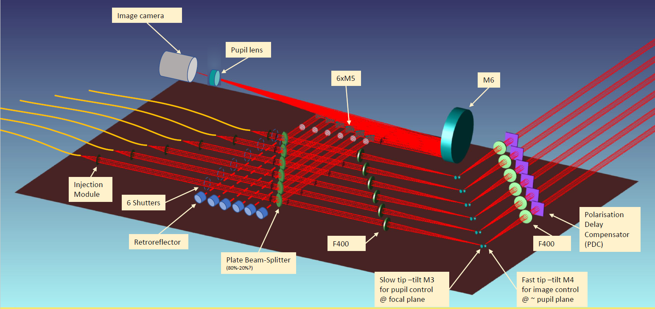
SPICA-VIS Instrument Control Software and Observing Software
2. ICS: Active devices – Periscope and injection table
Frédéric Morand
SPICA-VIS Design Review, July 23-24, 2020

Slide 4
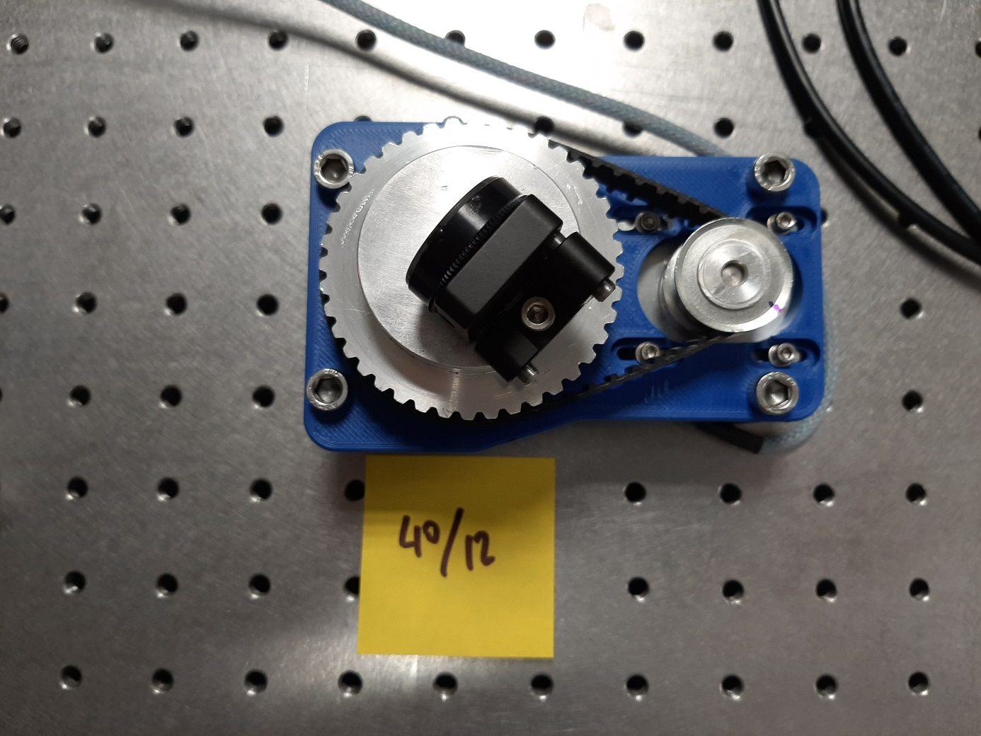
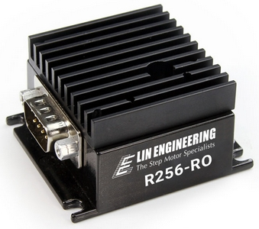
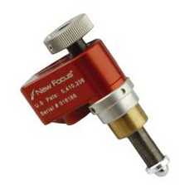
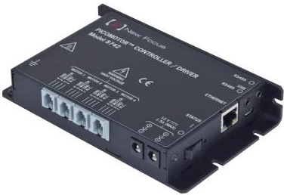
SPICA-VIS Instrument Control Software and Observing Software
2. Active devices – Periscope and injection table (continued)
+
Custom rotation stage
Lin engineering R256
+
Custom tip-tilt stage
with Picomotors
Newport 8740
Frédéric Morand
SPICA-VIS Design Review, July 23-24, 2020

Slide 5
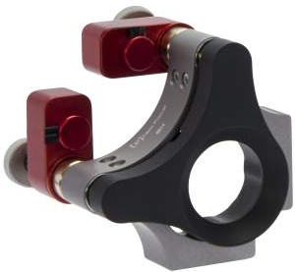
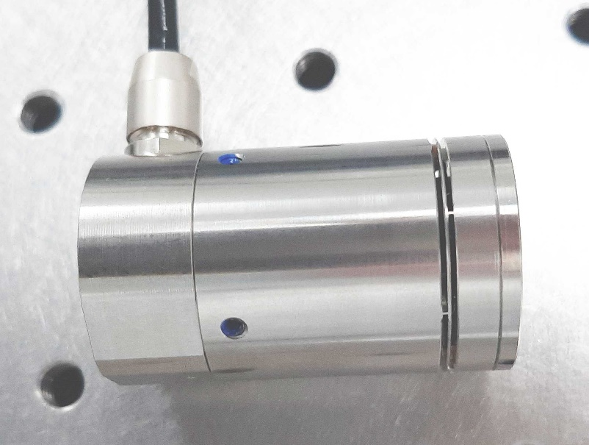
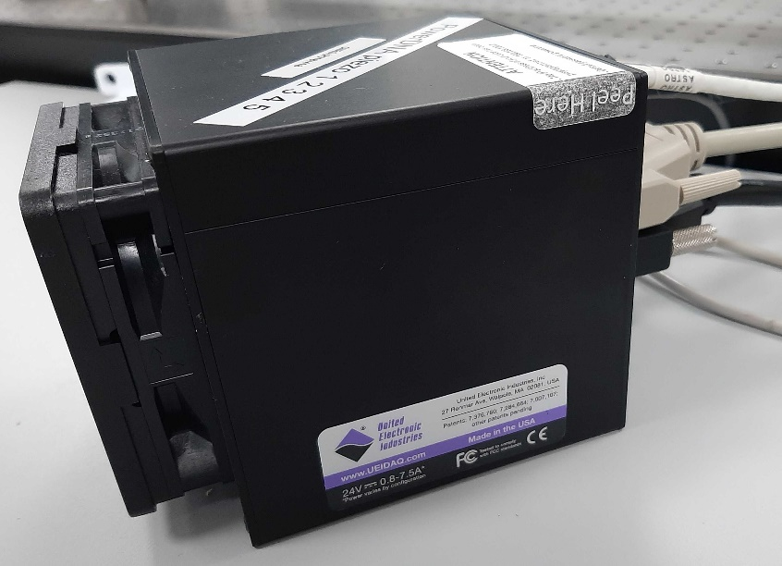
SPICA-VIS Instrument Control Software and Observing Software
2. Active devices – Periscope and injection table (continued)
+
Custom rotation stage
Lin engineering R256
+
TBC
Newport 8814 (TBC)
Newport 8740
+
PI piezo TT
DNA cube
Frédéric Morand
SPICA-VIS Design Review, July 23-24, 2020

Slide 6
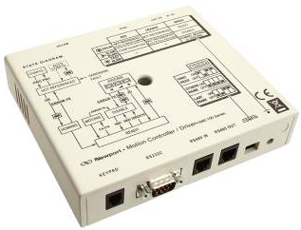
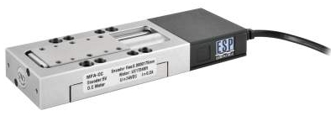
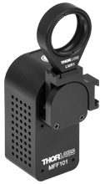
SPICA-VIS Instrument Control Software and Observing Software
2. Active devices – Periscope and injection table (continued)
+
Newport MFA-PP
Newport SMC100PP
Thorlabs MFF101/M
Frédéric Morand
SPICA-VIS Design Review, July 23-24, 2020

Slide 7
SPICA-VIS Instrument Control Software and Observing Software
2. Active devices: summary
Modules | Motors | Number | Type | Controller | Server
SFO (SPICA Feeding Optics) | FOP | 1 | DC motor | VEGA controller | spica_periscope_server
SFO (SPICA Feeding Optics) | TT-n / TP-n n∈[1,6] | 12 | Custom TT stage with Picomotors | Newport 8742 | spica_ip-ctrl_server
PDC (Polarization Delay Compensator) | PDC-n n∈[2,6] | 5 | Rotation Stage with Stepper Motor | R256 – Lin Engineering | spica_pdc_server
ADC (Atmospheric Dispersion Compensator) | AF-n / AS-n n∈[1,6] | 12 | Rotation Stage with Stepper Motor | R256 – Lin Engineering | spica_adc_server
BAS (Beam Adjustment System) | PH-n / PV-n n∈[1,6] | 12 | Newport 8814 (TBC) | Newport 8742 | spica_ ip-ctrl _server
BAS (Beam Adjustment System) | FT-n / FP-n n∈[1,6] | 6 | PI | DNA Cube | spica_tt-tracker_server
SFI (Spatial Filter Input mode) | DL-n n∈[2,6] | 5 | Newport MFA-PP | Newport SMC100PP | spica_delayline_server
BSL (Beam Selector) | SH-n n∈[1,6] | 6 | Thorlabs MFF101/M |  | spica_shutter_server
BCS (Beam Control System) | BCC | 1 | Newport MFA-PP | Newport SMC100PP | spica_ipdet_server
DIS (Dispersion System) | grating wavelength | 2 (3) TBD | TBD | TBD | spica_grating_server
FBI (Fiber Back Illumination) | FBI | 1 | TBD | TBD | spica_power_server
Total number of motors:
Injection table: 60
Spectrograph: 3 (or 4)
Other devices:
- 2 cameras
- Retrofeed source
- Spectral source(s)
Frédéric Morand
SPICA-VIS Design Review, July 23-24, 2020

Slide 8
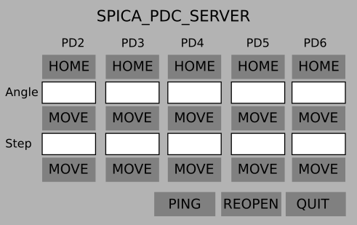
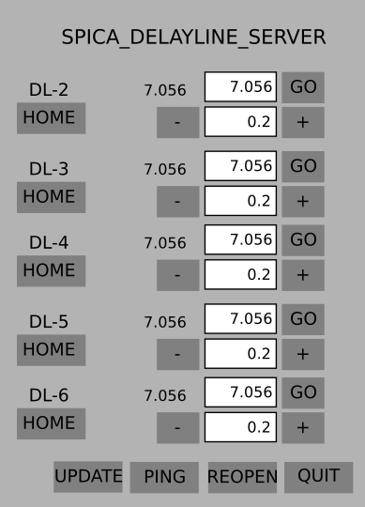
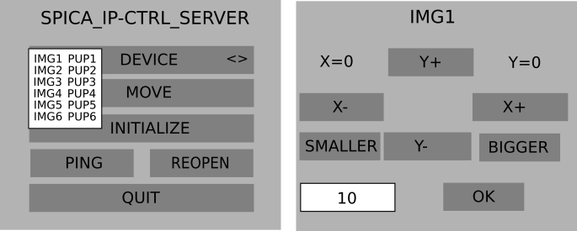
SPICA-VIS Instrument Control Software and Observing Software
3. ICS: Low-level servers and GUIs
Servers
spica_periscope_server
spica_adc_server
spica_pdc_server
spica_ip-ctrl_server
spica_tt-tracker_server
spica_delayline_server
spica_shutter_server
spica_grating_server
spica_ipdet_server
spica_scidet_server
spica_power_server
Frédéric Morand
SPICA-VIS Design Review, July 23-24, 2020

Slide 9
SPICA-VIS Instrument Control Software and Observing Software
4. Templates
Templates are sequences of predefined elementary operations
A set of necessary scenarios for SPICA-VIS operation has been defined -> constraints on OS definition
Observation template
Calibration templates
Detector calibration
Spectral calibration
Kappa matrix calibration
Transfer function
Technical templates
Birefringence calibration
Reference pixels
SPICA-VIS / SPICA-FT cophasing
IMG/PUP command matrices
TTT command matrices
Frédéric Morand
SPICA-VIS Design Review, July 23-24, 2020

Slide 10
SPICA-VIS Instrument Control Software and Observing Software
5. OS : Principles and general organization
OS main functions
MF1: Scheduling operations for recording data (science)
MF2: Controlling all SPICA-VIS devices
MF3: Communicating with CHARA modules
MF4: Providing a Graphical User Interface (GUI)
OS secondary functions
SF1: Record of technical data
SF2: End of night operations
SF3: Diagnosis in case of a technical issue
Communication with SPICA/VIS servers
(MF2)
Communication with CHARA modules
(MF3)
Scheduler
(MF1 / SF)
GUI
(MF4)
Frédéric Morand
SPICA-VIS Design Review, July 23-24, 2020

Slide 11
SPICA-VIS Instrument Control Software and Observing Software
5. OS : Principles and general organization (continued)
Scheduler
Will be described in the next section
Graphical User Interface
  Observation general information
  Status of SPICA-VIS (and SPICA-FT)
  Scheduler status
  Errors, warnings, last relevant logs entries
  Real Time Displays (preliminary)
    IMG/PUP detector images
    Science detector images (full, interferometric or photometric channel)
    FT of interferometric channel : OPD, V², SNR, …
    Photometry monitoring (e.g. bargraphs)
Frédéric Morand
SPICA-VIS Design Review, July 23-24, 2020

Slide 12
SPICA-VIS Instrument Control Software and Observing Software
5. OS : Principles and general organization (continued)
Detectors software
Frame grabbing and copy in a shared memory
Several processes are connected to the shared memory (same or different pieces of software)
  Science detector -> 2 main processes
    Save frames (+ ancillary data) to FITS files
    Real time displays (as described before)
  IM/PUP detector -> 3 main processes
    Real time displays : images (or ROI) + photocenter computation during alignment procedure
    Servo of the 6 beams onto fiber : star position -> (PID + command matrix) -> TTT
    Save frames to FITS files (for technical purposes)
Logs
Need of timestamped logs for all SPICA-VIS servers and OS itself
Use of Linux multitail command to display last entries
Frédéric Morand
SPICA-VIS Design Review, July 23-24, 2020

Slide 13
SPICA-VIS Instrument Control Software and Observing Software
6. OS : Scheduler and sequences
Sequences
Corresponding to MF1 and SF functions and/or to the different templates
Scheduler principles
Scheduler is the core of OS : dedicated to automated
execution and control of the sequences flow
Each function (sequence) of OS is seen as a sequence
of several steps (macro-commands)
Each step is itself a list of elementary commands
Sequences and steps are described in script files
Command parser to decode and execute script files
Example of sequence : record of data science
Example (from VEGA record data script file) :
STDSP 1 CAMR_PORT1 PORT1 START_DET_PHOTON_RECORD
STDSP 1 CAMB_PORT1 PORT1 START_DET_PHOTON_RECORD
STDARSP 1 CAMR_PORT1 PORT1 GetNoFrame 1
STDARSP 1 CAMB_PORT1 PORT1 GetNoFrame 1
STDARSPX 1 CAMR_PORT1 PORT1 GET_RECORD_STATUS 1 1
STDARSPX 1 CAMB_PORT1 PORT1 GET_RECORD_STATUS 1 2
SOLVE_XnoVal 2 4
SLP 1000
PRINT RECORD_DATA_IN_PROGRESS
JMP -7
PRINT DATA_RECORD_DONE
SEND_MESSAGE_2_CHARA OBSERVE_FRINGE_DATA_DONE
Frédéric Morand
SPICA-VIS Design Review, July 23-24, 2020

Slide 14
SPICA-VIS Instrument Control Software and Observing Software
6. OS: Scheduler and sequences - an example : science data record sequence
START
Align pupils and images
Check power and servers
Optimize flux injection and close TTT control loop
OB infos
Config infos
Get record infos from CD
NOFRINGES record
Initialize
SPICA-FT
Initialize
Start SPICA-FT
fringe tracking
Find fringes Start tracking
DARK record
FRINGES record
Wait for CHARA to be locked on star
STAR_ACQUIRED
END
RECORD_DONE
Frédéric Morand
SPICA-VIS Design Review, July 23-24, 2020

Slide 15
SPICA-VIS Instrument Control Software and Observing Software
7. SPICA-VIS messages
Use of CHARA messages to talk with other CHARA modules (mainly CD)
Need of creating several new messages specific to SPICA-VIS operations
Example of existing messages that OS would use
CHARA message | Direction
ASTROMOD_SET_STAR | From CD
ASTROMOD_SET_ACTIVE_SCOPES | From CD
ASTROMOD_SET_REFERENCE_CART | From CD
ASTROMOD_SET_OBS_WAVELENGTH | From CD
OBSERVE_PI_NAME | From CD
OBSERVE_PROGRAM_NAME | From CD
OBSERVE_OBJECT_TYPE | From CD
OBSERVE_STAR_ACQUIRED | From CD
OBSERVE_FRINGES_FOUND | From CD
OBSERVE_FRINGES_DATA_DONE | To CD
Frédéric Morand
SPICA-VIS Design Review, July 23-24, 2020

