Slide 1


The CHARA/SPICA history
2012
  SPIE 2012: VEGA limitations (ICCD, multimode) + CHARA-AO program
  FRIEND idea pushed by Philippe: EMCCD + single mode fibers
  First fringes end of 2012 with OCAM2 detector on one VEGA focus
2014
  First sky tests of FRIEND (3-beam prototype with EMCCD and single mode fibers)
  First idea of a 6T visible beam combiner
2015
  CESAR experiment dedicated to fiber injection in partial AO correction
2016
  First consultations for H-band IO guide for fringe tracking (⬅ VLTI/GRAVITY)
  First structuration of the CHARA/SPICA project with SPICA-VIS & SPICA-FT
  First design of SPICA-VIS
2017-2018-2019
  Funding requests, Structuration of the Science Group; Studies.
  Design, realization, tests of SPICA-FT. Test bench in Nice.
2020
  First light of SPICA-FT within MIRCx
  Design review of SPICA-VIS
Denis Mourard
SPICA-VIS Design Review, July 23-24, 2020

Slide 2
Scientific Requirements - general considerations
General astrophysical framework during the development of SPICA
  Sun as a star
  Star-Planet relations
  Renewal of stellar physics through asteroseismology, photometric transits, distance measurements…
Unique niche for CHARA visible with 0.1mas angular resolution
Core program
  Fundamental parameters: R & Teff, through θLD and π + Fbol
  Surface-brightness color relations for estimation of angular diameters (➔ extragalactic distances)
  “Stellar activity” (rotation, multiplicity, environment…) as stellar noise for exoplanet science
Extension of the program through the Visible Interferometry Science Cases whitebook (Stee et al., 2015, ArXiv)
General idea around the development of CHARA/SPICA
  Design dedicated to large (~1000 *) surveys: automation
  Sensitivity R=8 for a good coverage of the HR diagram ➔ AO + LR
  Precision σR/R=1% ➔ Spatial filtering, photometric channels
  Efficiency ➔ 15 baselines, large number of spectral channels
  MR/HR for stellar activity, imaging capability
Strong link with the ESA/PLATO Mission
(but also TESS, CHEOPS, ARIEL)
CHARA/SPICA products included in the non-seismic stellar parameters determination.
Considered as follow-up facility (TBC)
Denis Mourard
SPICA-VIS Design Review, July 23-24, 2020

Slide 3
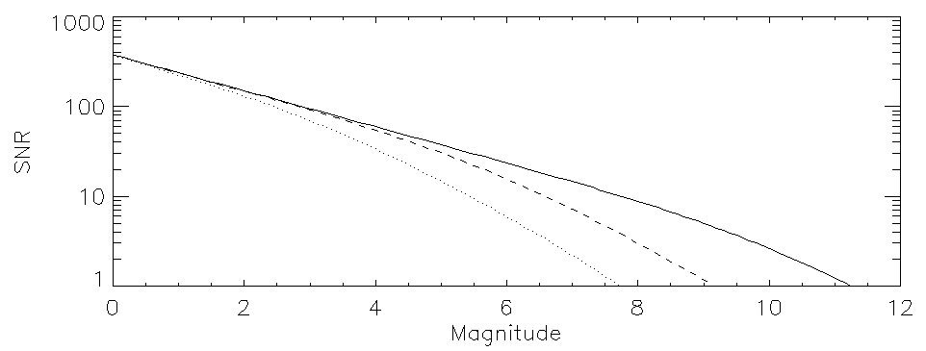
Scientific Requirements: specifications
A H-band 6T-ABCD fringe sensor aiming at performing a group delay and phase delay tracking of the fringes.
A visible instrument combining All-In-One the 6 CHARA beams in the optical domain (600-850nm) and proposing two main modes of dispersion:
  R=140 for sensitivity and angular diameter measurements
    Spectral band 600-850nm; 50 spectral channels of ~5nm
    for stars with theta=0.2mas, V²>0.6
    for stars with theta=0.5mas, V²>0.02
    for limb darkening (>0.8mas) V²_{min}=0.002
  R=3000 for spectral imaging
    Spectral band of ~65nm in 600-850nm; 250 spectral channels of ~0.25nm
    Differential visibility measurements V² =0.6 or V²=0.1
  R=10000 for specific programs
SNR on V² for one spectral channel: V²=0.02, 10mn, R=140
DIT = 20ms, 200ms, 10s
Development of a SNR model for V² and Vdiff, based on the FRIEND paper.
Noise model in ASPRO2 for more detailed simulations
Denis Mourard
SPICA-VIS Design Review, July 23-24, 2020

Slide 4
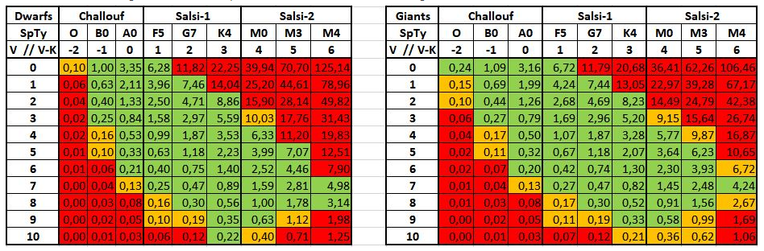
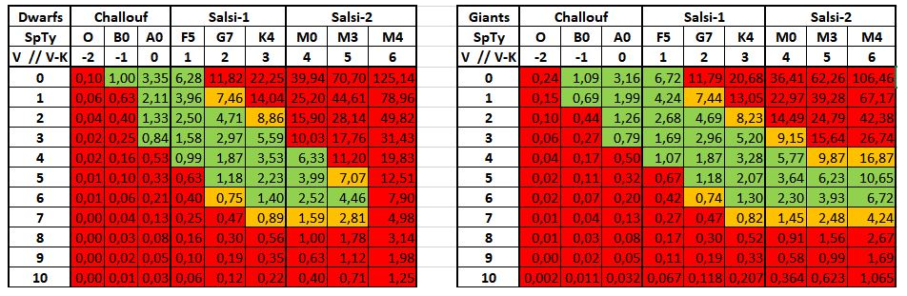
Scientific Requirements: θLD and (θLD +LD) measurements
θLD only with hypothesis on the LD law
σR/R=1%
θLD and LD from SPICA
Denis Mourard
SPICA-VIS Design Review, July 23-24, 2020

Slide 5
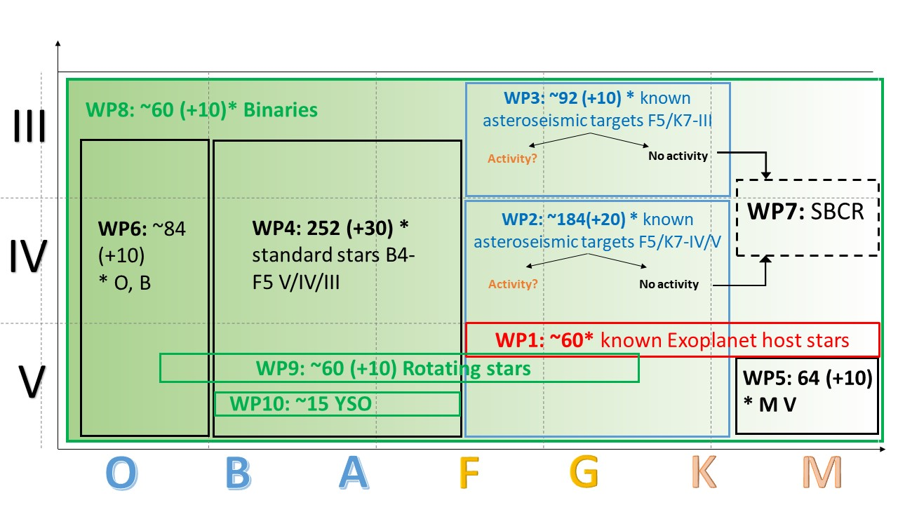
Scientific Requirements: definition of the large survey
Denis Mourard
SPICA-VIS Design Review, July 23-24, 2020

Slide 6
Scientific Requirements: conclusion
WP1 – R. LIGI - Exoplanet Host Stars (Survey: 60D+5I = 65*)
  for analysis of fundamental parameters of stars and planets
WP2 – S. DEHEUVELS - known asteroseismic targets F5 to K7 dwarfs (Survey: 185D+16I = 200*)
  for analysis of fundamental parameters of stars + inputs for SBCR (WP7)
WP3 – O. CREEVEY - known asteroseismic targets F5 to K7 giants (and sub-giants) (Survey: 92D+8I = 100*)
  for analysis of fundamental parameters of stars + inputs for SBCR (WP7)
WP4 – N. NARDETTO - B4-F5 asteroseismic/pulsating stars (Survey: 252D+22I = 275*)
  for analysis of fundamental parameters of stars
WP5 – T. BOYAJIAN - K7 to M dwarfs (Survey: 64D+3I = 67*)
  for analysis of fundamental parameters of stars
WP6 – D. GRACZYK - O, B1, B2, B3 (Survey: 83D+7I = 90*)
  for analysis of fundamental parameters of stars
WP7 – N. NARDETTO - SBCR Analysis: WP to be connected to WP1, 2, 3, 5 and 6
WP11 – A. CLARET + D. MOURARD - Limb-darkening across the HR diagram
WP8 – D. MOURARD + G. SCHAEFER - Binaries: (Survey: 60I)
  for analysis of mass in HR diagram.
WP9 – A. DOMICIANO - Rotation: (Survey: 60I)
  for analysis of the rotation of stars in HR diagram.
WP12 – M. WITTKOWSKI - Winds & Environment (Survey: 64D+4I = 68* or 15I)
  for analysis of the wind and environment of stars in HR diagram.
WP10 – S. KRAUS - YSOs: Additional program with 15I.
WP13 – C. SOUBIRAN - Galactic Archeology (tbd)
…
  + inputs for SBCR (WP7) + input for study of stellar activity (WP8, 9, 12) + input for LD (WP11)
Denis Mourard
SPICA-VIS Design Review, July 23-24, 2020

