Slide 1


INJECTION TABLE
Mechanical Study
Only 3 modules of the Injection Table have been studied up to now
No difficulty identified for other modules
Custom Rotation stage – Why?
SPICA Feeding Optics (SFO)
Atmospheric Dispersion Compensator (ADC)
Injection Module (INJ)
STS-VIS and LDC-VIS presented in the document
Philippe Berio/Christophe Bailet
SPICA-VIS Design Review, July 23-24, 2020

Slide 2
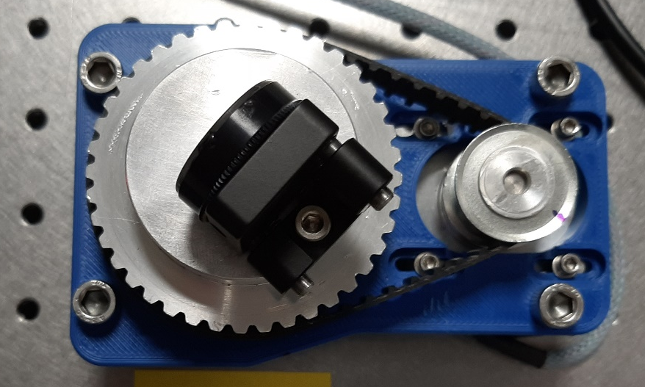
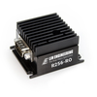
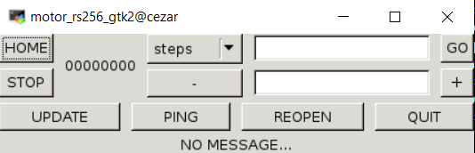
INJECTION TABLE
Mechanical Study
Custom Rotation stage – Why?
  At least 17 rotation stages in SPICA-VIS (12 ADC, 5 PDC + spectrograph?)
  Commercial stages > 500€ without controller
  Based on a stepper motor from Lin Engineering (step angle 0.9°), 2 gear wheels and 1 toothed belt (<100€)
  The teeth ratio between both wheels gives the resolution
  Controller from Lin Engineering (same than for CHARA/MIRCx)
  Repeatability Test : <0.02°
  Specifications: ADC 0.5° and PDC 0.1°
  Wobble test to do
  Control Software already developed (CHARA client/server+ GTK GUI)
Philippe Berio/Christophe Bailet
SPICA-VIS Design Review, July 23-24, 2020

Slide 3
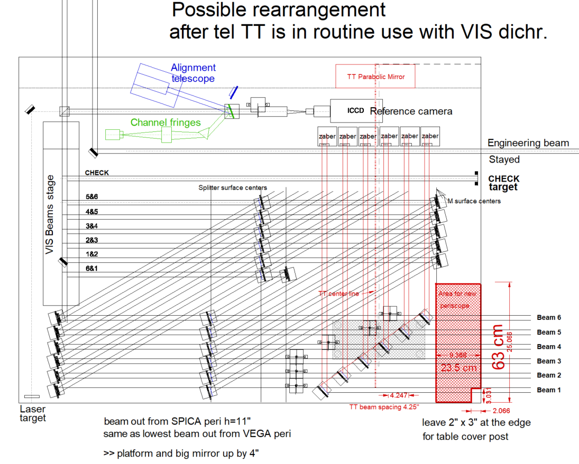
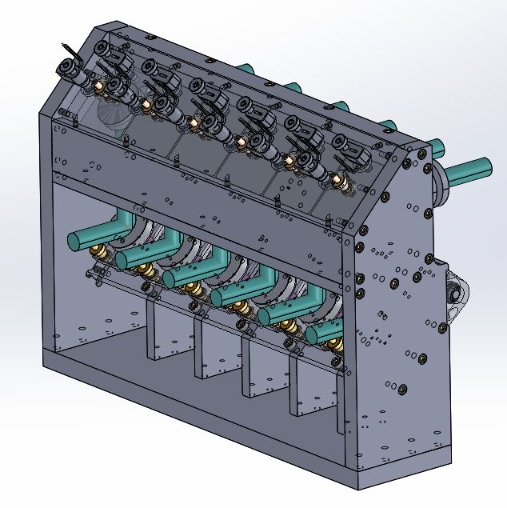
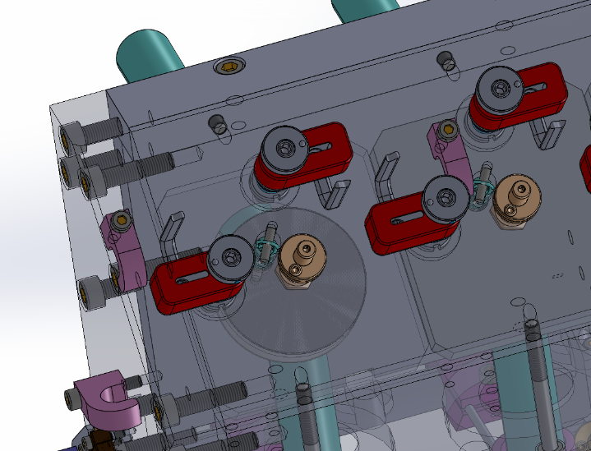
INJECTION TABLE
Mechanical Study
SPICA Feeding Optics
  Installed on the CHARA Visible Table
  Same concept than VEGA periscope
  Motorized IMG mirrors: Newport Pico motors (resolution 1μrad << spec 48μrad)
IMG mirrors
FOP mirrors
Philippe Berio/Christophe Bailet
SPICA-VIS Design Review, July 23-24, 2020

Slide 4
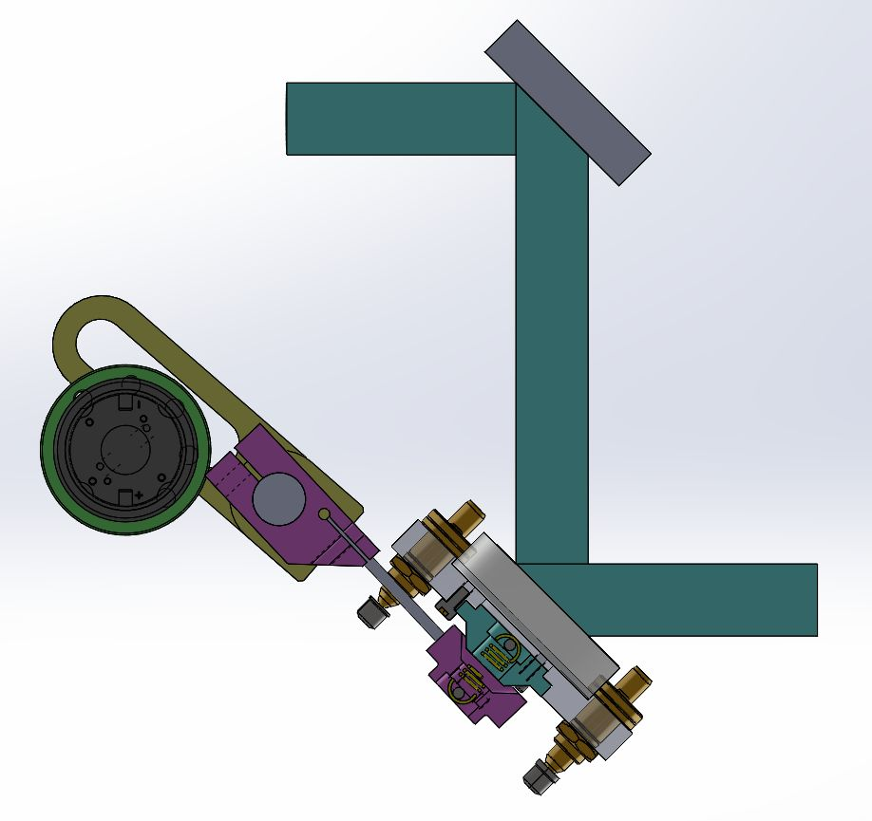
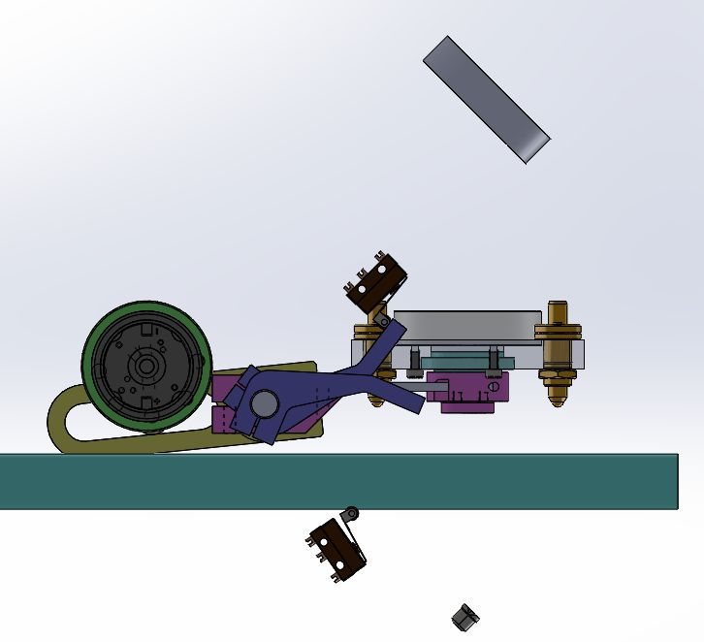
INJECTION TABLE
Mechanical Study
SPICA Feeding Optics
  One motor moves the 6 FOP simultaneously
  2 limit switches (UP and DOWN)
  A spring pulls the M1 mirror on kinematic points (DOWN) => good repeatability (TBC)
DOWN : SPICA-VIS
UP : CHARA
Philippe Berio/Christophe Bailet
SPICA-VIS Design Review, July 23-24, 2020

Slide 5
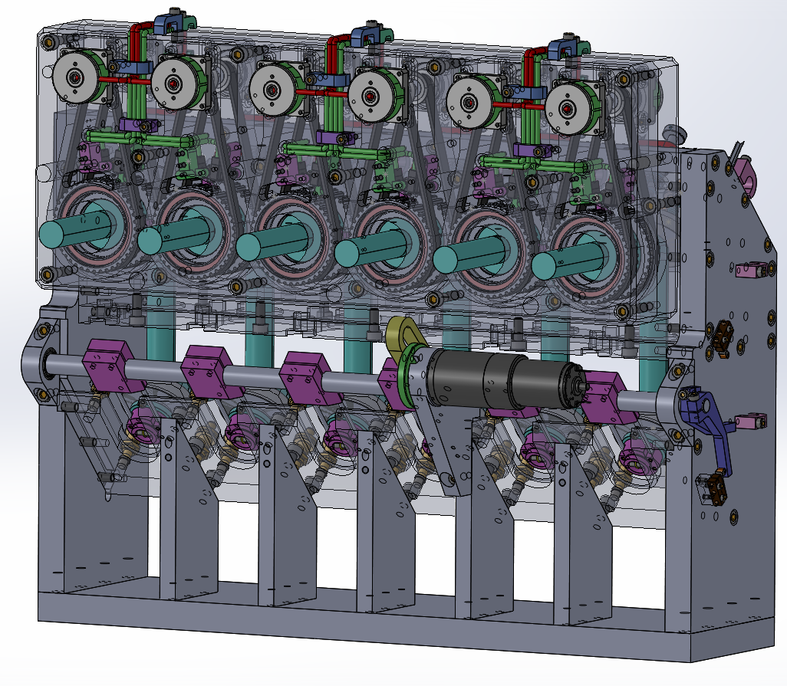
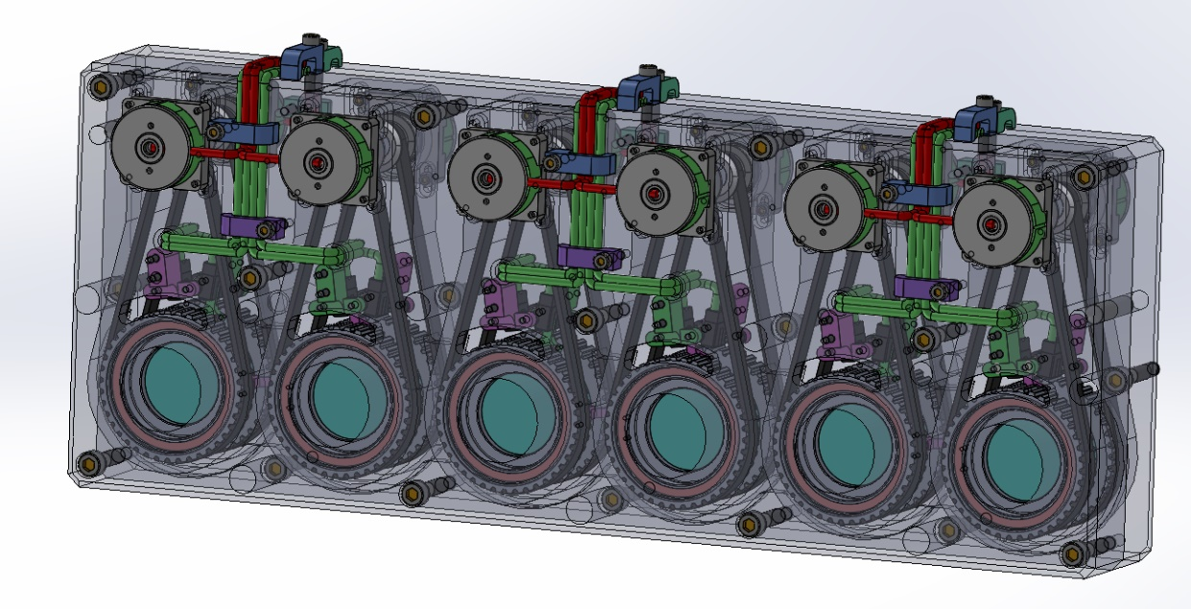
INJECTION TABLE
Mechanical Study
Atmospheric Dispersion Compensator
  Design complex (no space)
  12 custom rotation stages
  Attached on SFO
Philippe Berio/Christophe Bailet
SPICA-VIS Design Review, July 23-24, 2020

Slide 6
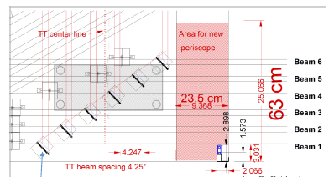
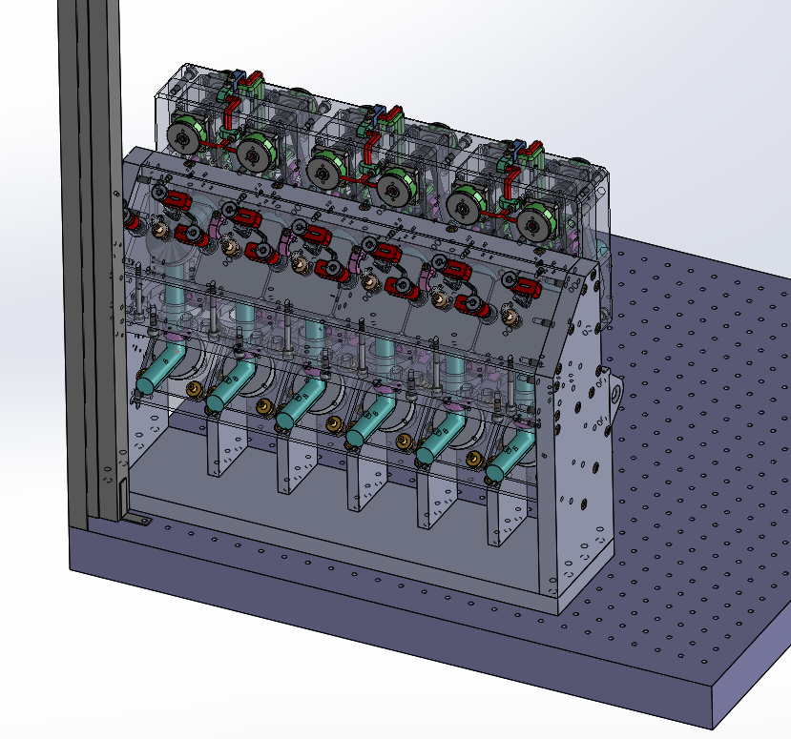
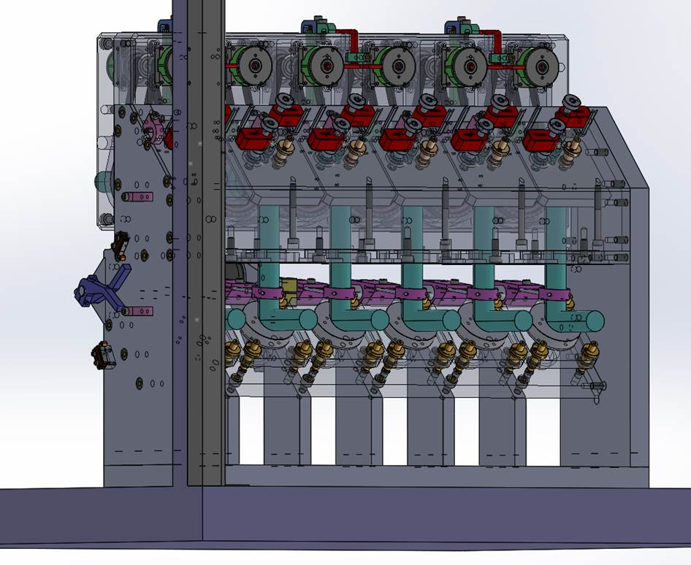
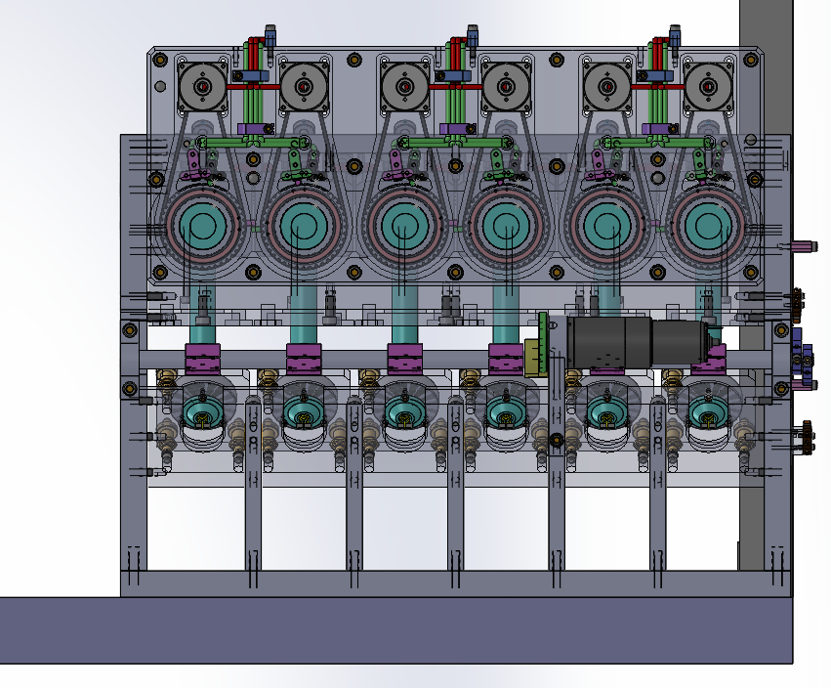
INJECTION TABLE
Mechanical Study
SFO+ADC Implantation on the CHARA visible table
Outside the table (2cm)
Roof post
Philippe Berio/Christophe Bailet
SPICA-VIS Design Review, July 23-24, 2020

Slide 7
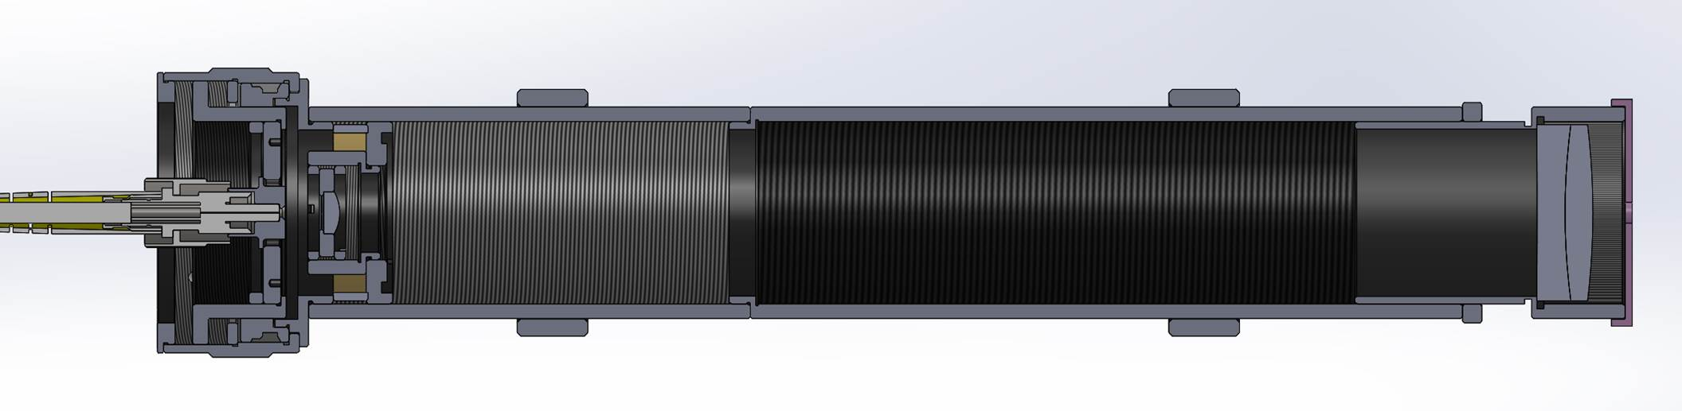
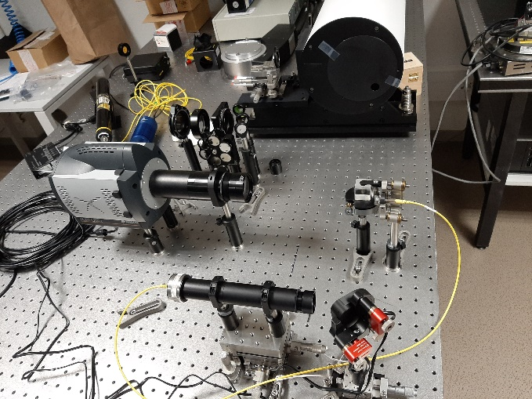
INJECTION TABLE
Mechanical Study
Injection Module
  Lens System (no OAP)
  No motorization (coupling optimization down with the PI TipTilt)
  Based on Thorlabs tubes
  Thorlabs high precision zoom housing => fiber at the focus of the plano-convex lens (+/-10μm)
  Testbench developed
  Coupling at 725nm: 75%
  Coupling over the spectral band ?
  Stability?
Philippe Berio/Christophe Bailet
SPICA-VIS Design Review, July 23-24, 2020

