Slide 1


SOFTWARES
Pipeline
Goal: Develop an automatic Pipeline which could be run at the end of observation nights
Based on the ESO pipeline architecture
Oragnization/Association/Classification of raw data/calibration maps from Header Keywords
  DPR CATG/DPR TYPE/DPR TECH for raw data
  PRO CATG for products
Processing modules: same method than the FRIEND pipeline
High Level Scripts: based on the MATISSE pipeline
Developped in Python (some parts in C if necessary)
Philippe Berio
SPICA-VIS Design Review, July 23-24, 2020

Slide 2
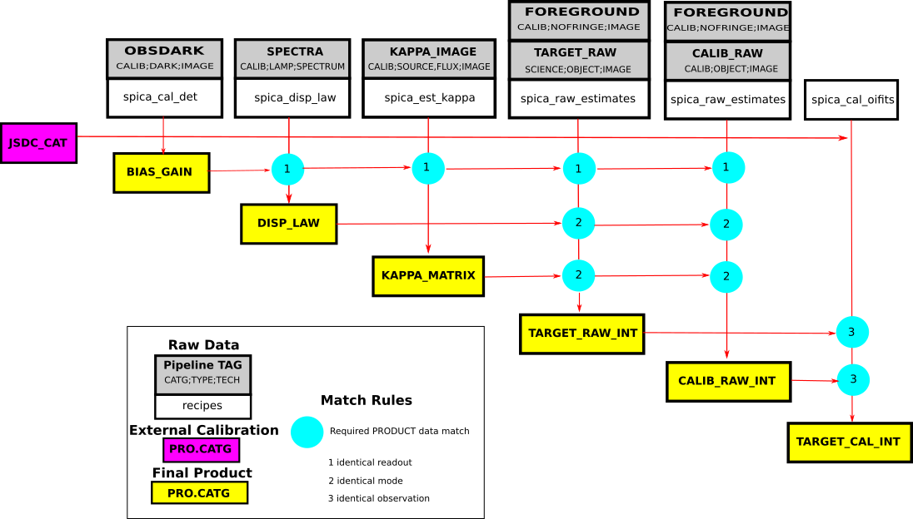
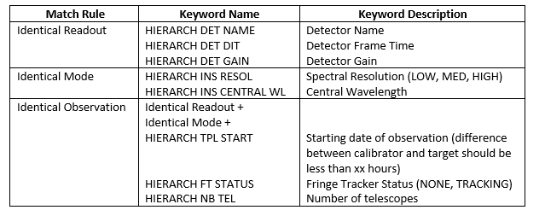
SOFTWARES
Pipeline
Data Reduction Cascade
Target/Calibrator
Calibration
Processing Module
Philippe Berio
SPICA-VIS Design Review, July 23-24, 2020

Slide 3
SOFTWARES
Pipeline
High Level Scripts
Automatic Pipeline:
  Groups the raw data following the match rules
  Associates the corresponding calibration maps
  Applies the processing modules to each raw data group
  Provides raw OIFITS files
Calibration Pipeline:
  Selects the calibrators corresponding to each target following the match rules
  Calibrates the raw OIFITS files (spica_cal_oifits)
  Feeds the database: L0 and L1 of OIDB, SPICA Survey Management Database
Philippe Berio
SPICA-VIS Design Review, July 23-24, 2020

