Slide 1


SPICA-VIS DESIGN REVIEW
Board: Judith Sturmann, Karine Perraut, Theo ten Brummelaar, John Monnier and Frantz Martinache
SPICA-VIS team: Denis Mourard, Stéphane Lagarde, Julien Dejonghe, Frédéric Morand, Cyril Pannetier, Christophe Bailet, Daniel Lecron, Fatmé Allouche, Philippe Berio
Goal:
Evaluate the SPICA-VIS design against its requirements & Identify issues
Design Review Agenda:
  Session 1: Management/System
  Session 2: Injection table
  Session 3: Spectrograph
  Session 4: Software
Implantation of SPICA-VIS in the CHARA focal lab
Optical design and co-alignment procedure
Control software design
Schedule of the project
Finalize mechanical study
Ordering/Manufacturing
Coding
Assembly/Integration
Next funding requests (INSU, ERC)
Philippe Berio
SPICA-VIS Design Review, July 23-24, 2020

Slide 2
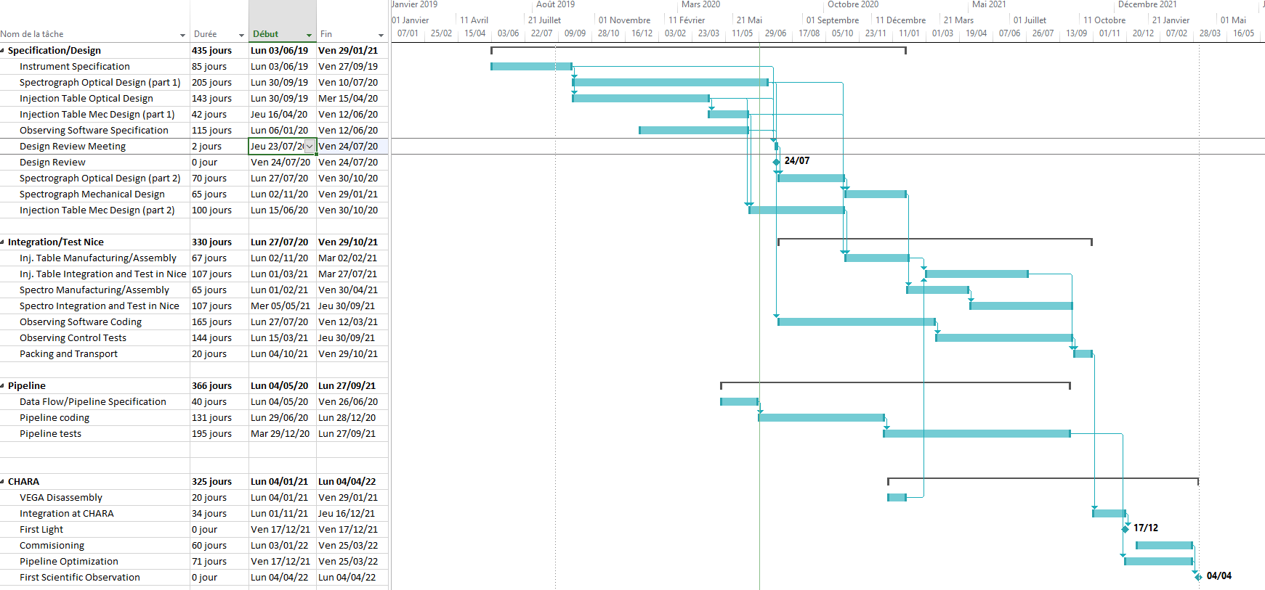
MANAGEMENT/SYSTEM
Schedule
End of Design (Jan.2021)
End of Integration at Nice (Sept. 2021)
Design Review (July 2020)
Integration at CHARA (Nov./Dec. 2021)
Philippe Berio
SPICA-VIS Design Review, July 23-24, 2020

Slide 3
MANAGEMENT/SYSTEM
Team
System Team
Stéphane Lagarde
Denis Mourard
Philippe Berio
Julien Dejonghe
Science Team
Nicolas Nardetto
Denis Mourard
…
…
…
…
Prime Investigator
Denis Mourard
Project Manager
Philippe Berio
AIT/AIV
Fatmé Allouche
All
Optical Study
Julien Dejonghe
Cyril Pannetier
Mechanical Study
Christophe Bailet
Julien Dejonghe
Control Software
Frédéric Morand
Daniel Lecron
Pipeline
Philippe Berio
Denis Mourard
Philippe Berio
SPICA-VIS Design Review, July 23-24, 2020

Slide 4
MANAGEMENT/SYSTEM
Funding
Module | Cost (k€) | Remaining Expenses (k€)
PDC | 6.9 | 6.9
ADC | 9.8 | 8.1
PERISCOPE | 11 | 6.9
BAS | 49.6 | 9.4
BCO+BCS | 9.7 | 8.5
SFI | 10.7 | 6.2
Spectral Source | 1.3 | 1.3
BS | 3.8 | 1.3
Vgroove | 21.9 | 21.9
Workstation/Det | 70.6 | 45
Mech. Manufacturing | 15 | 15
Transport | 6 | 5.5
STS VIS | 9.7 | 9.7
TOTAL | 226 | 146
Spectrograph/Coating/Retrofeed Source
➔ No estimation of the cost
➔ should be < 30k€
Margin 10k€
Travels 10k€
Total Cost: 276k€
Remaining Expenses: 196k€
Available Funding : 144k€
including 40k€ from Aarhus University, Danemark
Missing Funding : 52k€
2nd part of the INSU request
Philippe Berio
SPICA-VIS Design Review, July 23-24, 2020

