Slide 1
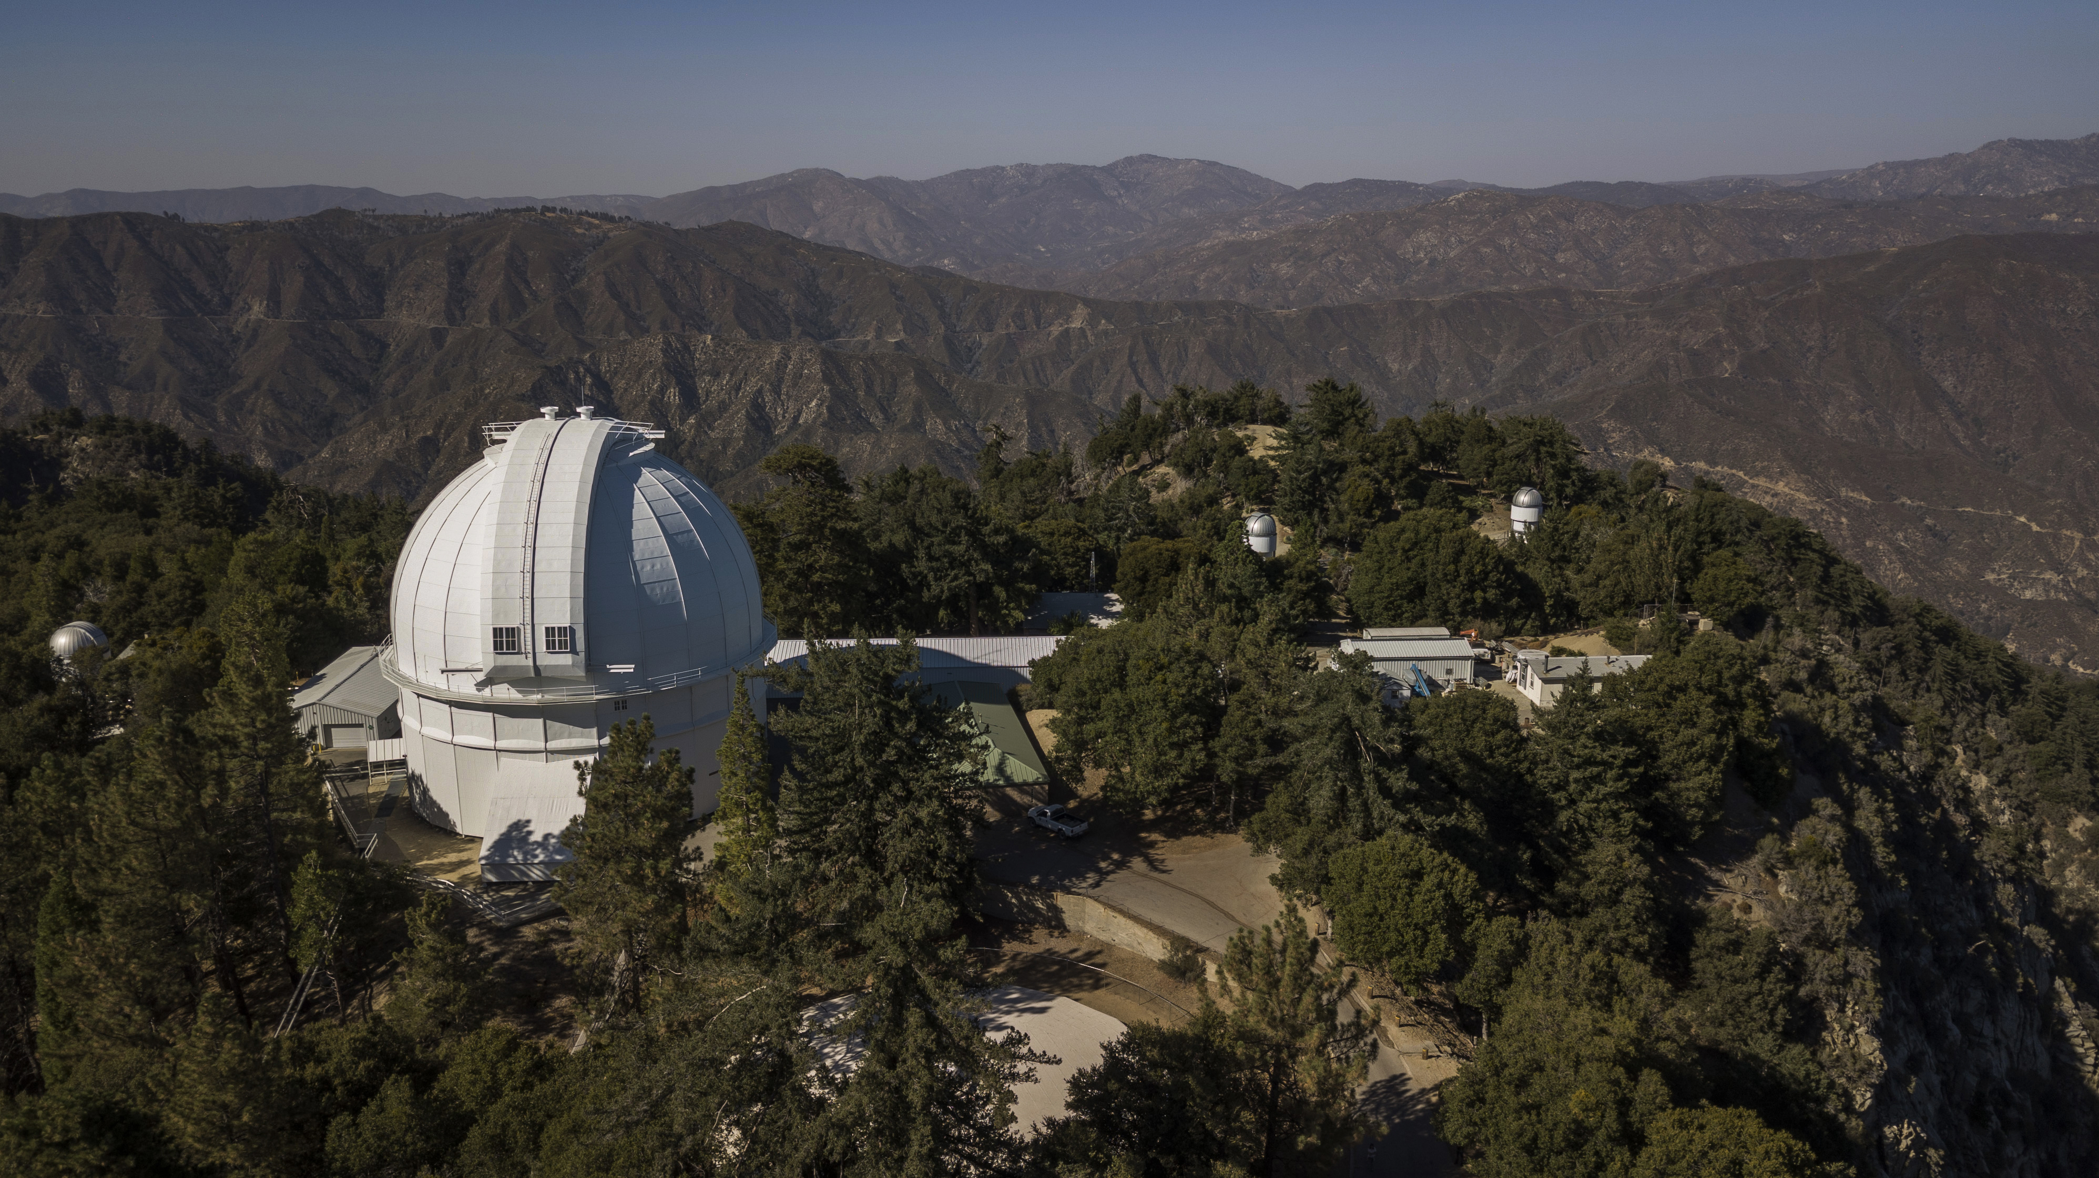
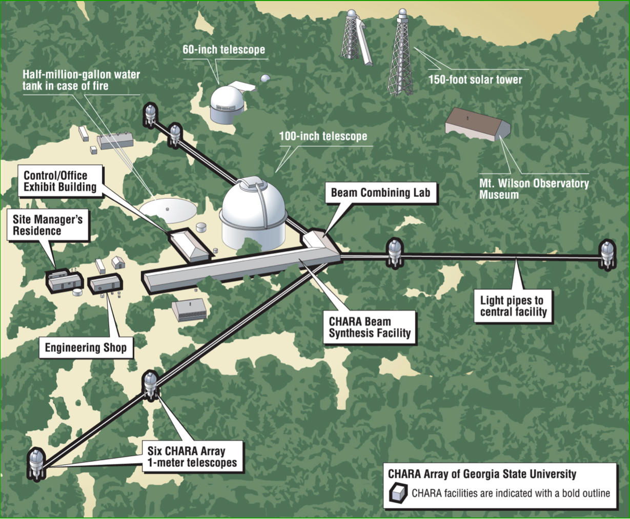
SPICA-VIS CONCEPT DESIGN: INJECTION TABLE
SPICA-VIS @ CHARA ARRAY
MAIN IMPUTS
6 telescopes, 1016 mm diameter
Baselines up to 330 m
6 beams separated by 3 inches (76,2 mm)
Beam diameter: ¾ inches (19,05 mm)
Magnification: 53,33
Field of view: 0,3 to 0,6 arc-seconds
Pupil max-min distance from North side of table: approx 27 m – 16m
Pupil stabilization after LabAO: +/- 2% (TBC)
Image stabilization after LabAO: +/- 0,3’’ (confirmed)
➔
Margin for the field: +/- 0,3’’ on sky (unvigneted), +/-2,1 mm on the entrance optics (min diameter 28 mm)
Beam must remain centered on fast tip-tilt mirror (otherwise it generates fast piston): Fast tip-tilt placed at pupil plan
All motorized tip-tilt mirrors must rotate around the center of the optical surface

Slide 2
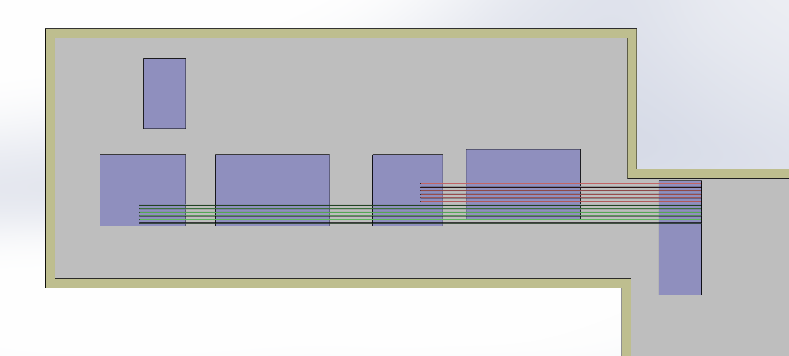
SPICA implantation in CHARA lab
SPICA
Spectro
Table
SPICA Inject°
Table
Visible Table
CHARA IRC
MIRC / SPICA FT
Metrology Table

Slide 3

CHARA Beams & Pupil Positions
16,67 to 27,16 m
SPICA Table
(former Vega)
11,62 m (TBC)
Metrology Table
5,05 to 15,54 m
Vis beam 6
Vis beam 5
Zero OPD surface
Vis beam 4
Vis beam 3
Vis beam 2
3 inches = 76,2 mm
Vis beam 1
6+$3^{3/2}$ inches
= 284,38227 mm
4,67 to 15,16 m
North
16,29 to 26,78 m

Slide 4
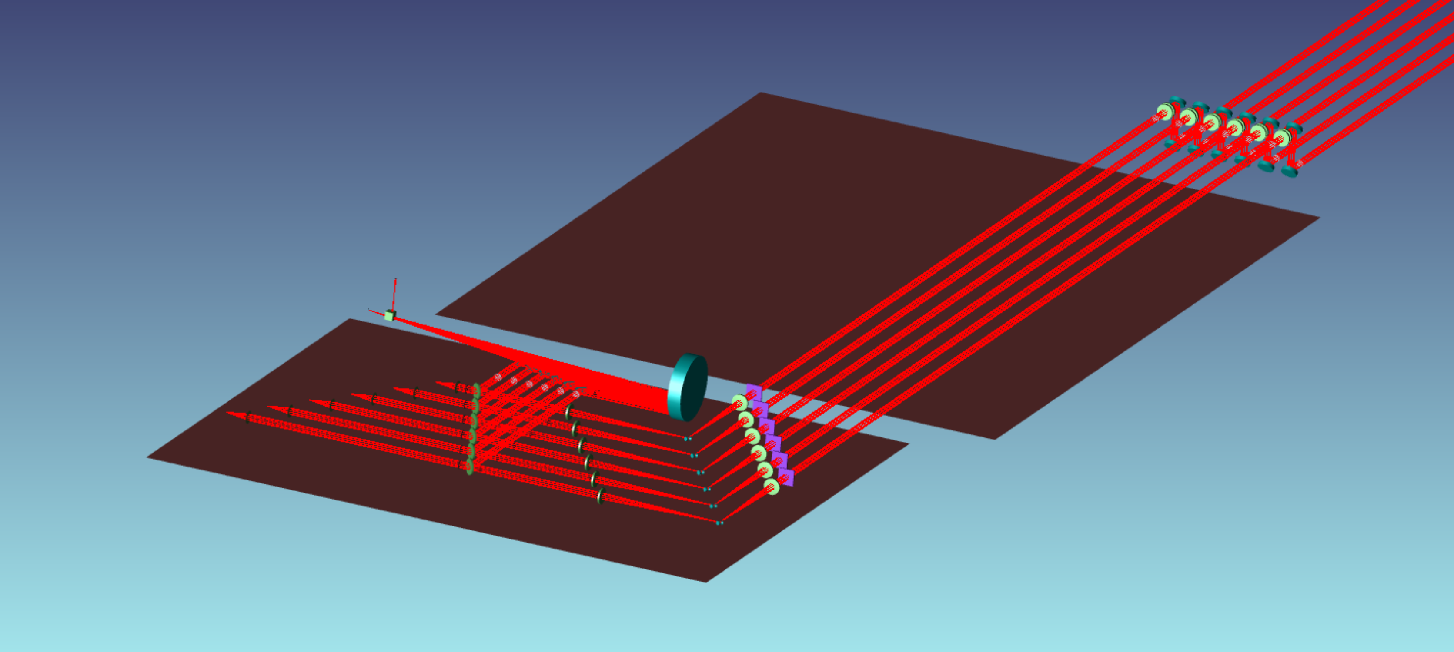
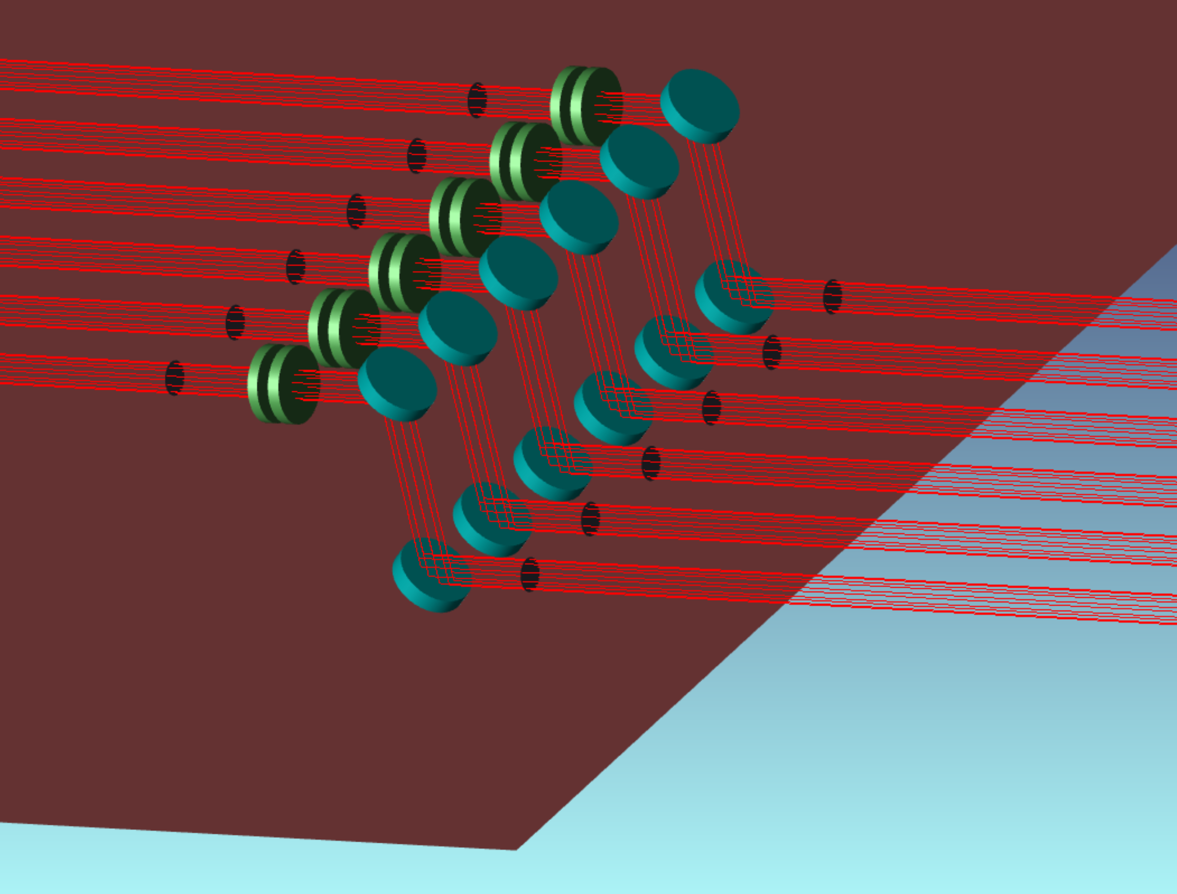
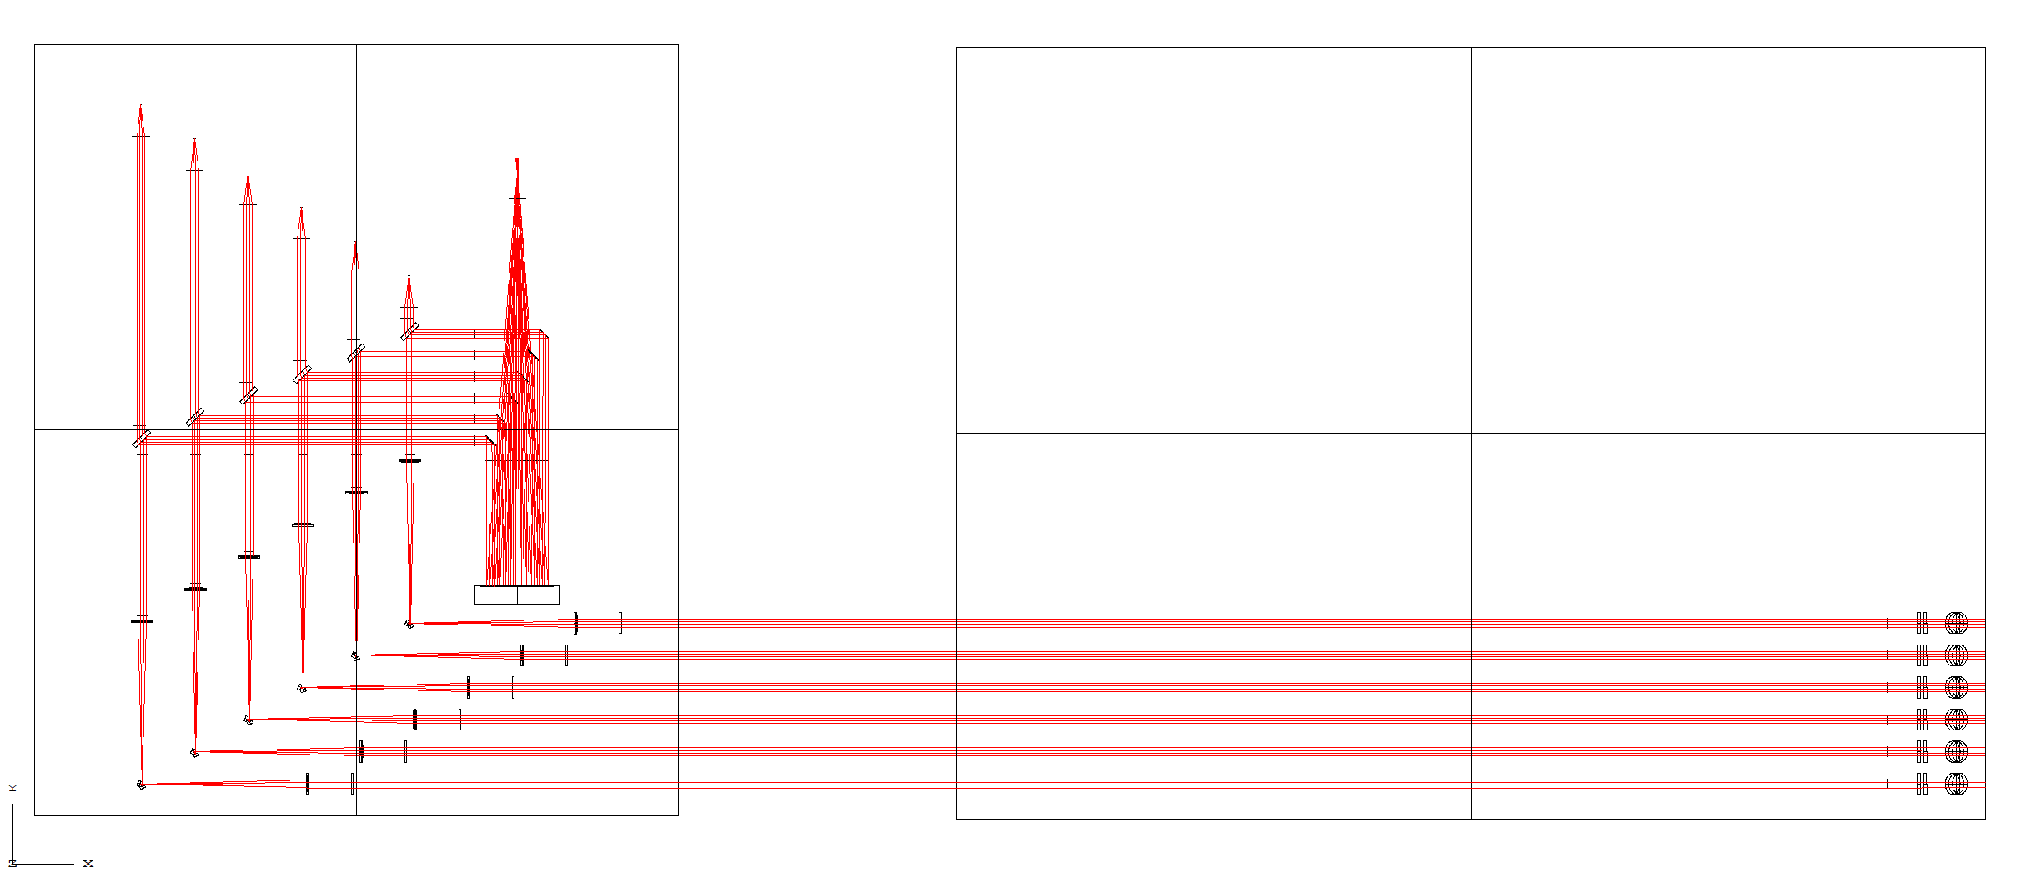
Periscope
CHARA VISIBLE TABLE
SPICA TABLE
M2 Slow tip_tilt
Atmospheric Dispersion Compensator (ADC)
M1 (removable)

Slide 5
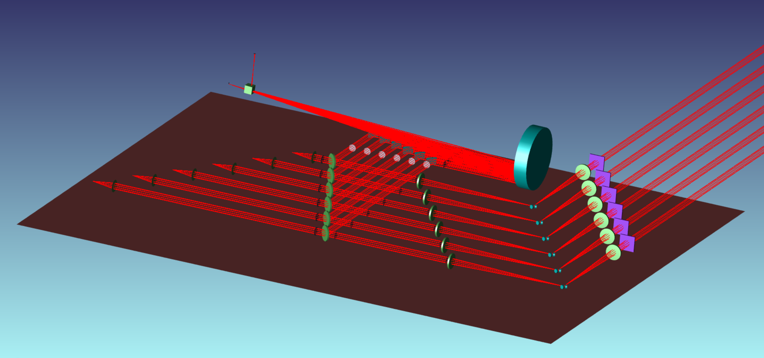
Image camera
Pupil lens
6xM5
M6
Injection Module
6 Shutters
Polarisation Delay Compensator (PDC)
Retroreflector
F400
F400
Plate Beam-Splitter
(80%-20%?)
Slow tip –tilt M3 for pupil control
@ focal plane
Fast tip –tilt M4 for image control
@ ~ pupil plane

Slide 6
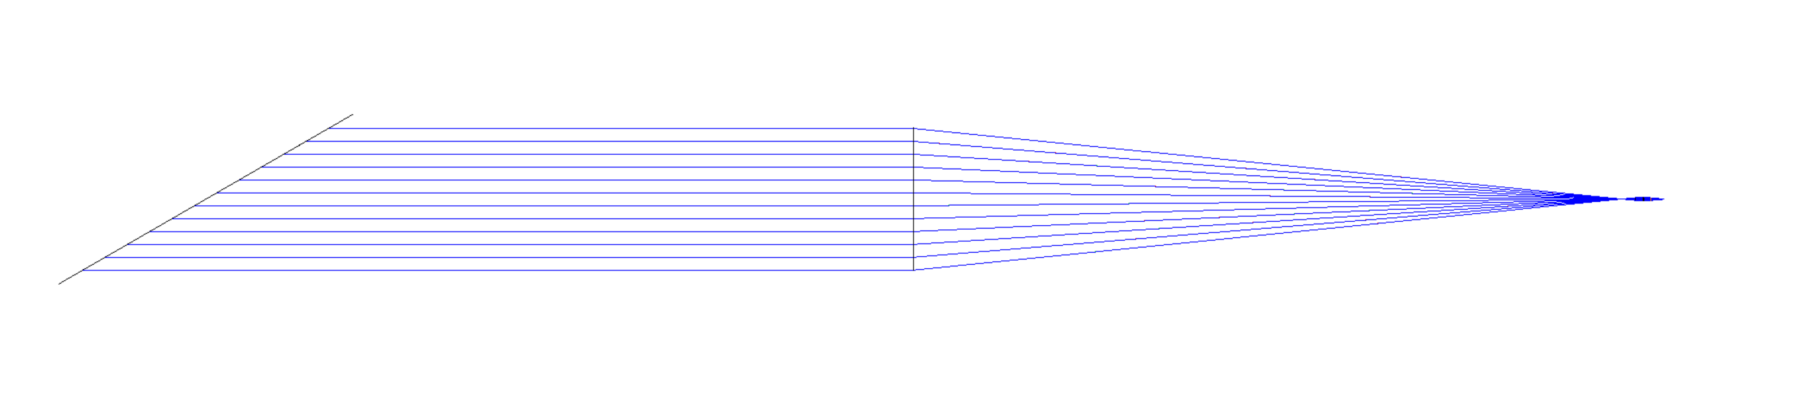
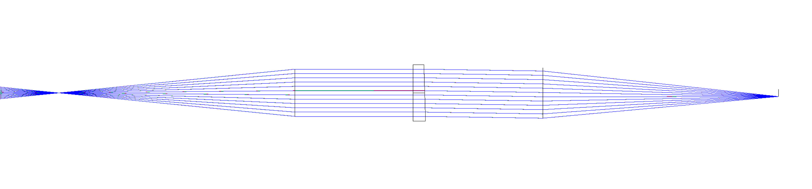
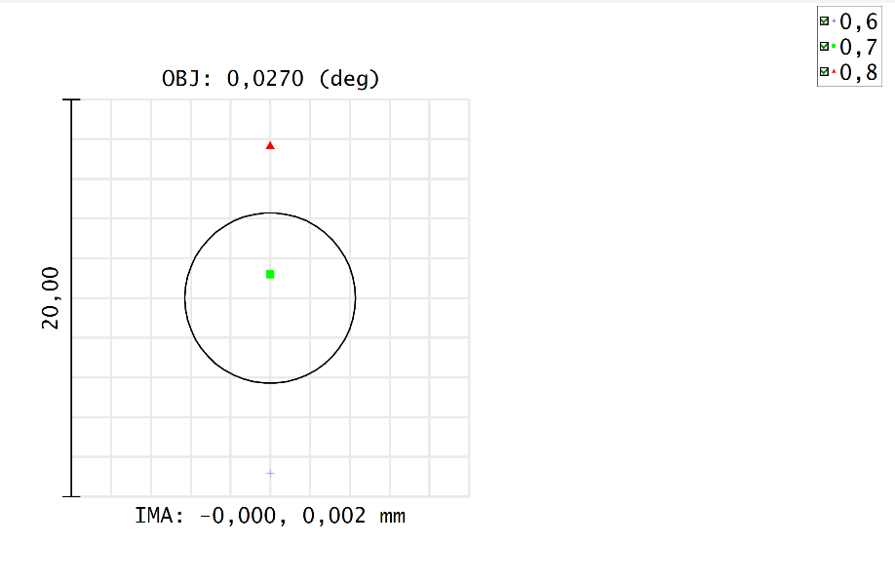
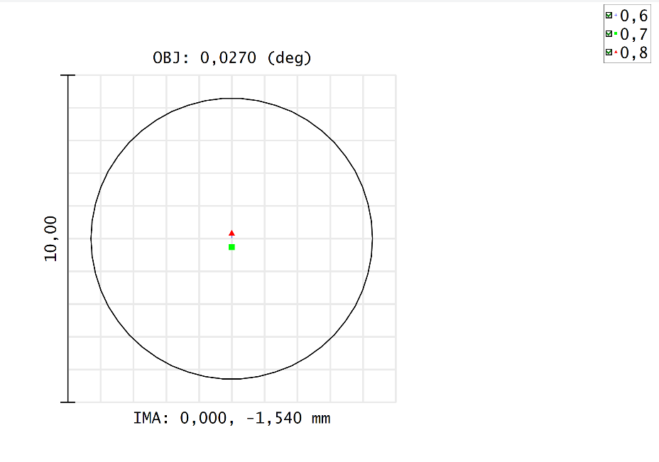
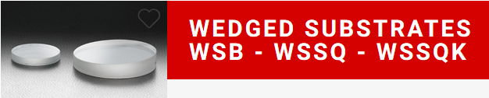
Periscope + ADC: Placed on CHARA Visible Table, the periscope allows to pass over others optics. M1 is removable, while M2 is motorized in Tip-Tilt
M2 Slow tip_tilt
NB: Field rotation at CHARA
ADC must follow field rotation, every 10 mins
Dispersion correction every 10 mins also
Non sensitive to beam incidence
Global deviation: 53’
To be corrected with image and pupil control…
Technical solution: 2 wedged windows, with 2 motorized orientations
Atmospheric Dispersion Compensator (ADC)
No correction
Max correction
M1 (removable)
Simulation for 60° from zenith: atmospheric dispersion
Vacuum
Air
1m telescope
Prism 1,7°

Slide 7
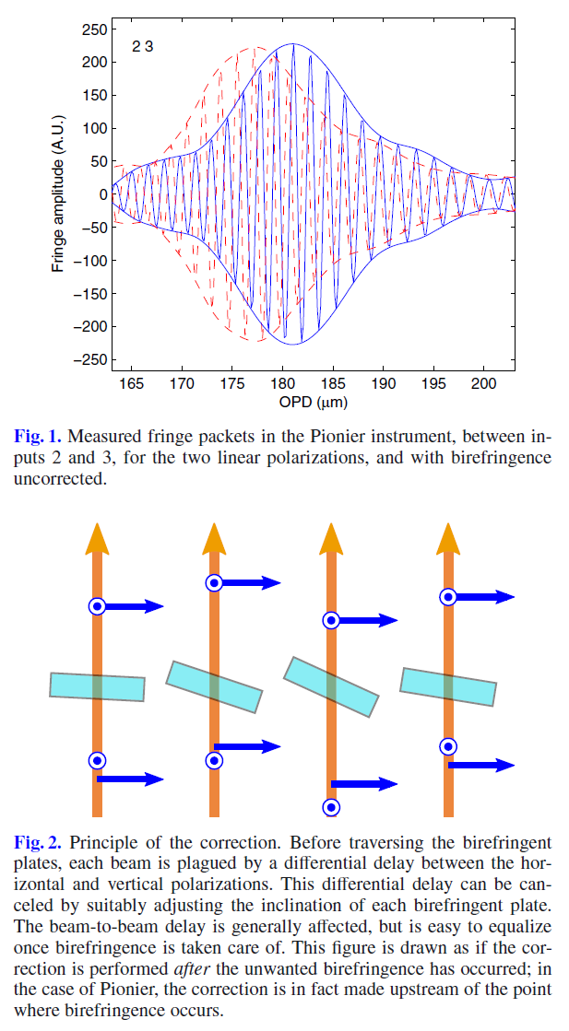
Polarization Delay Compensator (PDC)
Due to optical fibers, the vertical and horizontal polarizations have a different delay, and this delay may be different on the 6 beams.
To correct this effect, a cristal material is inserted in each beam, and tilted to equalize the phase of V and H polarizations.
Requires motorized stage
On the right: extract from A&A 543, A31 (2012), B. Lazareff, J.-B. Le Bouquin, and J.-P. Berger,
A novel technique to control differential birefringence in optical
Interferometers, Demonstration on the PIONIER-VLTI instrument
To be completed…

Slide 8
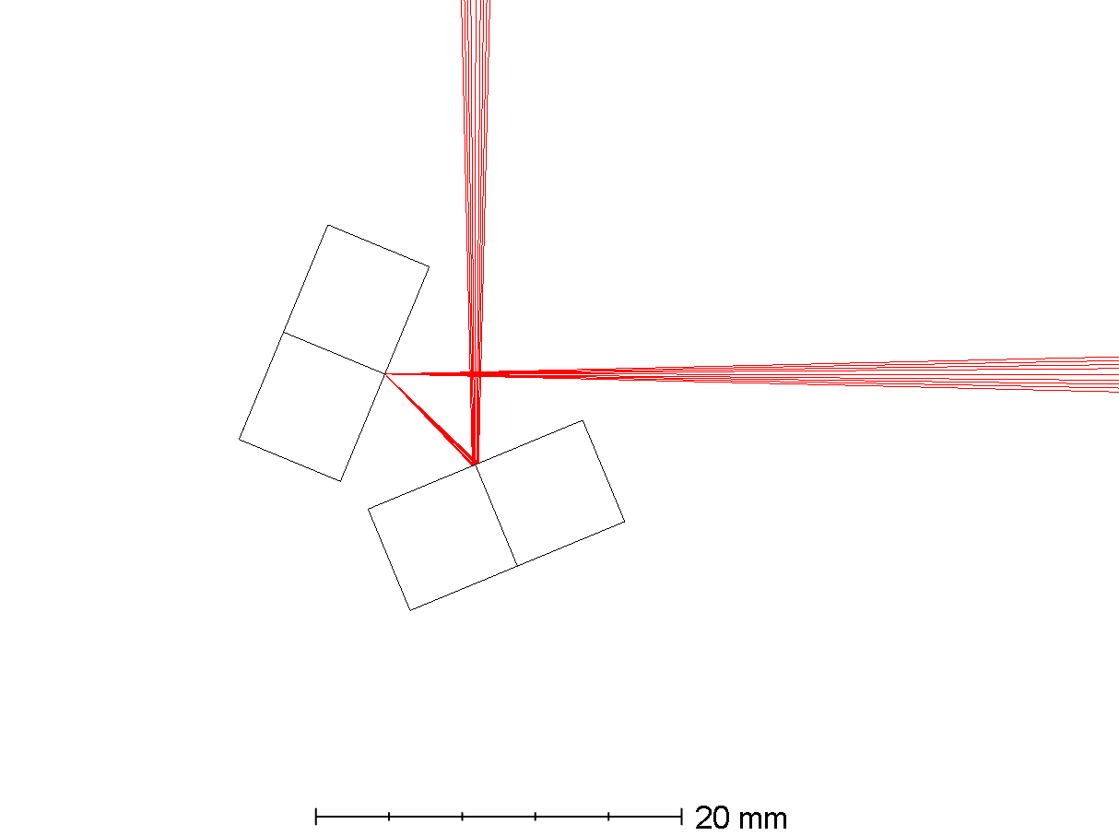
Image and Pupil Control: Placed in a focal plane, a slow tip-tilt mirror stabilizes the pupil. Near the approximate pupil plane, the fast tip-tilt mirror stabilizes the injection into fibers.
To avoid generating fast piston errors, the beam must always be precisely centered on the fast tip-tilt rotation point.
Field: +/-0,3’’ (sky), +/- 16’’ (lab) ~ 0,0001 rad
Typical fast tip-tilt movement: 0,0001 rad
If centering error is 1 mm, generated fast piston = 100 nm = Lambda/7
If centering error is 0,1 mm, generated fast piston = 10 nm < Lambda/70
Pupil diameter @ fast tip-tilt: 0,37 mm
➔ centering accuracy: 0,1/0,37 = 27% easy!
Slow tip –tilt M3 for pupil control
@ focal plane
Focal plane
Beam centering on fast tip-tilt:
Fast piston = eα
~Pupil plane
Fast tip –tilt M4 for image control
@ ~ pupil plane
α
e

Slide 9
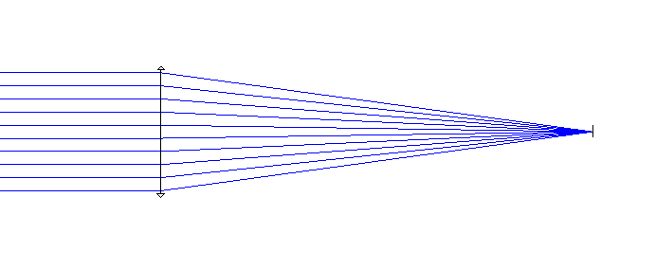
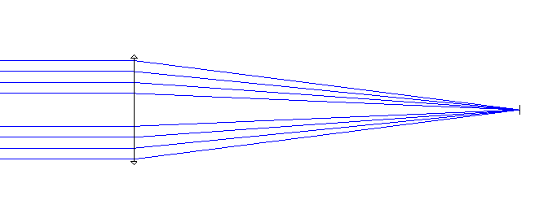
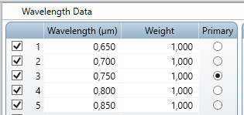
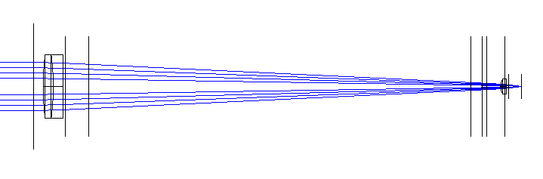
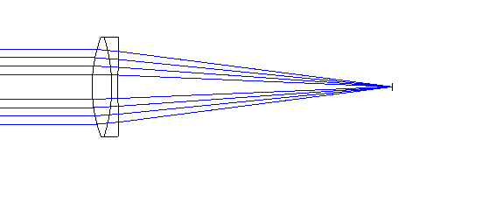
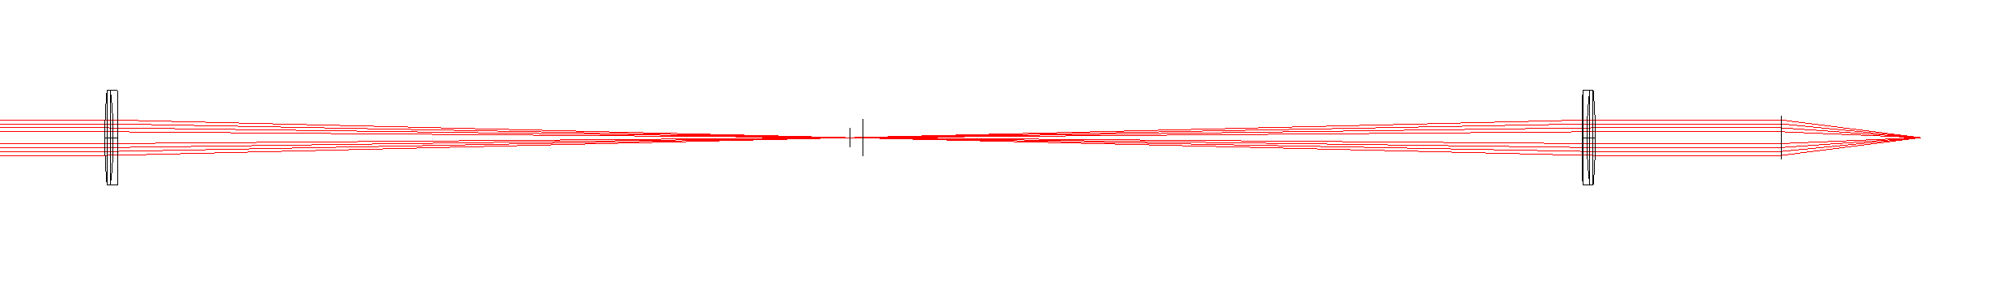
Fiber Injection:
Receiver Efficiency : 0,827839
Receiver Efficiency : 0,717590
Receiver Efficiency : 0,709846 -0,01 +0,02
Design Yves Bresson
Receiver Efficiency: 0,651543 -0,01 +0,05
Effect of the 2 achromats: Receiver Efficiency : 0,700749 -0,02 + 0,01

Slide 10
Fiber Injection: effect of beam centering error
Pupil lateral shift (mm) | 0 | 1 | 2 | 3 | 4 | 5 | 6 | 7 | 8 | 9 | 10
Syst efficiency (vignetting) | 0,937 | 0,937 | 0,937 | 0,929 | 0,882 | 0,819 | 0,753 | 0,688 | 0,620 | 0,552 | 0,486
Receiver efficiency (injection quality) | 0,711 | 0,697 | 0,651 | 0,586 | 0,538 | 0,495 | 0,447 | 0,393 | 0,339 | 0,290 | 0,241
Coupling efficiency | 0,666 | 0,653 | 0,610 | 0,544 | 0,475 | 0,405 | 0,336 | 0,270 | 0,211 | 0,160 | 0,117
➔ Beam should be centerd within 1mm (5%)

Slide 11
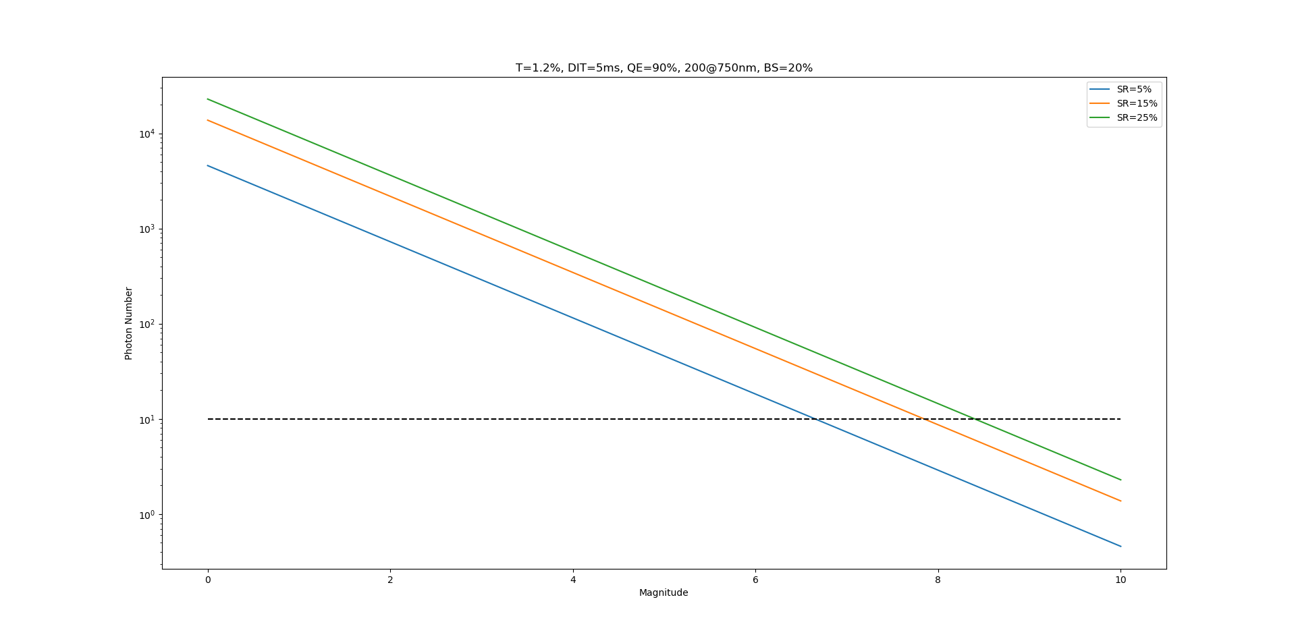
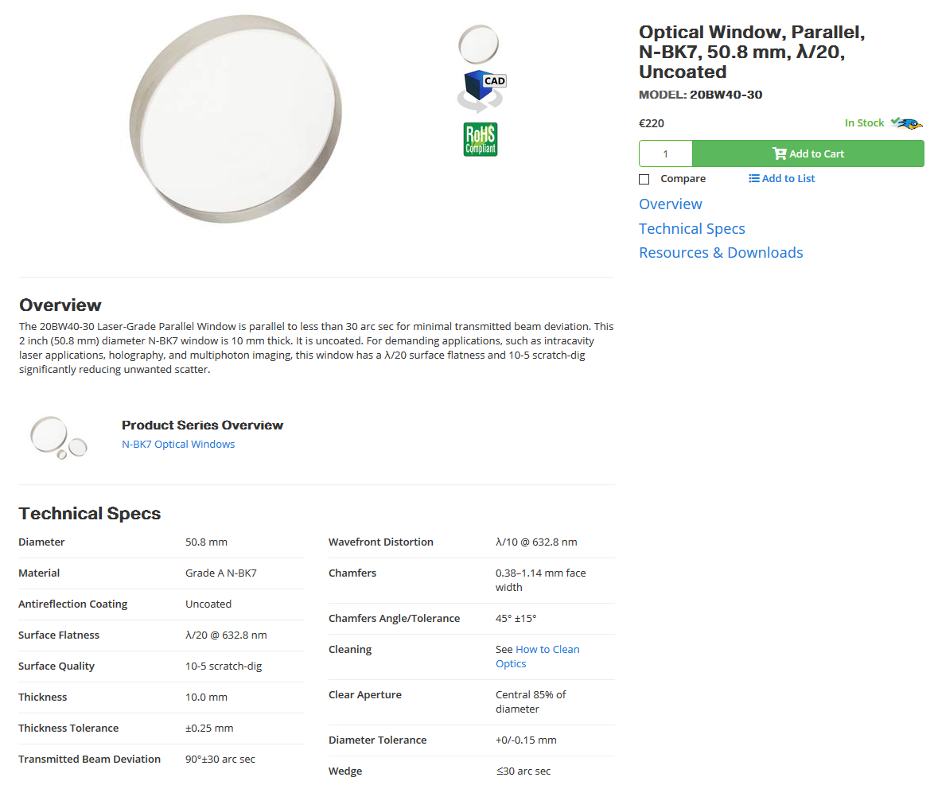
Science/Tracking beam ratio
Simulation of the number of photons on the tracking detector, function of magnitude, for different Strehl ratios (simulation by Ph Berio)
Custom beamsplitter, R/T = 20/80
Wedge to avoid ghost
Max wedge to minimise dispersion effect: 1’
Min wedge to exclude ghost injection into fiber: a few arcsec
➔ Newport window, 10’’ – 30’’ wedge

Slide 12

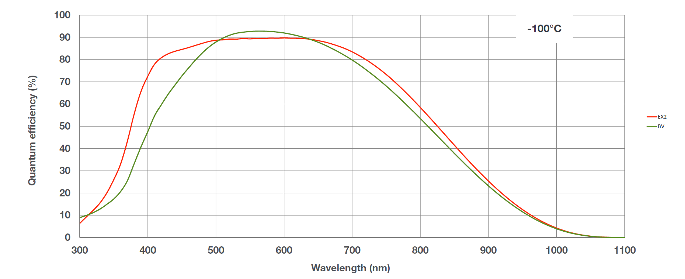
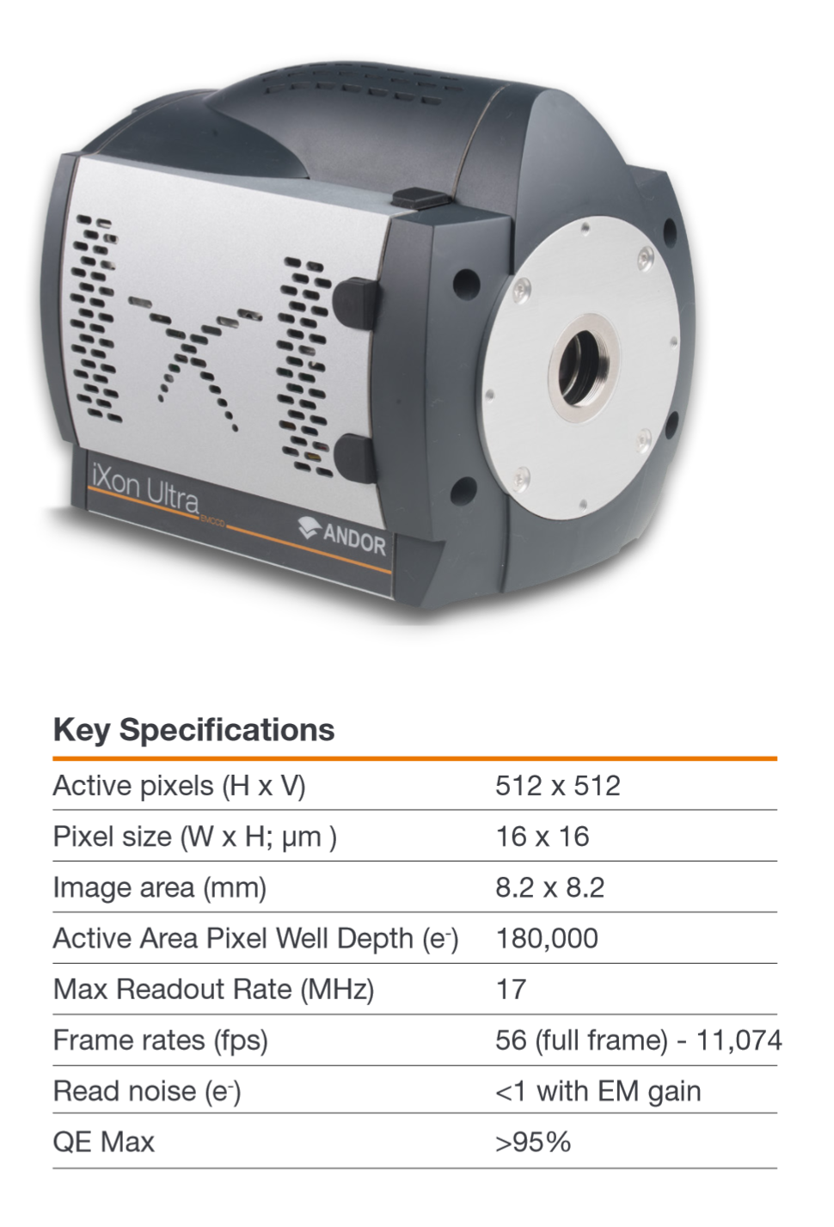
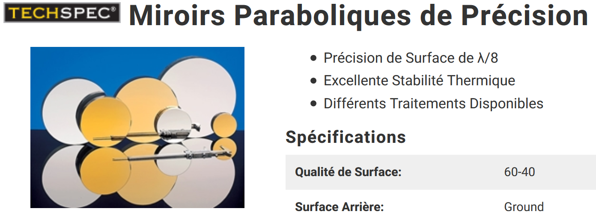
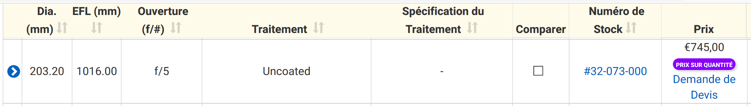
Image/Pupil Camera
Fast camera with windowing to stabilize injection into fibers.
2,44 L/D on 5-6 pixels
F = 1000 mm?
Parabole Edmund diam. 203,2 – F1016
6,1 pixels @ 750 nm

Slide 13
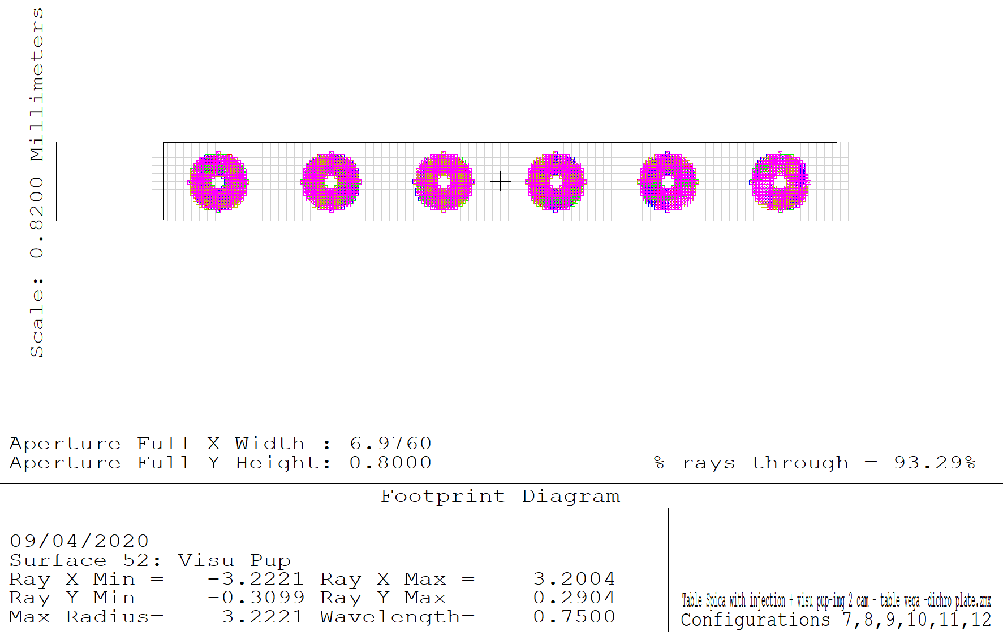
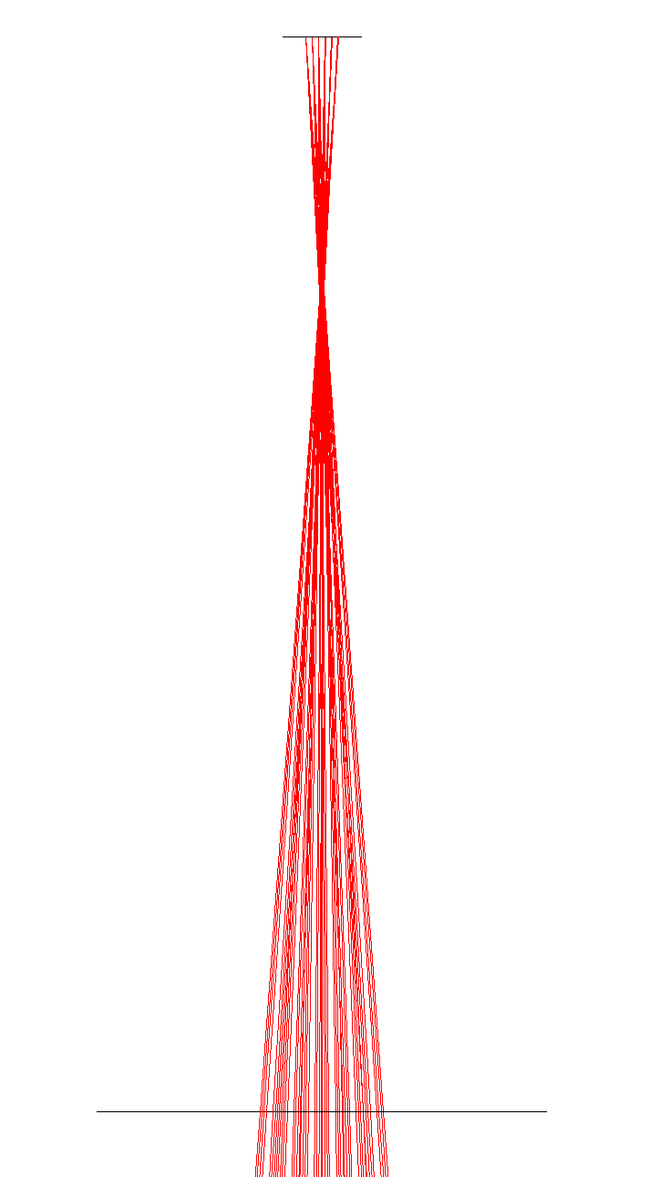
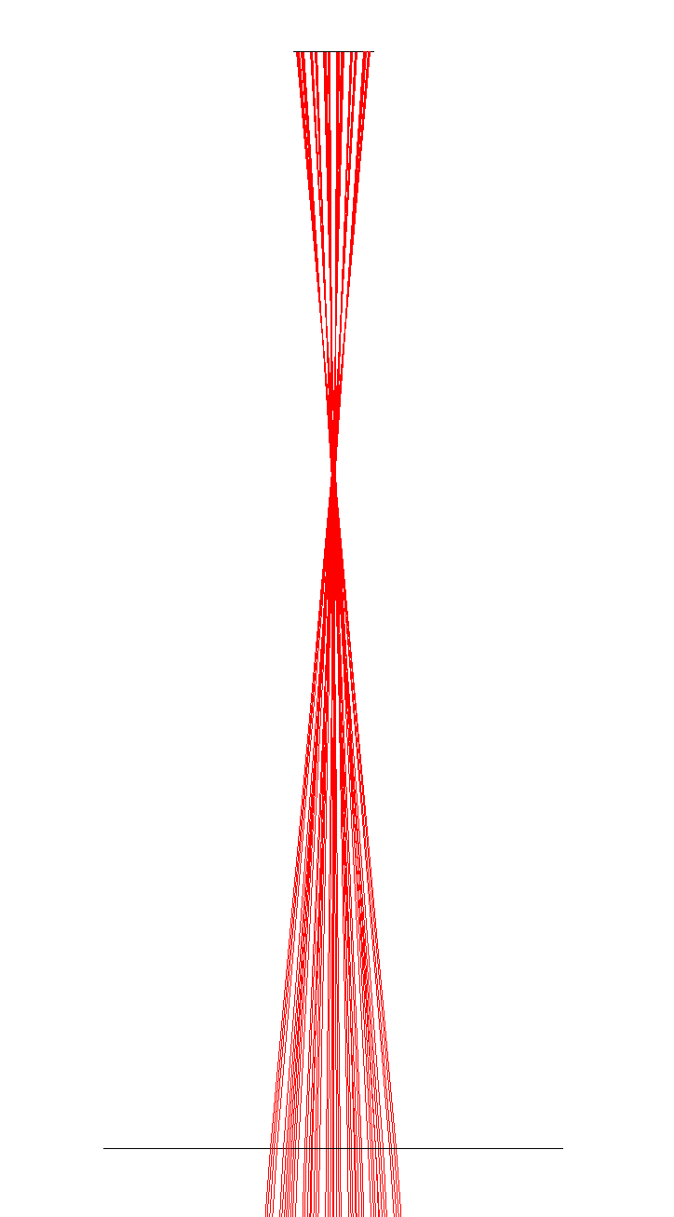
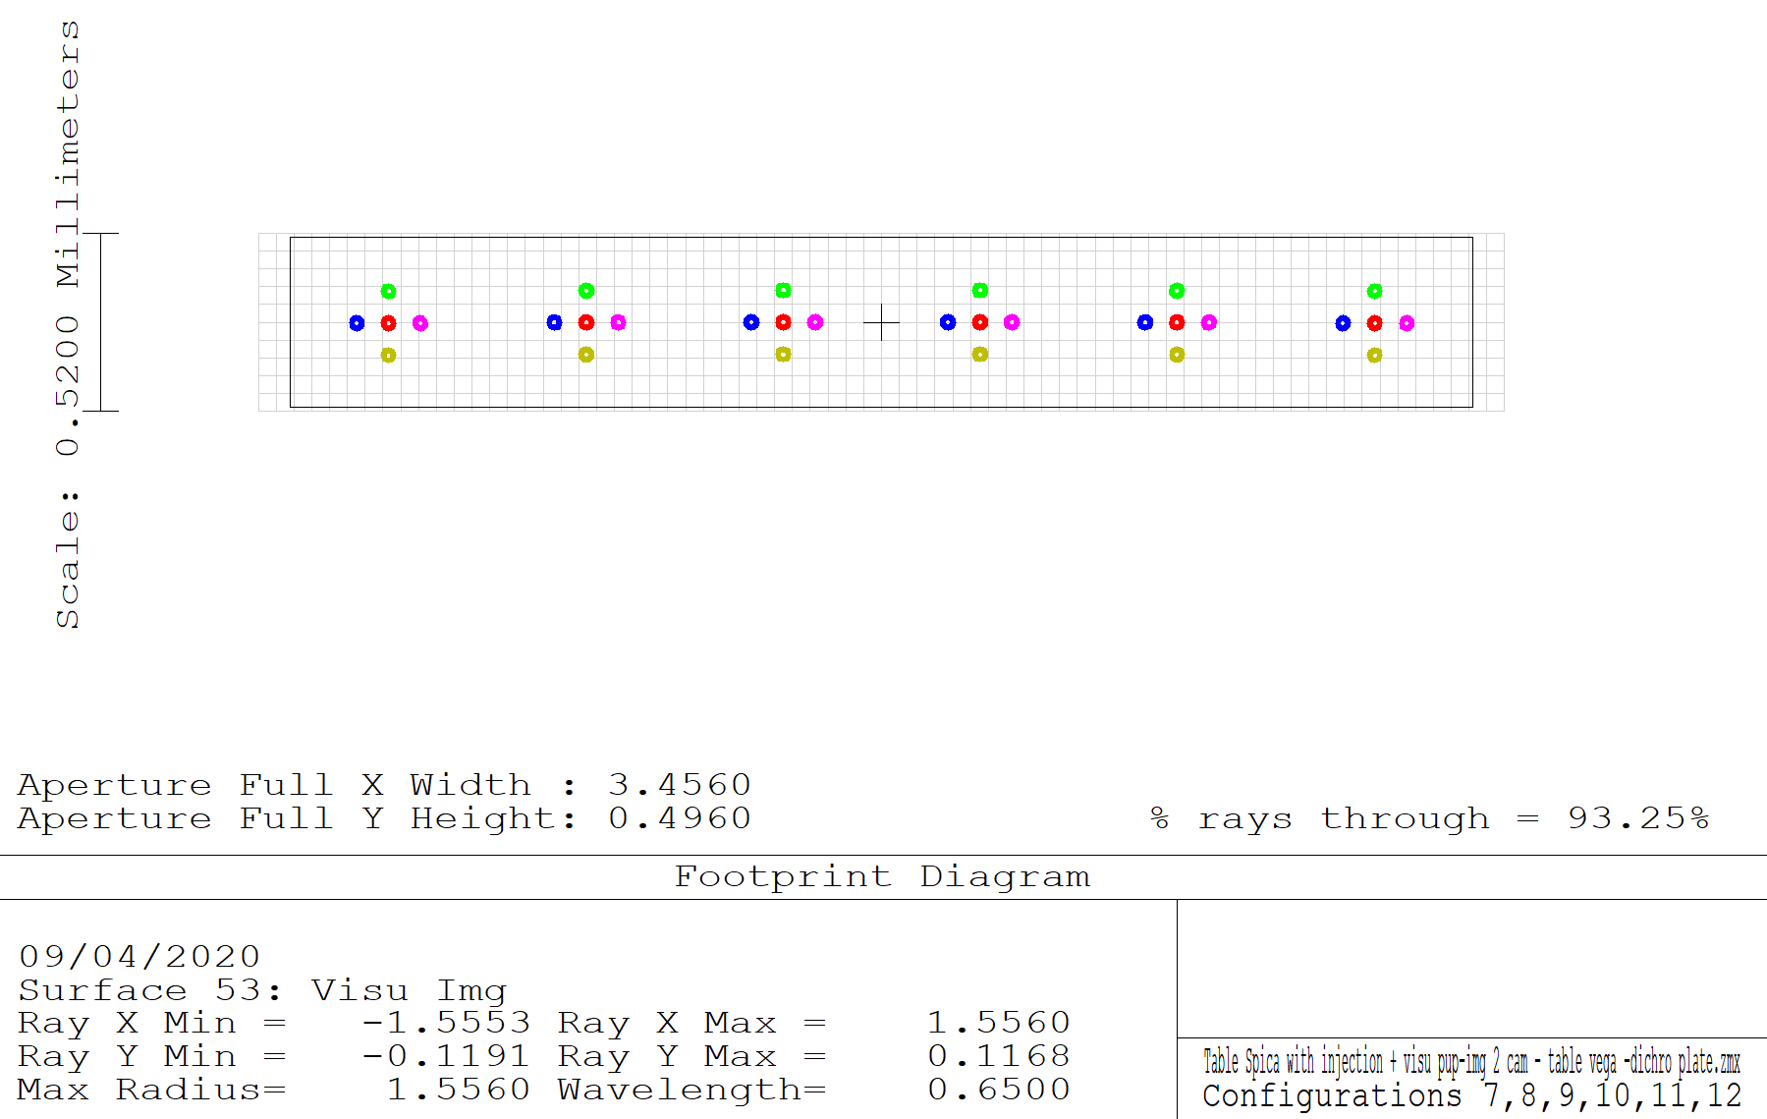
436 pix
Image/Pupil visualization system
50 pix
Image mode
Detector
6 separated images
(beams are tilted before large parabola)
Pupil mode
Detector
216 pix
Reapeatability: +/- 0,01 mm
Lateral lens movement enables adjustment of 6 pupils position on detector
36 pix
= 2’’
Removable lens
F300 lens

Slide 14
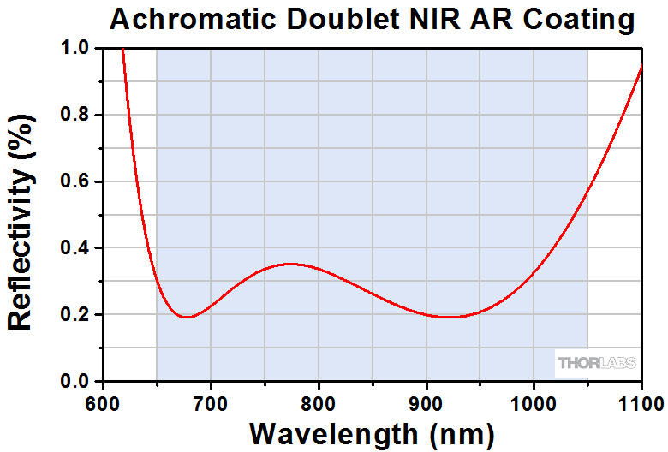
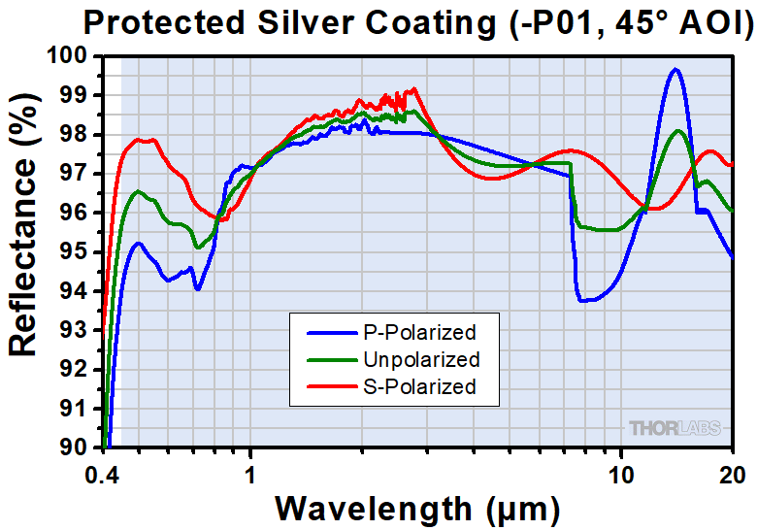
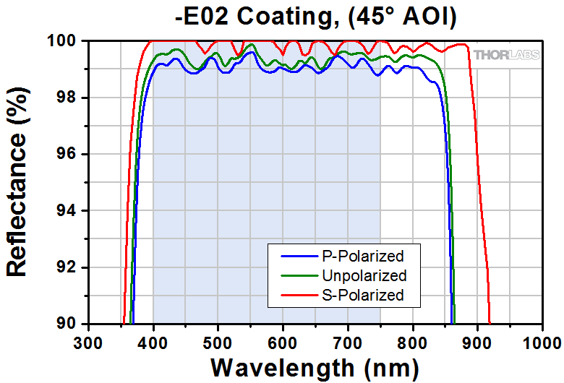
Coatings

Slide 15
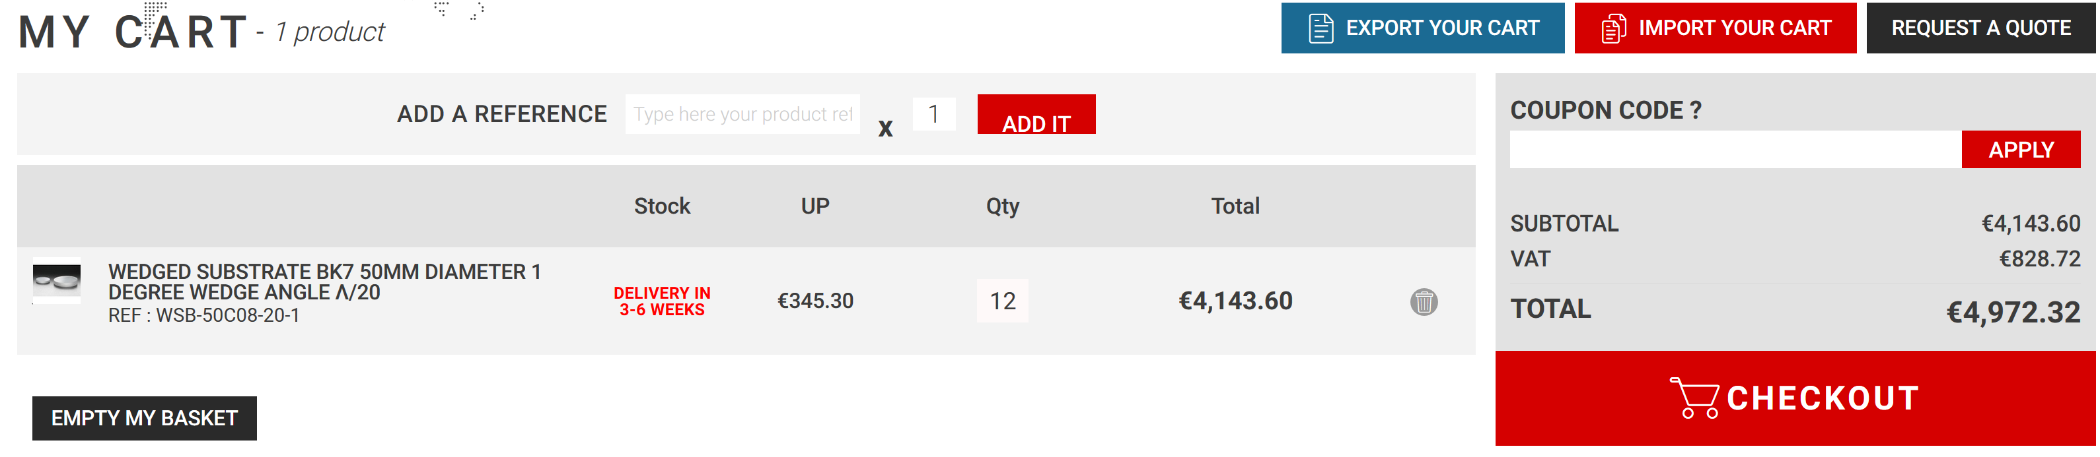
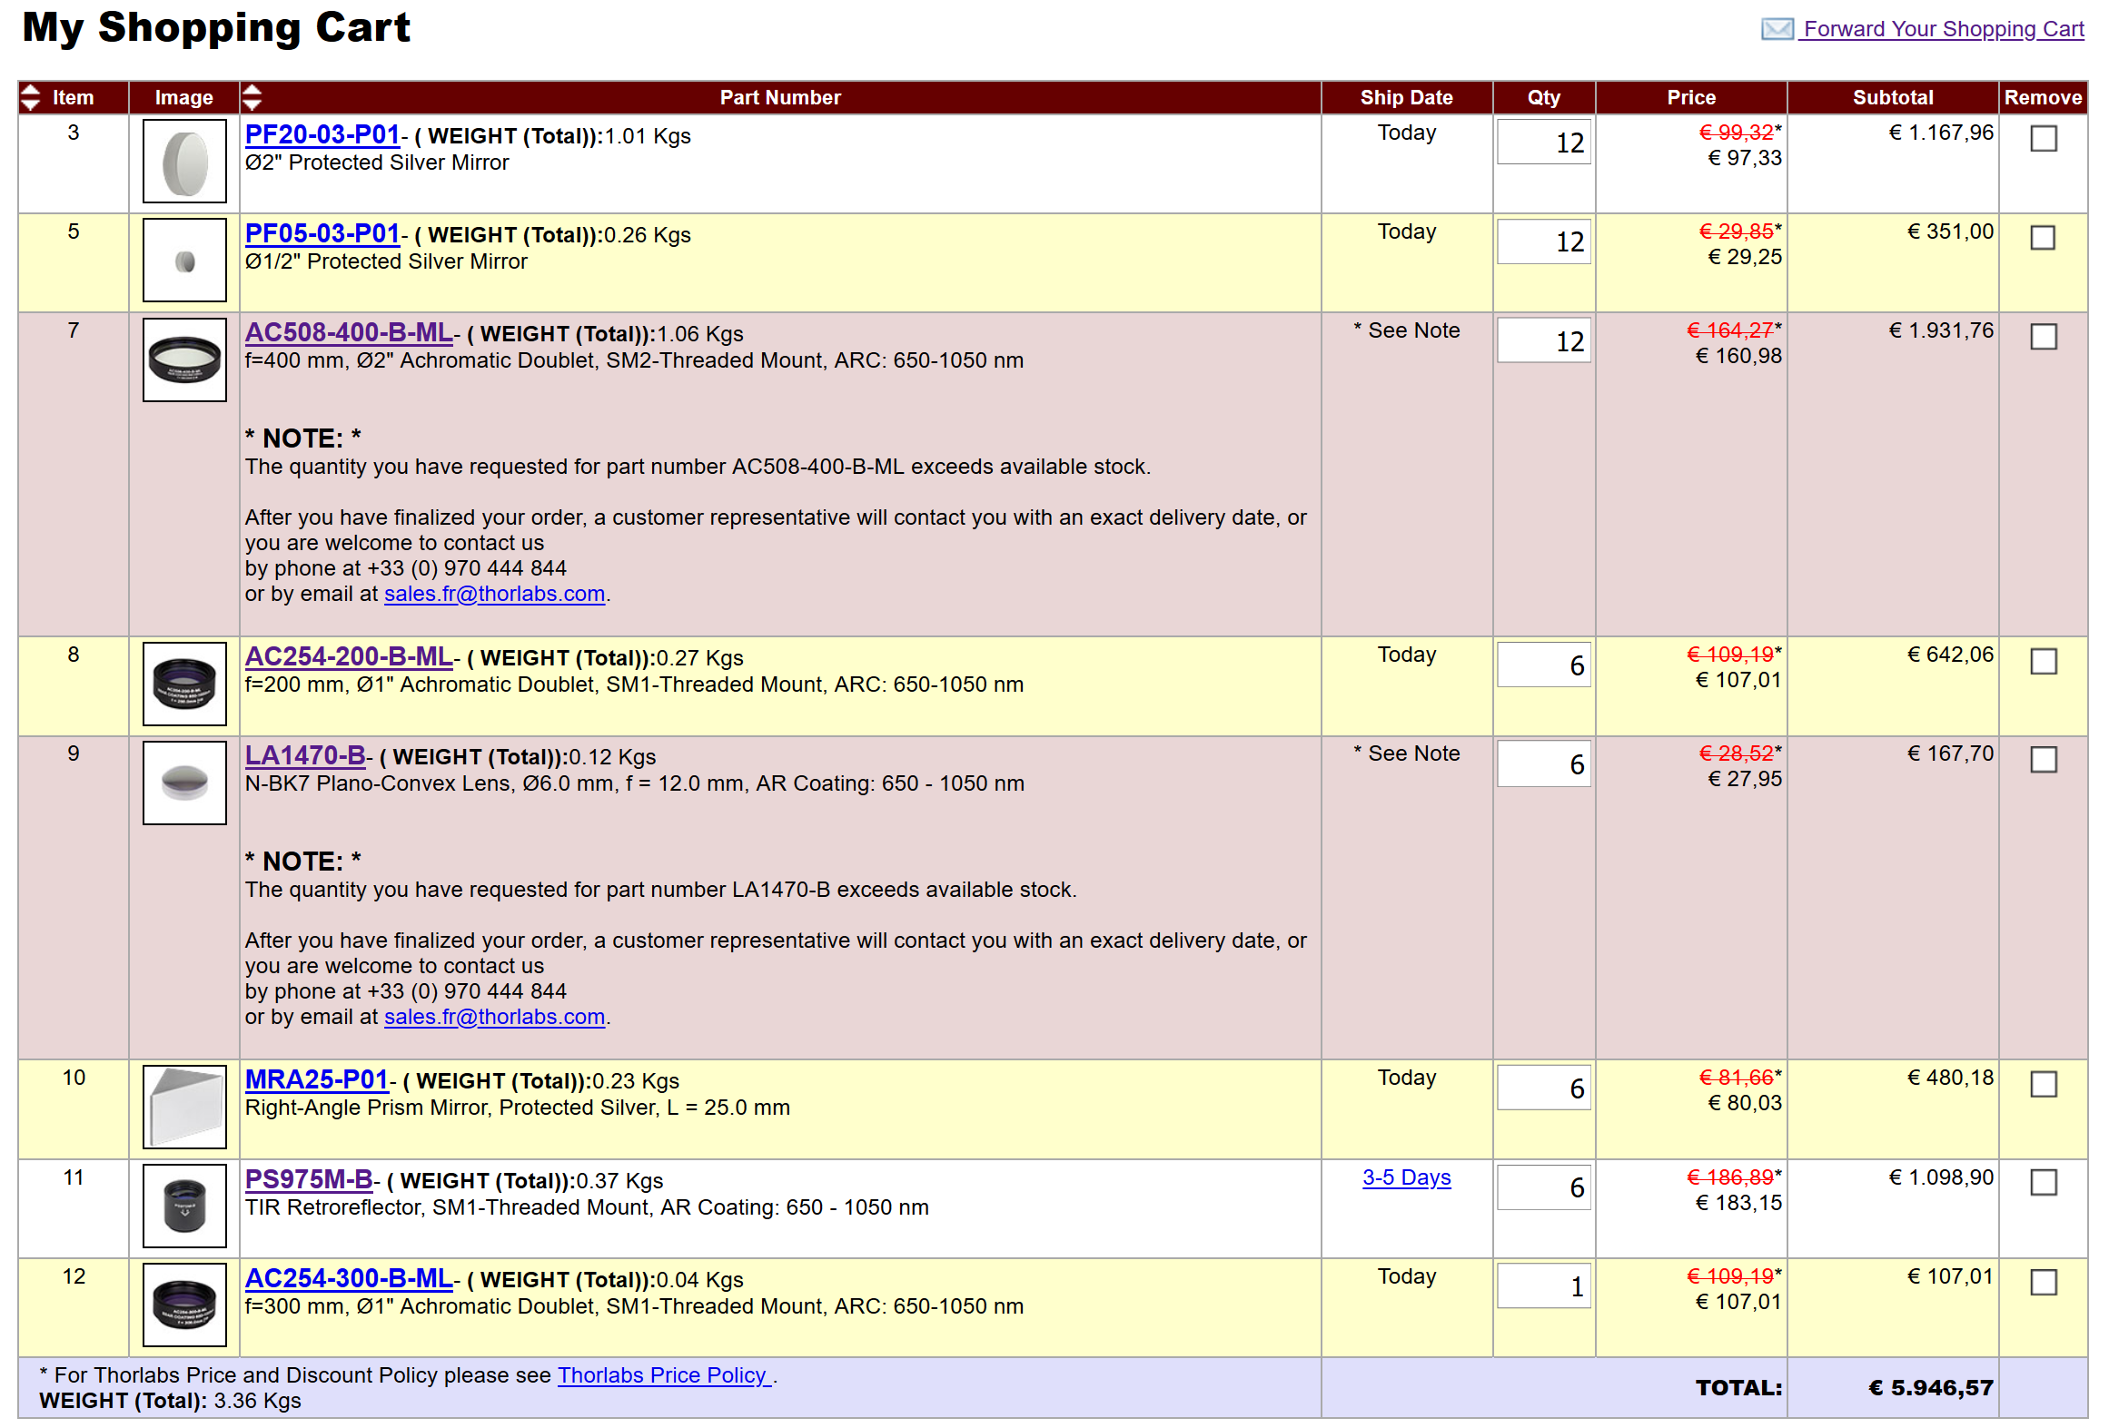
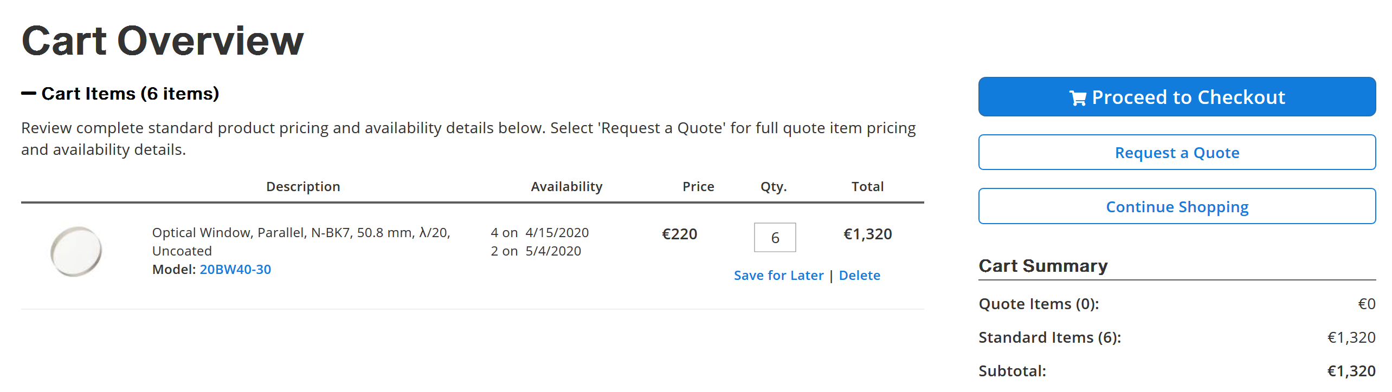

Shopping…

