Slide 1











VEGA
Recent results and ongoing programs
CHARA 2017: Year 13 Science Review – Adaptive Optics and Open Access
Anthony Meilland
and the VEGA team

Slide 2
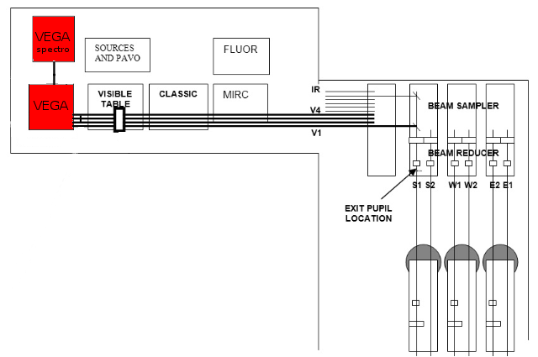
The VEGA instrument
4-beams visible combiner (3 in standard modes)
Self-Track, CLIMB, MIRC(4T), or self-track + CLIMB (4T)
Two cameras : Blue & Red
Three spectral resolutions:
  R3: R = 1700 ⬄ Δλ = 150nm
  R2: R = 5000 ⬄ Δλ = 45nm
  R1: R = 30000 ⬄ Δλ = 8nm
Tunable λ : 480-870nm
Two Standard modes :
  R2_656 : R@656nm & B@486nm
  R2_720 : R@720nm & B@580nm

Slide 3
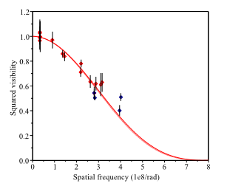
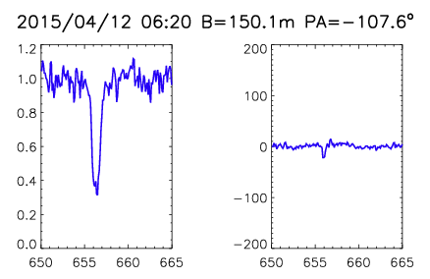
The VEGA instrument
Two types of data reduction
Auto-correlation |  | Intercorrelation
Calibrated measurement |  | Differential measurements
V² and Closure phase |  | v(λ) and φ(λ)
Need of calibrator |  | No need of calibrator
V²
v(λ)
φ(λ)
Continuum |  |  |  | Mostly Lines
Diameters |  |  |  | Environnement
Binaries |  |  |  | Differential-rotation
Flattened stars |  |  |  | Binaries in LR?

Slide 4
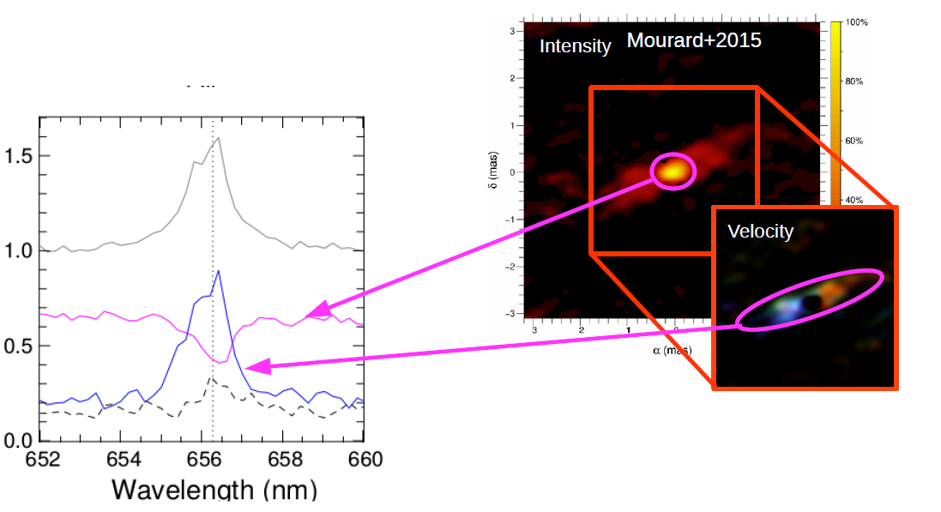
The VEGA instrument
Two types of data reduction
Auto-correlation |  | Intercorrelation
Calibrated measurement |  | Differential measurements
V² and Closure phase |  | v(λ) and φ(λ)
Need of calibrator |  | No need of calibrator
V²
v(λ)
φ(λ)
Integral field spectroscopy
With sub-mas spatial resolution
Continuum |  | Continuum + Lines |  | Mostly Lines
Diameters |  | Environnent |  | Environnement
Binaries |  | Photospheric lines |  | Differential-rotation
Flattened stars |  | Spectro-imaging |  | Binaries in LR?

Slide 5
VEGA Science Programs
55 Programs in a decade
Other
Pulsating Stars
Radiative Wind
Surface brightness
YSO
Exoplanets
Host Stars
B[e] Stars
Environments
Diameters
Be Stars
Asteroseismic
Fundamental parameters of stars
Stellar
surface
Giants
Rotation
Binarity
roAp
Metal Poor
Atmosphere
Hierachical
Systems
Interacting
Binary
Eclipsing Binary

Slide 6
VEGA Science Programs
35 Publications in refereed Journals
Other
Pulsating Stars
Radiative Wind
Surface brightness
YSO
Exoplanets
Host Stars
B[e] Stars
Environments
Diameters
Be Stars
Asteroseismic
Fundamental parameters of stars
Stellar
surface
Giants
Rotation
Binarity
roAp
Metal Poor
Atmosphere
Hierachical
Systems
Interacting
Binary
Eclipsing Binary

Slide 7
VEGA Science Programs
5 publications in 2016 and already 2 for 2017…
Nardetto+ 2016
Mendigutia+ 2017
Other
Pulsating Stars
Radiative Wind
Surface brightness
Ligi+ 2016
Perraut+ 2016
YSO
Exoplanets
Host Stars
B[e] Stars
Environments
Diameters
Be Stars
Asteroseismic
Fundamental parameters of stars
Stellar
surface
Giants
Rotation
Binarity
roAp
Metal Poor
Atmosphere
Hierachical
Systems
Challouf+ 2017
Interacting
Binary
Eclipsing Binary
Perraut+ 2016
Nemravova+ 2016

Slide 8
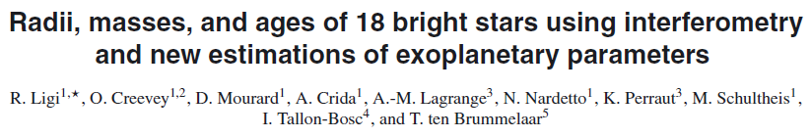
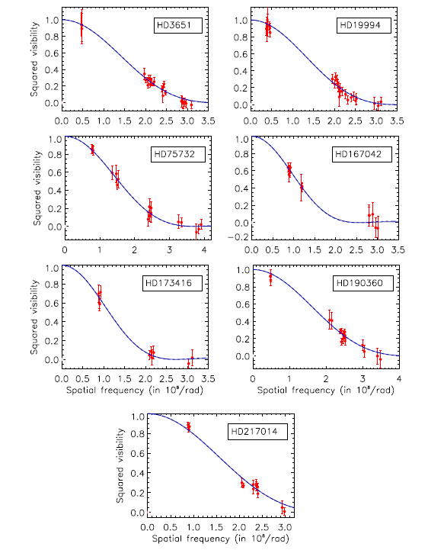
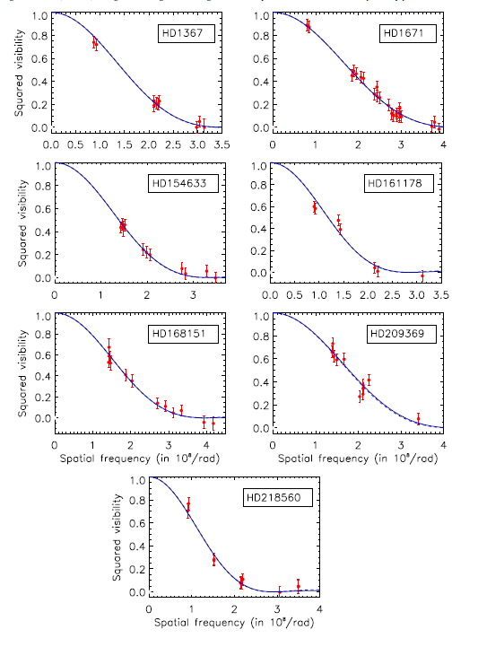
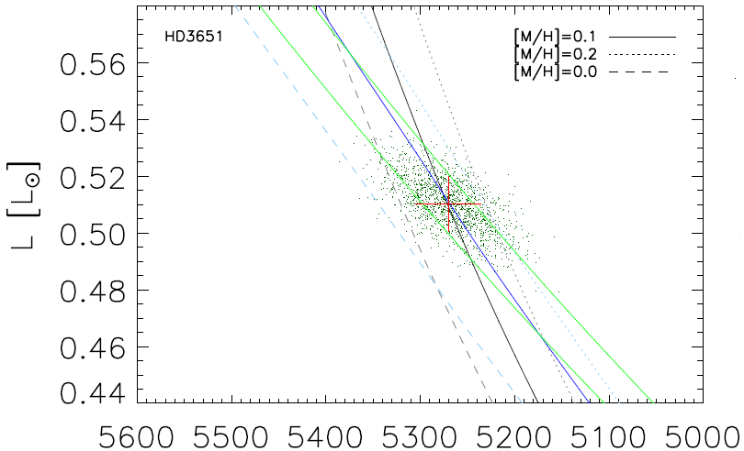
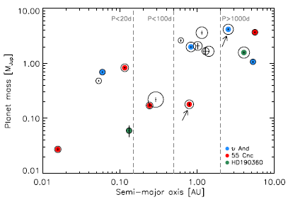
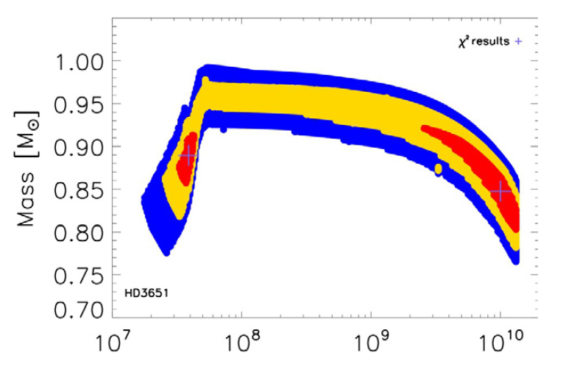
VEGA New publications
5 publications in 2016 and already 2 for 2017…
Other
Pulsating Stars
Radiative Wind
Surface brightness
YSO
Exoplanets
Host Stars
B[e] Stars
Environments
Diameters
Be Stars
Asteroseismic
Funmatental parameters of star
Stellar
surface
Giants
Rotation
Binarity
roAp
Metal Poor
Inpendant Angular diameters
Hierachical
Systems
Planet mass & distance
Atmosphere
Interacting
Binary
Eclipsing Binary
L, M , Teff and Age

Slide 9

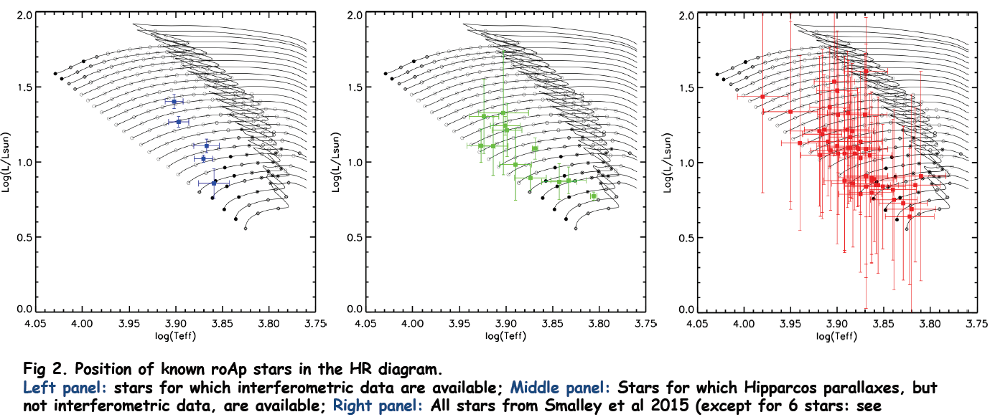
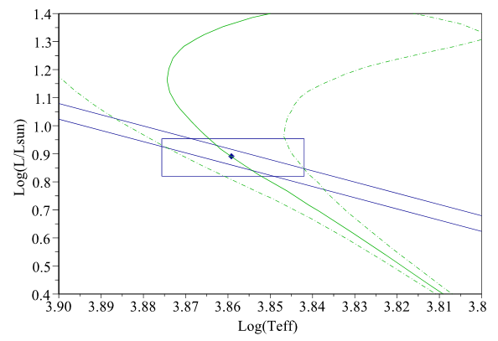
VEGA New publications
5 publications in 2016 and already 2 for 2017…
Other
Pulsating Stars
Radiative Wind
Surface brightness
YSO
Exoplanets
Host Stars
B[e] Stars
Environments
Hipparcos +
Diameters
Hipparcos
All stars
Interferometry
Be Stars
Asteroseismic
Funmatental parameters of star
Stellar
surface
Giants
Rotation
Binarity
roAp
Metal Poor
One more star in Karine Perraut VEGA mini survey to refine fundamental stellar parameters of these rapidly oscillating Ap stars
Atmosphere
Hierachical
Systems
Interacting
Binary
Eclipsing Binary

Slide 10
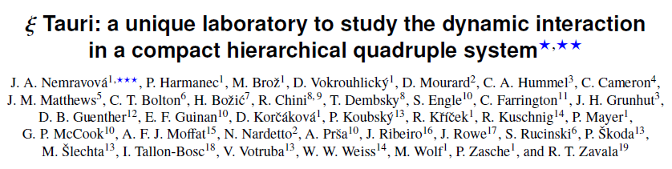
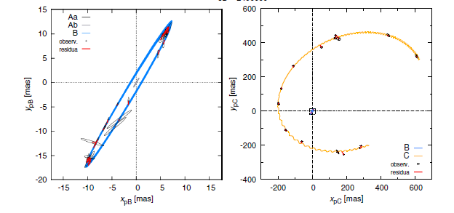
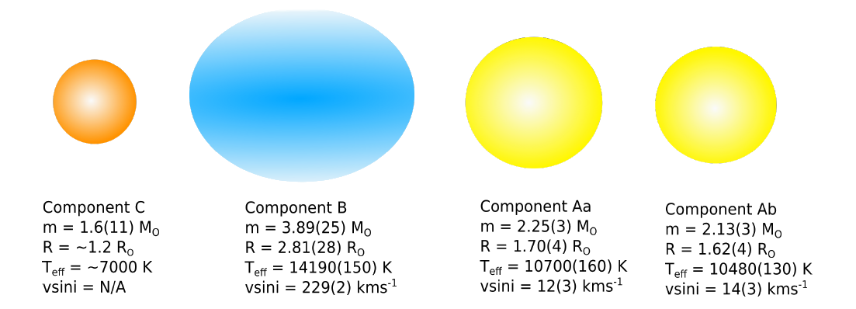
VEGA New publications
5 publications in 2016 and already 2 for 2017…
Other
Pulsating Stars
Radiative Wind
Surface brightness
Hierachical systems are amazing
Laboratories for stellar physics
Stellar parameters of the
4 components of the system
Multi-technique study
Photomety
Spectroscopy
Interferometry
Astrometry
YSO
Exoplanets
Host Stars
B[e] Stars
Environments
Diameters
Be Stars
Asteroseismic
Funmatental parameter of star
Stellar
surface
Giants
Rotation
Binarity
roAp
Metal Poor
Atmosphere
Hierachical
Systems
Interacting
Binary
Eclipsing Binary

Slide 11
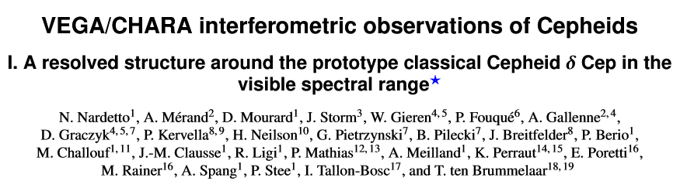
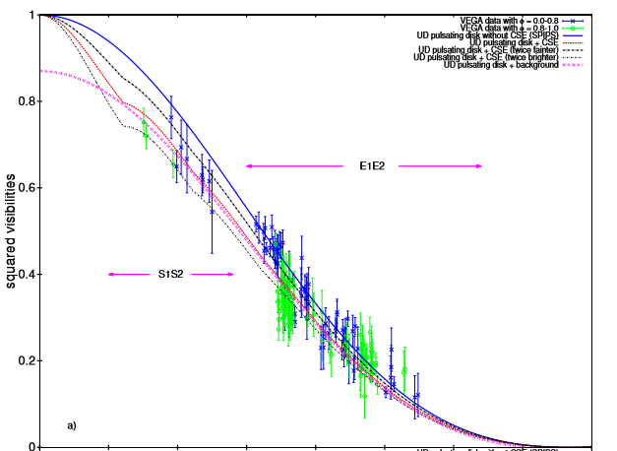
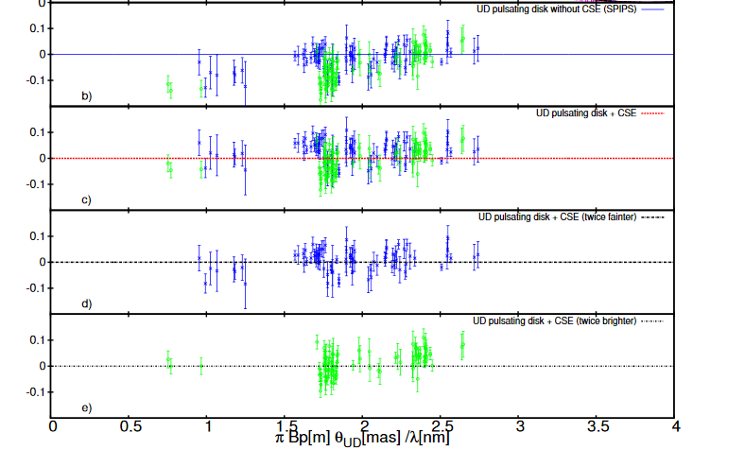
VEGA New publications
5 publications in 2016 and already 2 for 2017…
Other
Pulsating Stars
Radiative Wind
Overresolved component
Surface brightness
YSO
Exoplanets
Host Stars
B[e] Stars
Environments
Diameters
Be Stars
Asteroseismic
Funmatental parameters of star
Stellar
surface
Giants
Rotation
Binarity
roAp
Metal Poor
Atmosphere
Hierachical
Systems
Interacting
Binary
Eclipsing Binary

Slide 12
VEGA New publications
5 publications in 2016 and already 2 for 2017…
Other
Pulsating Stars
Radiative Wind
Overresolved component
Surface brightness
YSO
Exoplanets
Host Stars
B[e] Stars
Environments
Diameters
Be Stars
Asteroseismic
Funmatental parameters of star
Stellar
surface
Giants
Rotation
Binarity
roAp
Metal Poor
Atmosphere
Hierachical
Systems
Interacting
Binary
Eclipsing Binary

Slide 13
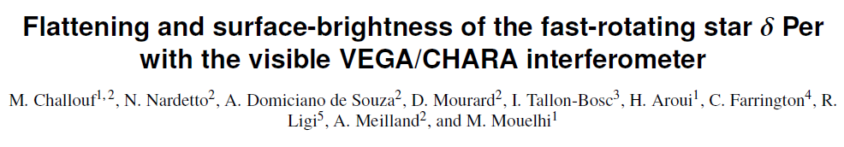
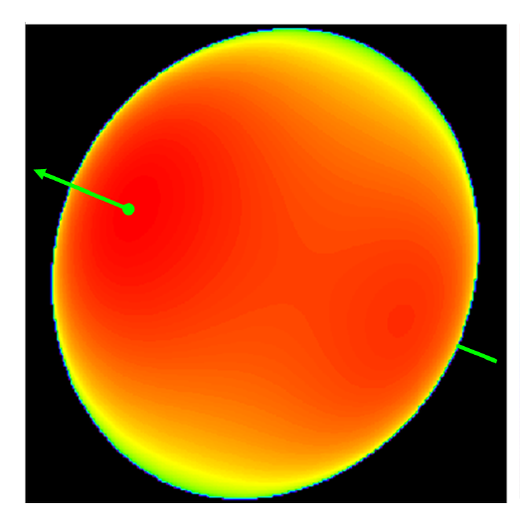
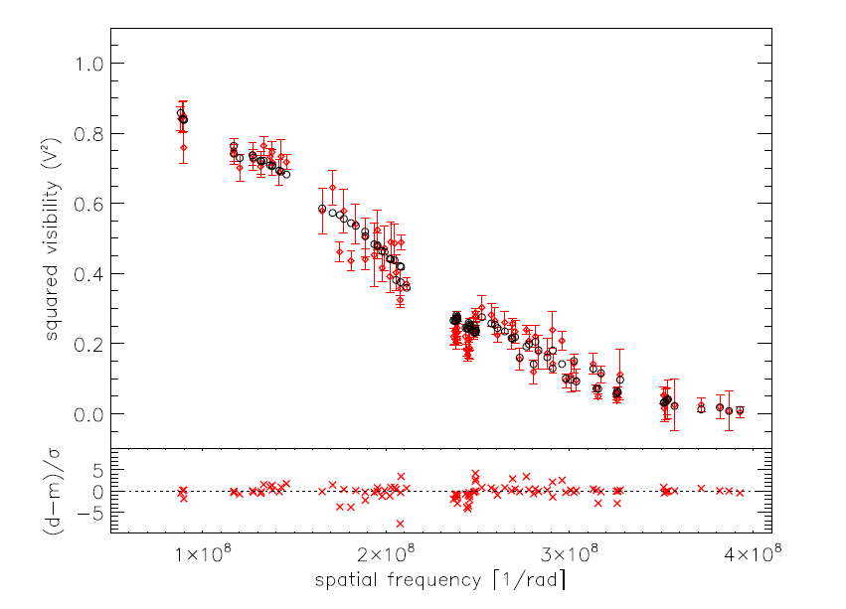
VEGA New publications
5 publications in 2016 and already 2 for 2017…
Other
Pulsating Stars
Radiative Wind
Surface brightness
YSO
Exoplanets
Host Stars
B[e] Stars
Environments
Diameters
Be Stars
Asteroseismic
Funmatental parameter of star
Stellar
surface
Giants
Rotation
Binarity
roAp
Metal Poor
Atmosphere
Hierachical
Systems
Interacting
Binary
Eclipsing Binary
θ=0.544±0.007mas
Flattening of 1.121±0.013
57% of Critical Velocity

Slide 14

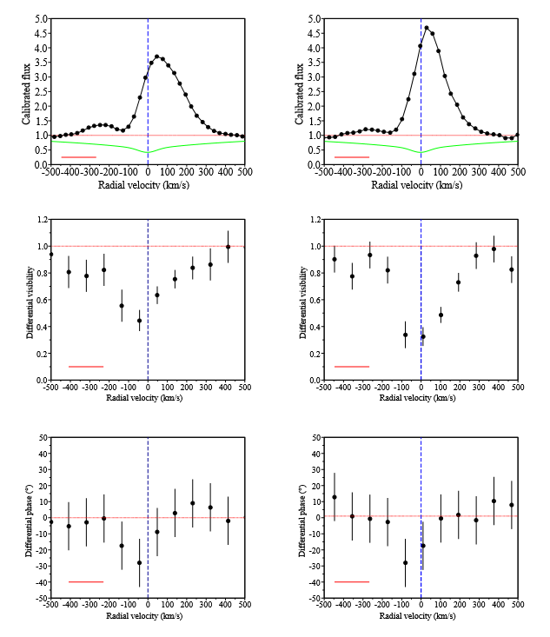
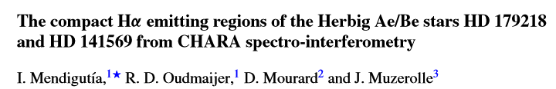
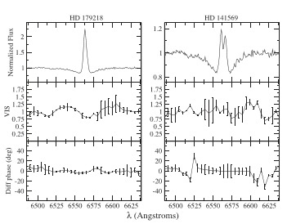
VEGA New publications
5 New publications in 2016 and already 2 for 2017…
VEGA and YSO
Other
Pulsating Stars
Radiative Wind
NOAO 2015
Surface brightness
YSO
Exoplanets
Host Stars
B[e] Stars
Environments
Diameters
Be Stars
Circumstellar
Environment in Hα
Geometry
Kinematics
Asteroseismic
Funmatental parameter of star
Stellar
surface
Giants
Rotation
Binarity
roAp
Metal Poor
Atmosphere
Hierachical
Systems
Interacting
Binary
Eclipsing Binary
Disk wind
Compact Keplerian disk ?

Slide 15
VEGA 2016 Observations
V52
Cepheids
Other
Pulsating Stars
Radiative Wind
Surface brightness
YSO
V01
Exoplanets
Host Stars
B[e] Stars
Environments
V66
Be Survey
Diameters
V43
Be Stars
Asteroseismic
V59
γ Cas 4T
Fundamental parameters of stars
V67
Stellar
surface
Giants
Rotation
Binarity
roAp
Metal Poor
V16
Atmosphere
Hierachical
Systems
V50
Interacting
Binary
Eclipsing Binary

Slide 16
VEGA 2016 Observations
RUN | PI-Run | Dates | Nights | Weather issues | Technical issues | Data | Number of measurements
REMOTE-1 | Denis | 25-29 May | 5 | 2 | 2 | 1 | 10
REMOTE-2 | Karine | 8-17 June | 10 | 1,5 | 0 | 8,5 | 30
Mount Wilson I | Philippe | 8-11 Jul | 4 | 0 | 0 | 4 | 4n FRIEND
REMOTE-3 | Nicolas | 23-31 Jul | 9 | 3 | 0 | 6 | 52
REMOTE-4 | Isabelle | 19-25 Aug | 7 | 0 | 0 | 7 | 79
Mount Wilson II | Denis | 20 Sep 1 Oct | 12 | 5 | 0 | 7 | 50 +3.5n FRIEND
REMOTE-5 | Denis | 19-23 Nov | 5 | 2,5 | 0 | 2,5 | 35
REMOTE-6 | Orlagh | 10-13 Dec | 4 | 1,5 | 0 | 2,5 | 19
Total |  |  | 56 | 15,5 | 2 | 38,5 | 275 +7.5n FRIEND
68% of good nights
 | 2013 | 2014 | 2015 | 2016
# of Nights | 59 | 48 | 62 | 56
# of Bad Nights | 17 | 13 | 16 | 17,5
# of measurements | 272 | 286 | 304+F | 275 +F

Slide 17
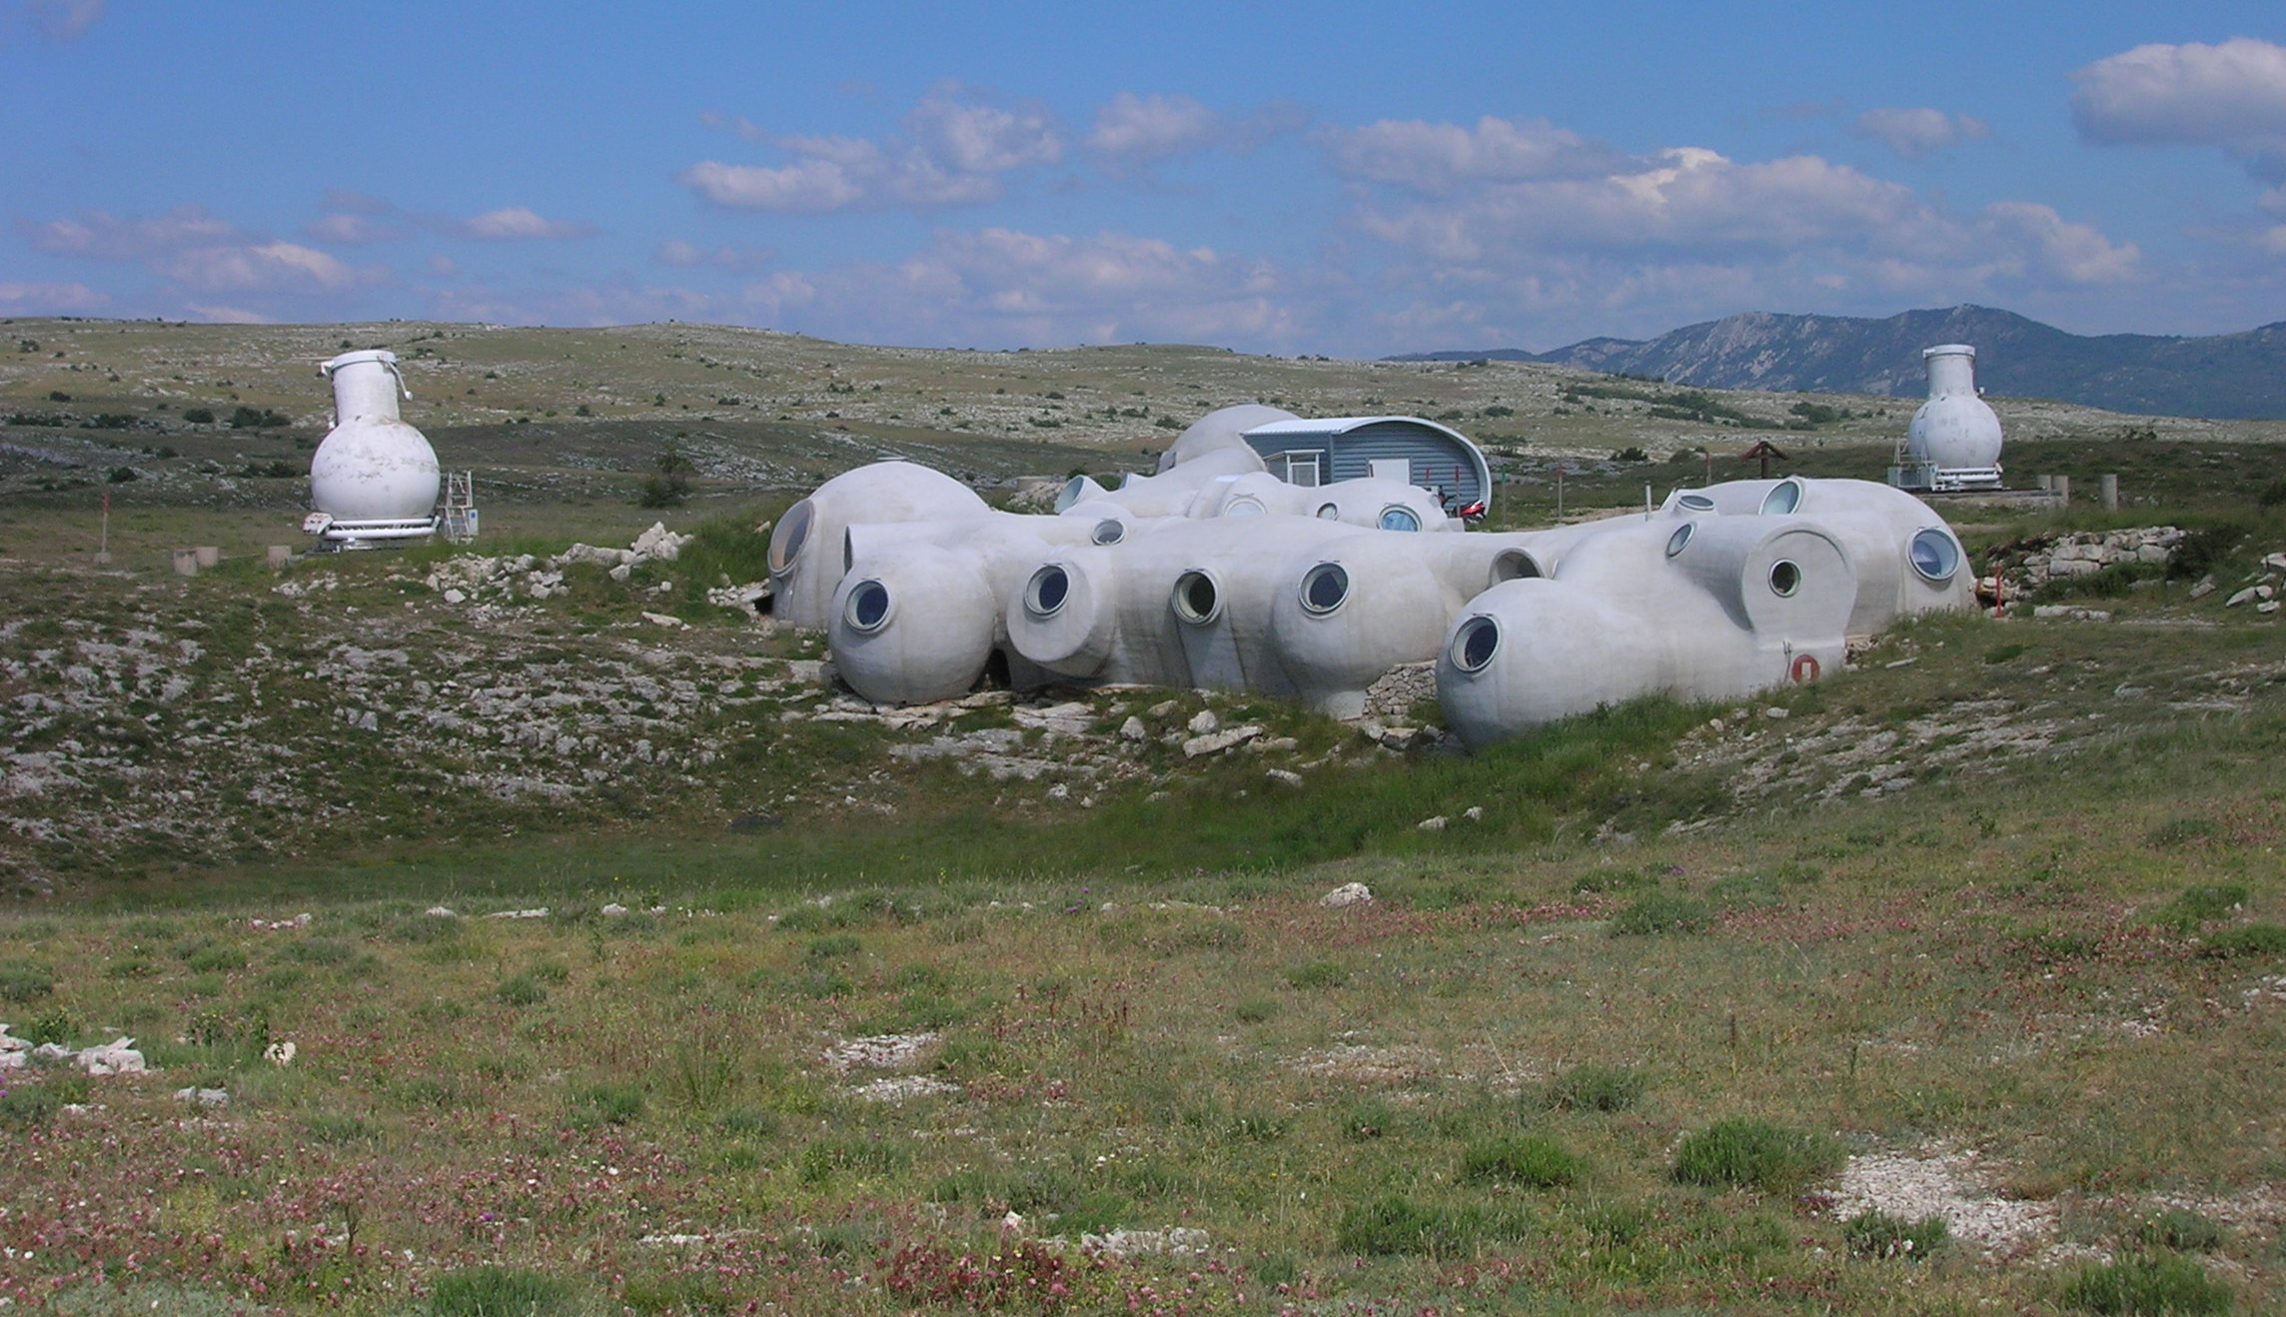
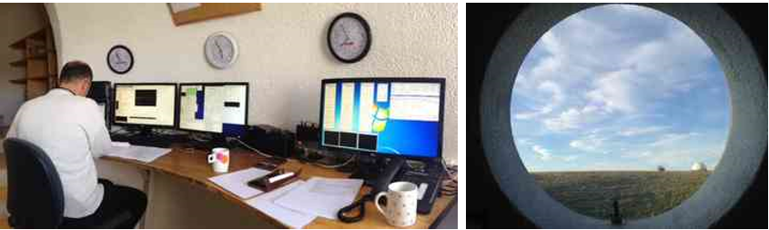
VEGA 2016 Observations
New CHARA/VEGA Control Room
in the GI2T building
Fred Morand observing almost all remote nights in Calern

Slide 18
VEGA technical news
New control room in the Old “GI2T” is now fully functional !
New alignment procedure : M10 & Tiptilt => Periscope & M6
  Fully operational now : More reactive & less « dangerous »
Upgrade in the 4T mode with CLIMB 3T + VEGA 2T tracking
Tests on γ Cas show that new procedure is more robust
New tests on the low resolution mode (R=1700) using CLIMB as tracker
    Data taken last week. To be reduced soon
Beginning of simplification of VEGA control software for integrated operation
  Still work to do until training session in Fall 2017…
  ...but our computer Guru Jean-Michel is working on it
Quite a hard time with the upgrade to xUbuntu (Poor Jean-Michel)

Slide 19
VEGA 2017A Programs
5 Runs : March, April, Mai, June, and July
V52
Cepheids
NOAO
Borges Fernandes
Other
Pulsating Stars
Radiative Wind
NOAO
Jamialahmadi
Surface brightness
YSO
NOAO
Ligi
V68
HD62623
Exoplanets
Host Stars
B[e] Stars
Environments
Diameters
V43
Be Stars
Asteroseismic
V66
Be Survey
V69
κ Dra
Fundamental parameters of stars
Stellar
surface
Giants
V67
Rotation
Binarity
roAp
NOAO
Albrecht
Metal Poor
V16
Atmosphere
Hierachical
Systems
V50
V65
Interacting
Binary
Eclipsing Binary

Slide 20
VEGA 2017A Programs
5 Runs : March, April, Mai, June, and July
V52
Cepheids
NOAO
Borges Fernandes
Other
Pulsating Stars
Radiative Wind
NOAO
Jamialahmadi
Surface brightness
YSO
NOAO
Ligi
V68
HD62623
Exoplanets
Host Stars
B[e] Stars
Environments
Diameters
V43
Be Stars
Asteroseismic
V66
Be Survey
V69
κ Dra
Fundamental parameters of stars
Stellar
surface
Giants
V67
Rotation
Binarity
roAp
NOAO
Albrecht
Metal Poor
V16
Atmosphere
Hierachical
Systems
V50
V65
Interacting
Binary
Eclipsing Binary
Promising start
Almost Finished

Slide 21
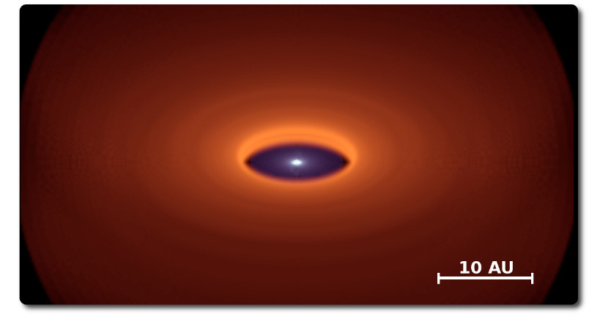
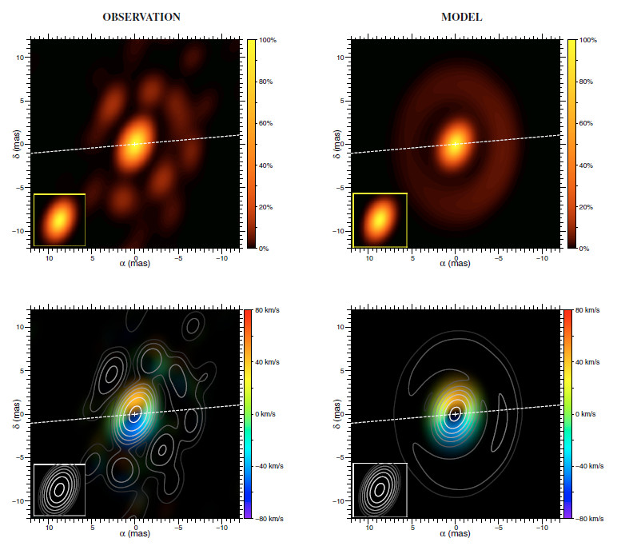
Some highlights on…
The A[e] supergiant HD62623
by Meilland & Millour
Supergiant : A4Iab (about 65Ro)
In fast rotation : vsini=68km/s (about 50% Vc)
Show the B[e] phenomenon : Strong IR exces (dust) + permited lines + forbidden lines
Binary system strongly suspected (Plets+ 1995)
VLTI/MIDI
MC3D + SIMECA
Keplerian disk model
VLTI/AMBER
Spectrally resolved images in Brγ
Meilland+ 2010
Millour+ 2011

Slide 22
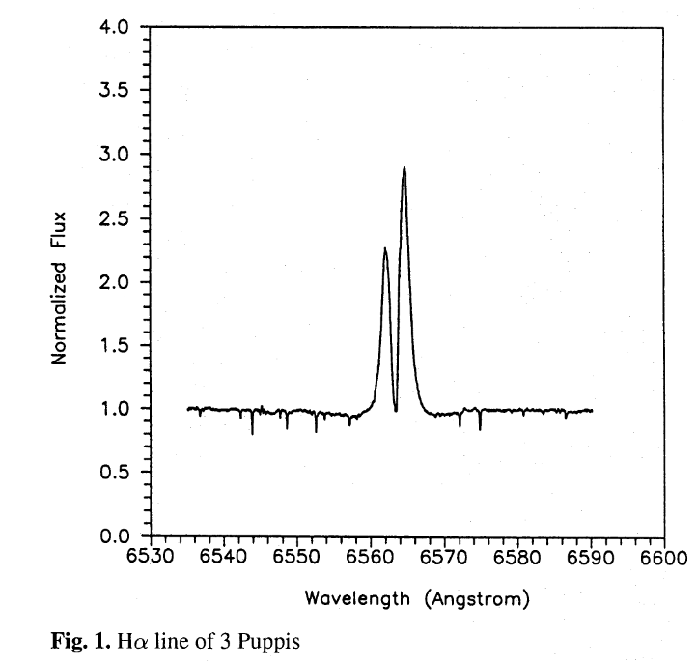
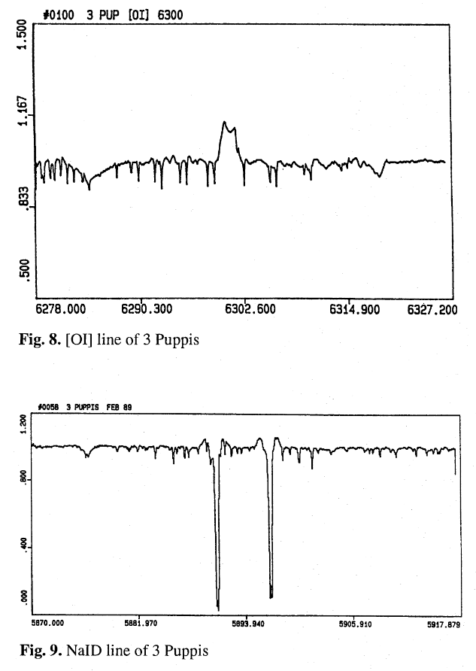
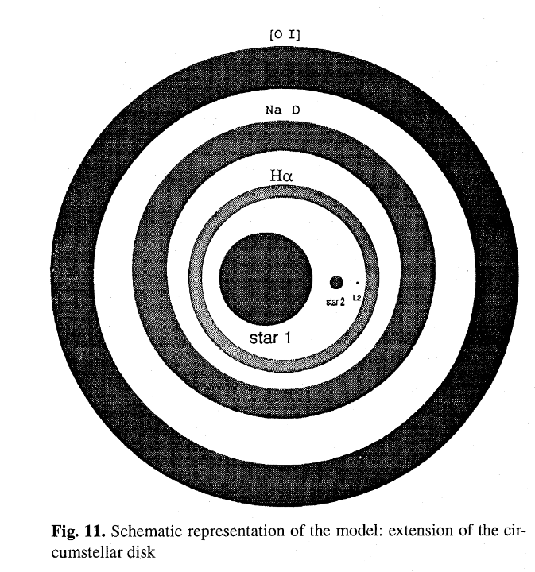
Some highlights on…
The A[e] supergiant HD62623
by Meilland & Millour
CHARA/VEGA program
Hα
[OI]
Diameter in continuum (D=0.8mas)
Possible flattening in continuum
Rotation law in gaseous disk :
  (Hα, Na, [OI] +Brγ from AMBER)
D₂ V₂
Na
D V 
D₁ V₁
D₃ V₃
From Plets+ 1995
Bright target
  for VEGA ⬄mR=3.8
  For CLIMB ⬄ mK=2.3
But it very very south (δ=-29) ⬄ max Alt=27°

Slide 23

Thanks!
VEGA@CHARA 10 Year Anniversary
2007-2017
These years have been a great adventure for us
We have add a wonderful series of papers together
We are still enthusiastic about this relationship
We want to take it further with FRIEND and SPICA
We hope you feel the same…
That sounds like a happy wedding!
...more things about our present and future together in Denis & Marc-Antoine talks

