Slide 1
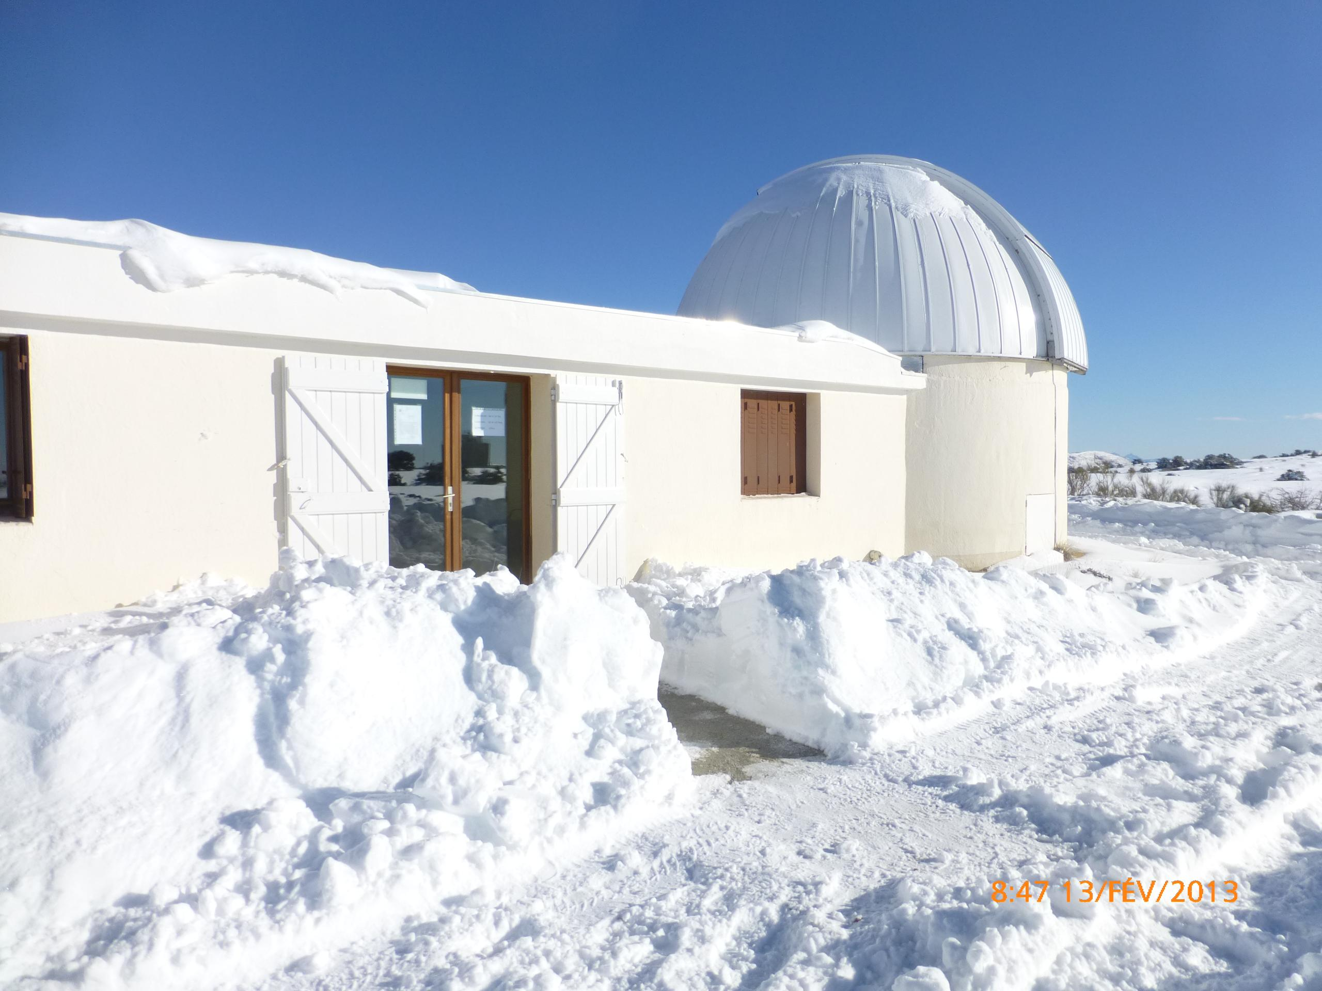


C2PU IN A NUT SHELL
Version 03, 05/02/2017
Jean-Pierre Rivet
CNRS, OCA,
Dept. Lagrange
jean-pierre.rivet@oca.eu
© C2PU, Observatoire de la Cote d’Azur,
Université de Nice Sophia-Antipolis
Notes:
Conférence présentée à PARSEC, le 1er octobre 2005.

Slide 2
What is C2PU ?
Centre Pédagogique Planète et Univers
(Center for Pedagogy in Earth and Universe Sciences)
http://c2pu.oca.eu
A facility for research and teatching in Astronomy
Belongs to the Observatoire de la Cote d’Azur (OCA)
Supported by:
  UNS (Université de Nice Sophia Antipolis)
  Region Council PACA (Provence, Alpes, Cote d’Azur)
  Department Council (06, Alpes Maritimes)
  Private donations (Scardia, Gili)

Slide 3
What is OCA ?
Observatoire de la Côte d’ Azur
www.oca.eu
A research center in Astronomy, Geophysics, and related sciences (Physics, Mathematics, Signal Processing, computational sciences, ...).
450 persons, spread over 4 locations, all in the “Alpes Maritimes” county (extreme south-East France):
  Mont Gros, Nice
  University Campus “Valrose”, Nice
  Geophysics laboratory, Sophia-Antipolis
  Plateau de Calern
3 research laboratories (Lagrange, Artemis and Geoazur)
1 technical service (Galilee)

Slide 4
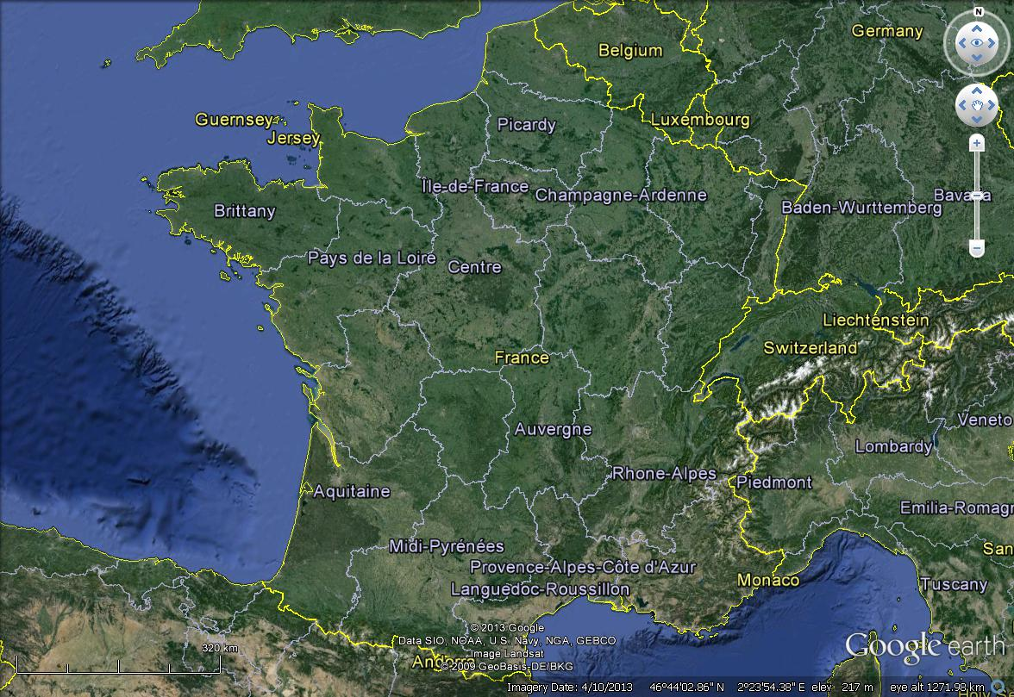
Where is OCA ?
Alpes Maritimes (06)

Slide 5
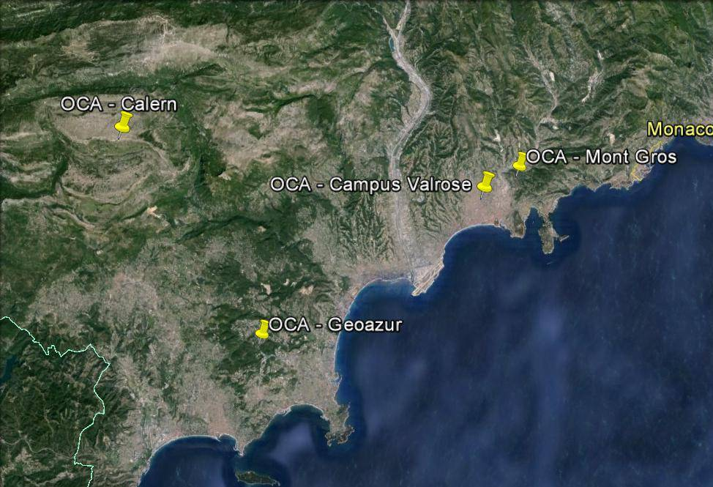
Where is OCA ?
Alpes Maritimes (06)
You are Here !
Nice
Grasse
Cannes

Slide 6
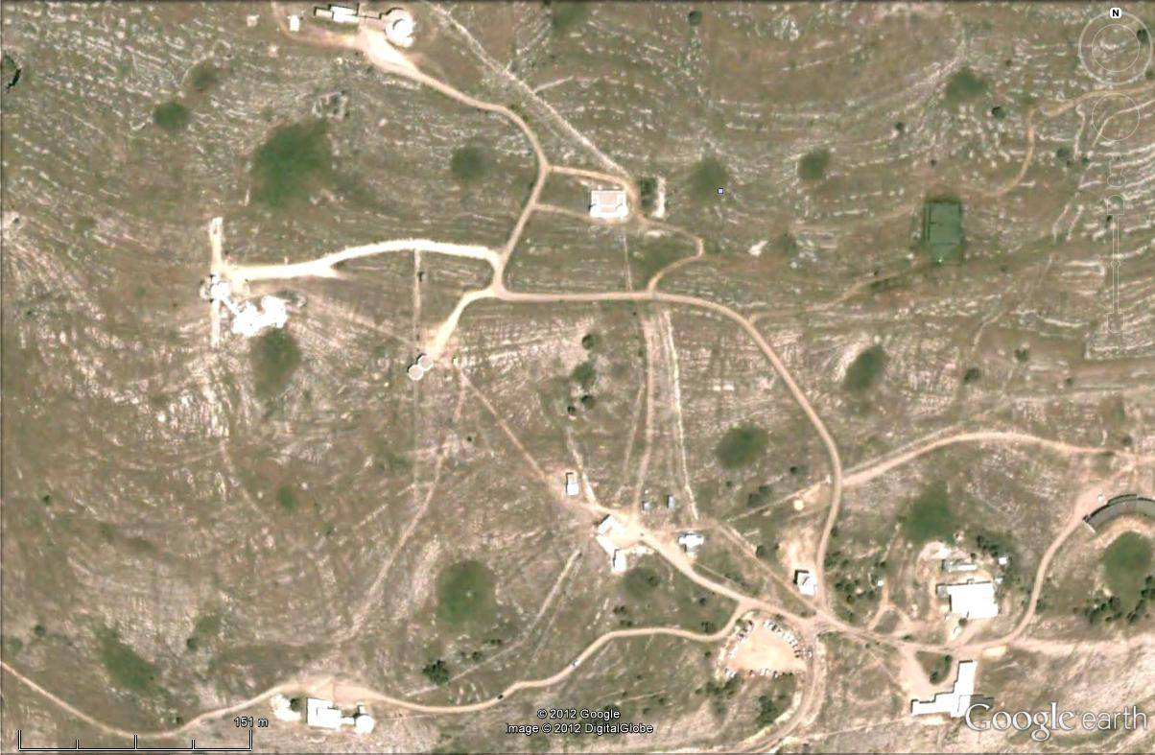
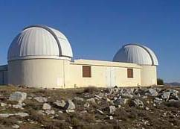
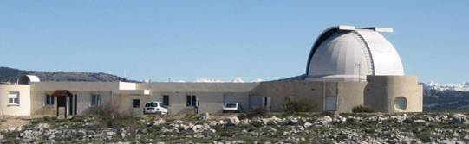
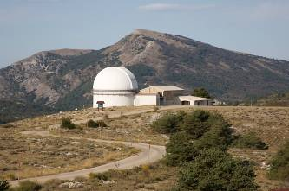
Where is C2PU ?
C2PU
Laser ranging
facility
Semirot builging.
Conf. room,
accommodation
Schmidt
telescope
Gate
Hotel.

Slide 7
Safety issues
General rules
  Take a moment to read carefully the “Safety rules booklet” and
  the “welcome booklet” given by the local staff to your supervisors.
  Make sure you have perfectly understood all issues.
  In case of doubt, please refer to a local staff member.
  You must strictly respect all these rules.
Specific rules
  At some periods of the year, you may encounter flocks of sheep
  with specific shepherd dogs (called “patous” dogs), specially trained to
  fight with bears and wolves. NEVER TRY TO TOUCH THESE DOGS:
  THEY ARE NOT PETS ! Keep clear from the flock they are guarding.
  If one of them is barking after you, make several steps backward,
  until it stops barking, while keeping the dog in sight. Do not panic,
  do not try to get closer.

Slide 8
For more informations
https://c2pu.oca.eu/

