Slide 1
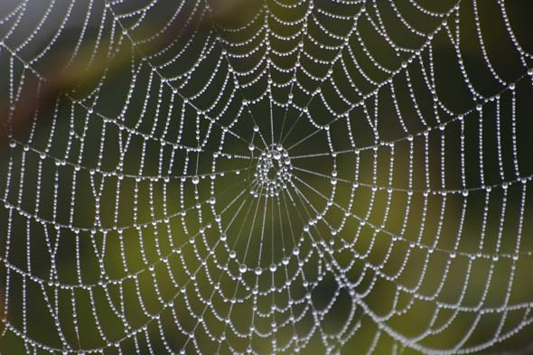


WEB SERVICES
FOR SOLAR SYSTEM
Version 01, 10/11/2017
© C2PU-Team, Observatoire de la Cote d’Azur

Slide 2
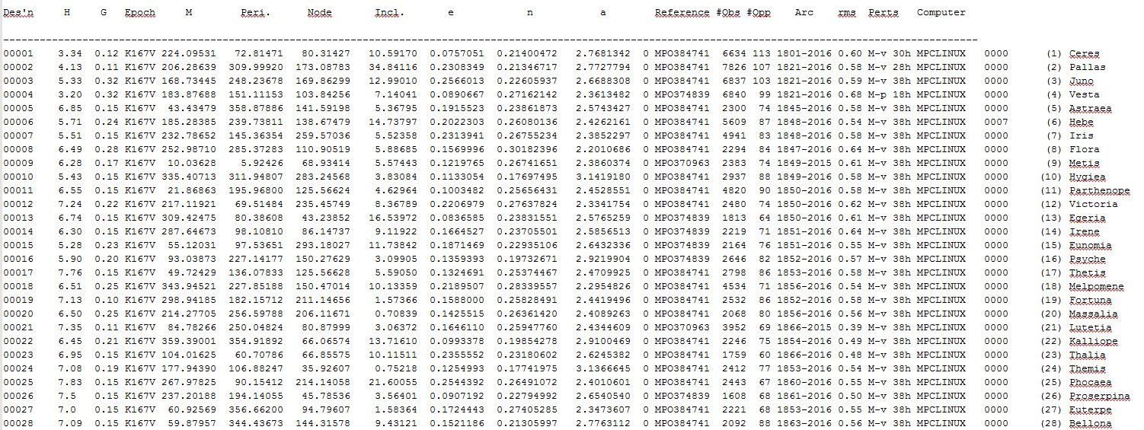
The “MPCorb” database
http://www.minorplanetcenter.org/iau/MPCORB/MPCORB.DAT

Slide 3

The “Miriade” WEB service
Want to know the coordinates of your asteroid/comet/planet/satellite at a given epoch ?
Want to know the observability of your asteroid/comet/planet/satellite from your observatory ?
“Miriade”: A Solar System Objects WEB service:
http://vo.imcce.fr/webservices/miriade/?forms
A super-production by:
Institut de Mécanique Céleste et de Calcul des Ephémérides (IMCCE)
Formerly: « Bureau des Longitudes » (1795)

Slide 4
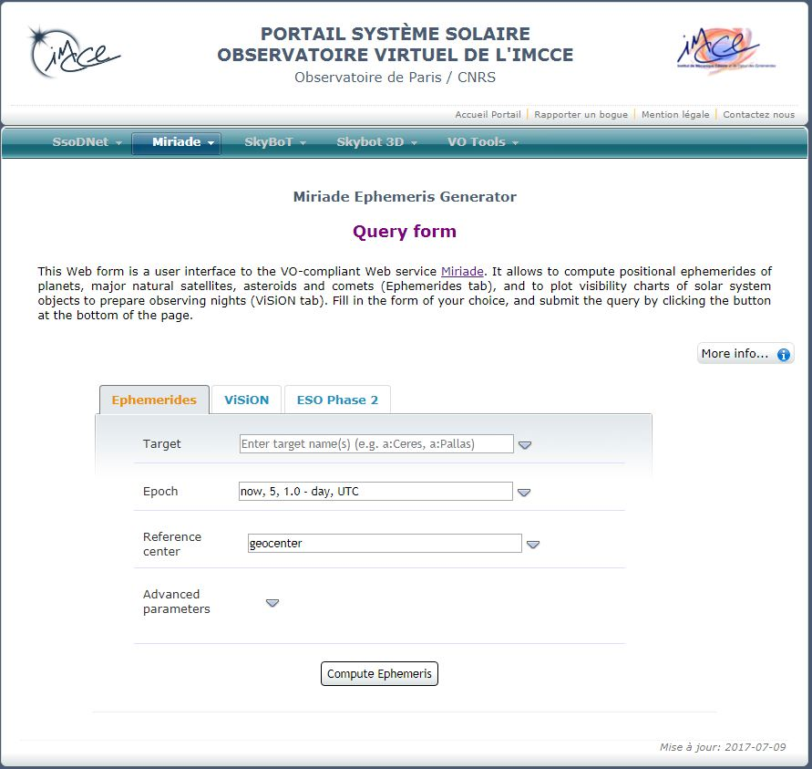
The “Miriade” WEB service
The portal page.
Ephemeris retrieval tab
Visibility assessment tab

Slide 5
Ephemeris Query Form
The query form.
Form expansion button
Target specification zone
Time specification zone
Observer specification zone
“GO” button

Slide 6
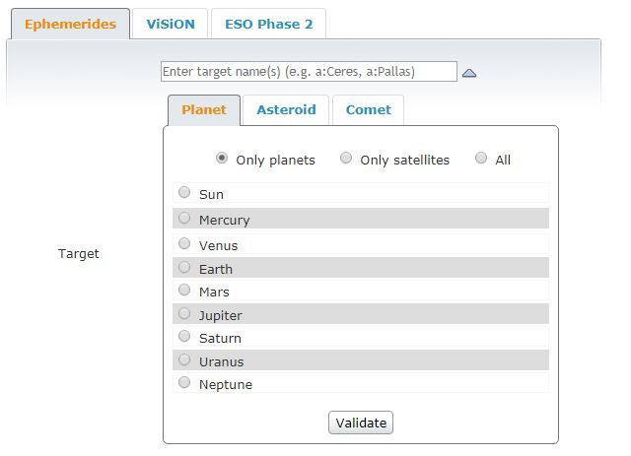
Target specification
The target
specification form.
Target type tabs
Don’t forget to validate your choices !

Slide 7
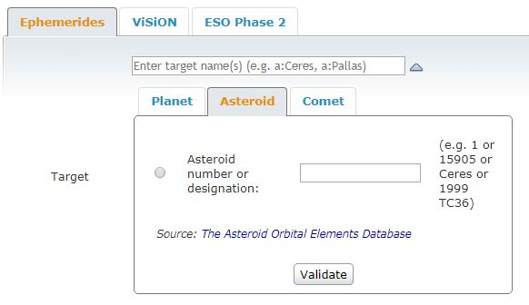
Target specification
The asteroid
specification form.
Target name. Valid formats:
2012 DA14 (provisional designation)
Hesperia (literal name)
69 (number)
(69)Hesperia (both)
Don’t forget to validate your choices !

Slide 8
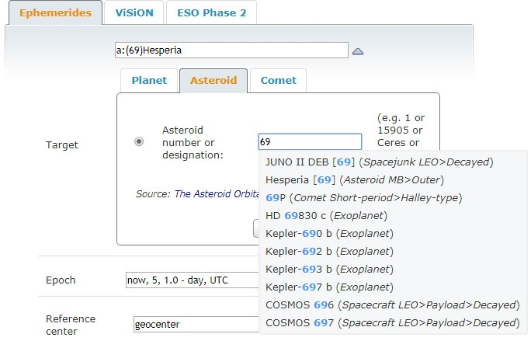
Target specification
Disambiguation form.
In case of doubt,
select the target you really want.

Slide 9
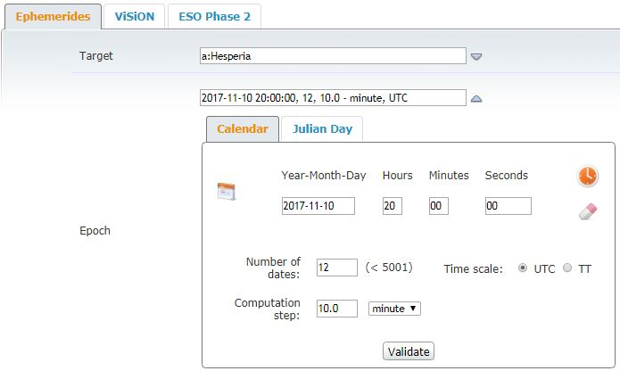
Time specification
The time
specification form.
Date picker widget
Initial date-time
Time picker widget
Reset button
Number of dates
Time span between dates
Don’t forget to validate your choices !

Slide 10
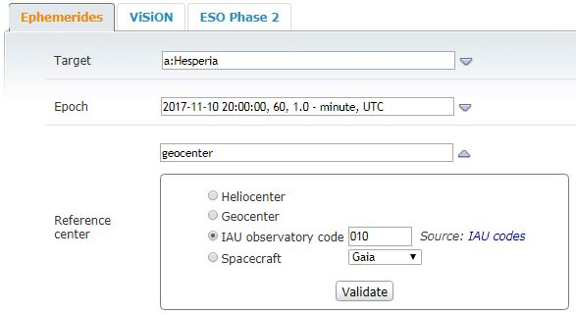
Observer specification
The observer
specification form.
Observer at Sun’s center
Observer at Earth’s center
Observer in an observatory
Observer on a spacecraft
Don’t forget to validate your choices !
NOTE:
The IAU (International Astronomical Union) has attributed a three-character tag
called “IAU code” to all (most) observatories. Example: Calern observatory: “010”

Slide 11
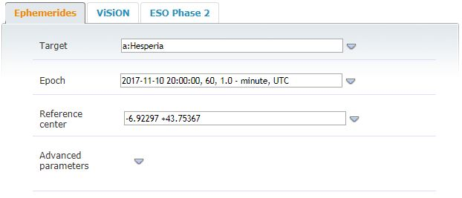
Observer specification
The observer
specification form.
Observer’s coordinates
FORMAT:
-6.92297 +43.75367
Latitude in centesimal degrees
(+ North, - South)
Longitude in centesimal degrees
(+ West, - East)

Slide 12
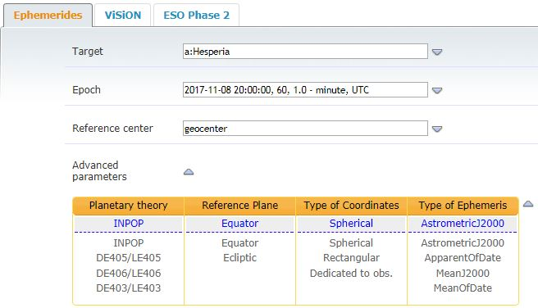
Hairy details...
Advanced parameters
Solver algorithm (do not change)
Equatorial or ecliptic coordinates
Spherical or rectangular coordinates
Type of coordinates
Usually, no need to tweak those parameters...

Slide 13
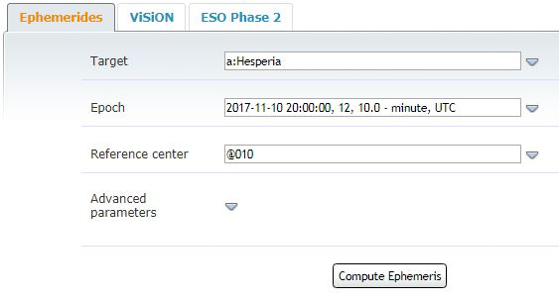
Launch the computation
Advanced parameters
Double-check all this
Click on this button to get your data

Slide 14
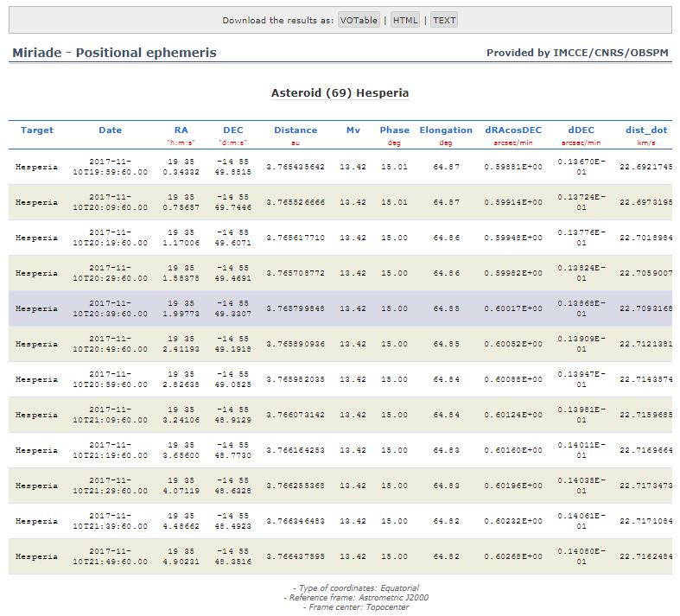
Results

Slide 15
Results
Click here to download the
results as a text file.
Ephemeris table

Slide 16
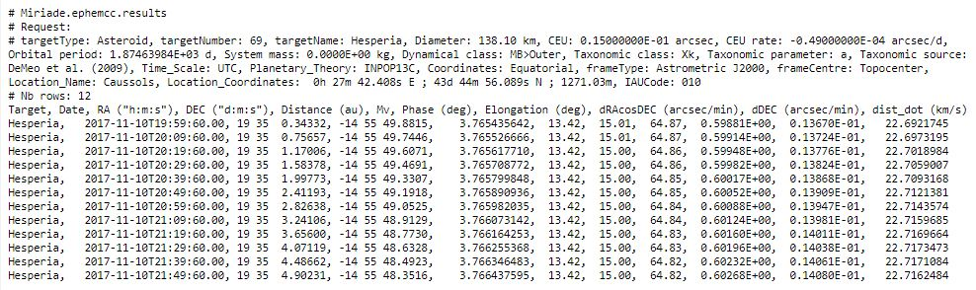
The results
C2
Right ascension
Declination
h
m
s
°
’
’’

Slide 17
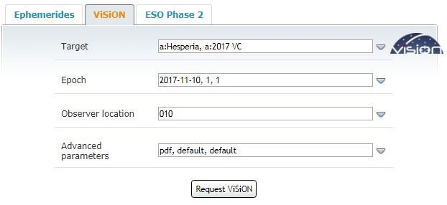
Observability Query Form
The query form.
List of targets (coma-separated)
Time specification zone
Observer specification zone
Advanced parameters zone
“GO” button

Slide 18
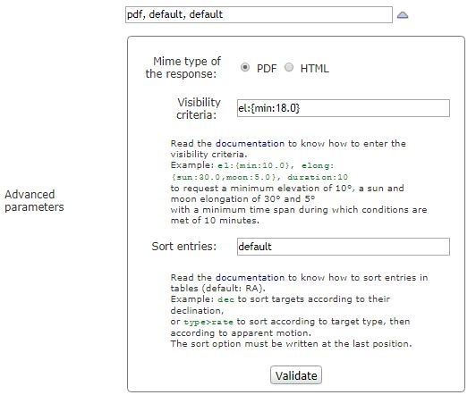
Observability Query Form
The advanced parameters
form.
Output format
Visibility criteria
Output sorting options
Click on this button to validate

Slide 19
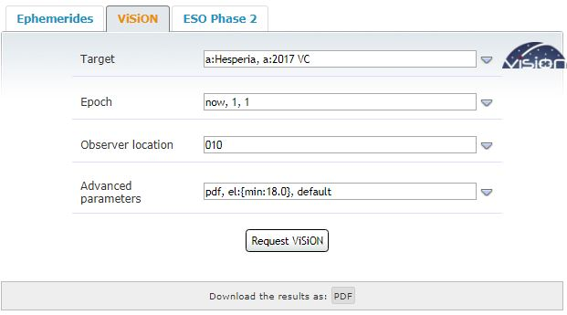
Observability Query Form
The query form.
“Go” button
Download button

Slide 20
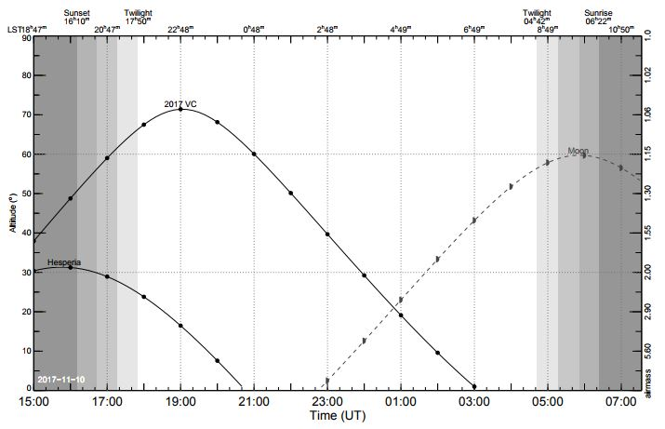
Results: Airmass Chart
Sidereal time scale
Elevation scale
Airmass scale
Sun elevation gray
scale encoding
Moon visibility curve
Targets’ visibility curves
UT hours scale

Slide 21
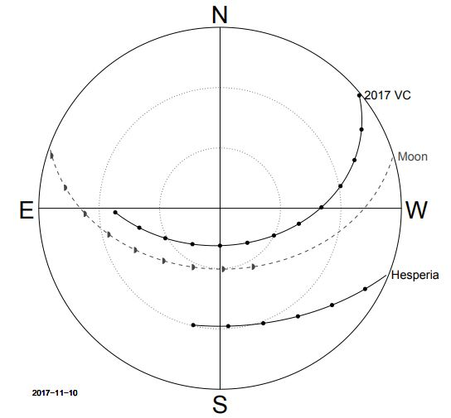
Results: Sky Chart
Horizon circle
30° elevation circle
60°elevation circle
Moon sky trajectory
Targets’ sky trajectories

Slide 22


JPL Small-Body Database Browser
Want to know every thing
about your asteroid/comet/satellite/planet ?
the Solar System “Big Browser”
http://ssd.jpl.nasa.gov/sbdb.cgi
Powered by:
Jet Propulsion Laboratory (JPL)
and NASA

Slide 23
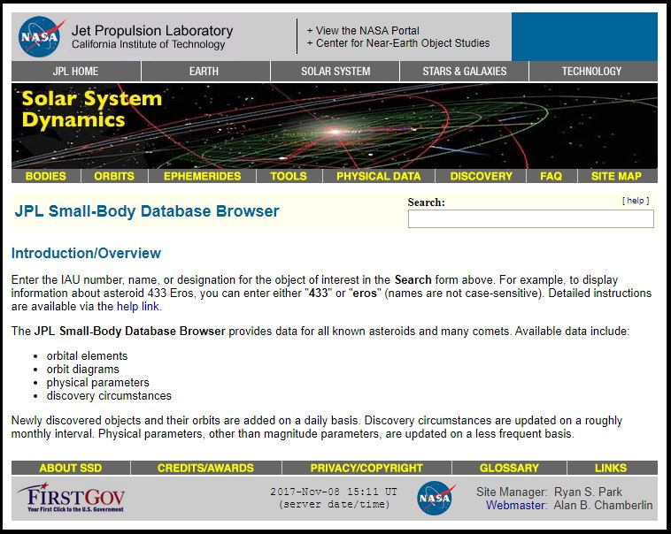
The WEB interface

Slide 24
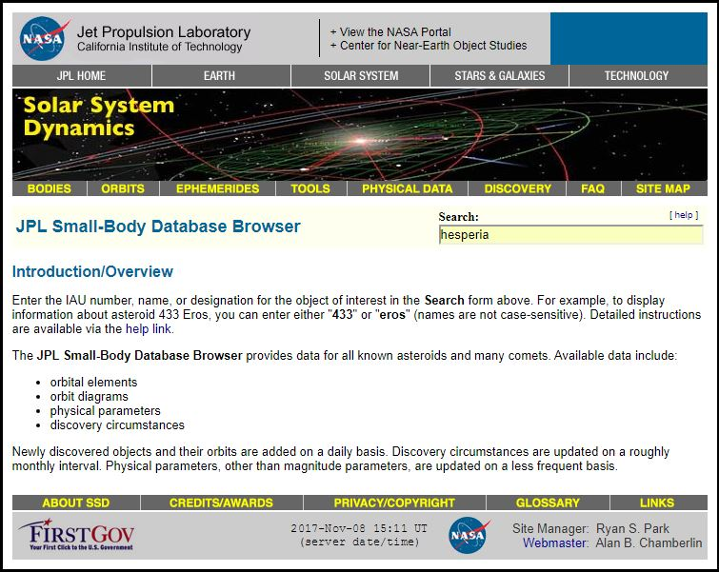
The WEB interface
Type the designation and
don’t forget to hit the
RETURN key to validate !

Slide 25
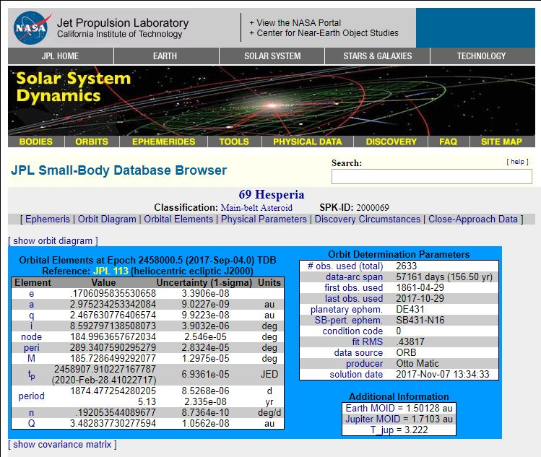
The results
Orbital elements
Technical informations
on orbit calculations

Slide 26
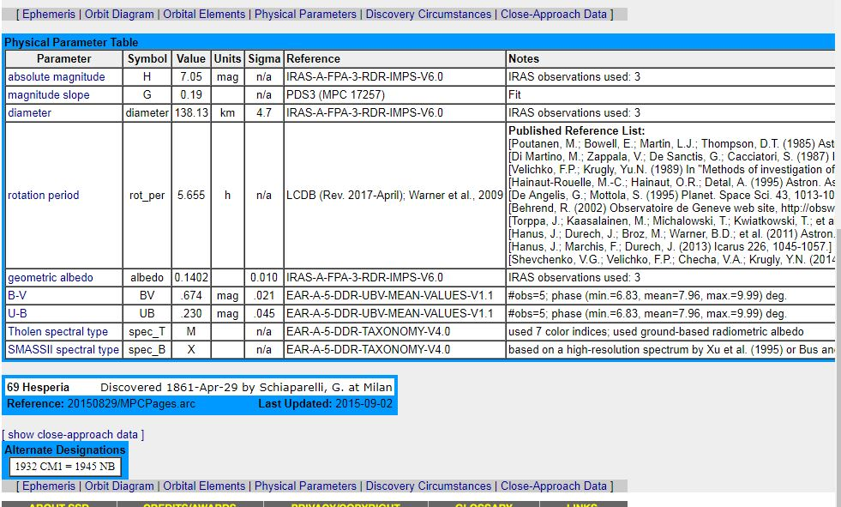
The results (cont’d)
Physical informations
Orbital elements
Discovery circumstances

Slide 27
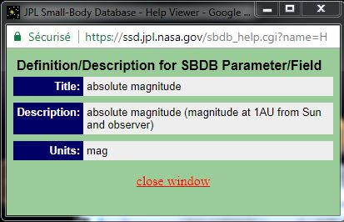
The results (cont’d)
C1
Click on blue strings to have informations (pop-up window)
Orbital elements

Slide 28
VISION Query Form
Want to know the coordinates
of your asteroid at a given epoch ?
A Solar System Objects ephemeris WEB service:
the “MIRIADE Ephemeris Generator”
http://vo.imcce.fr/webservices/miriade/?forms
A super-production by:
Institut de Mécanique Céleste et de Calcul des Ephémérides (IMCCE)
Formerly: « Bureau des Longitudes »

Slide 29
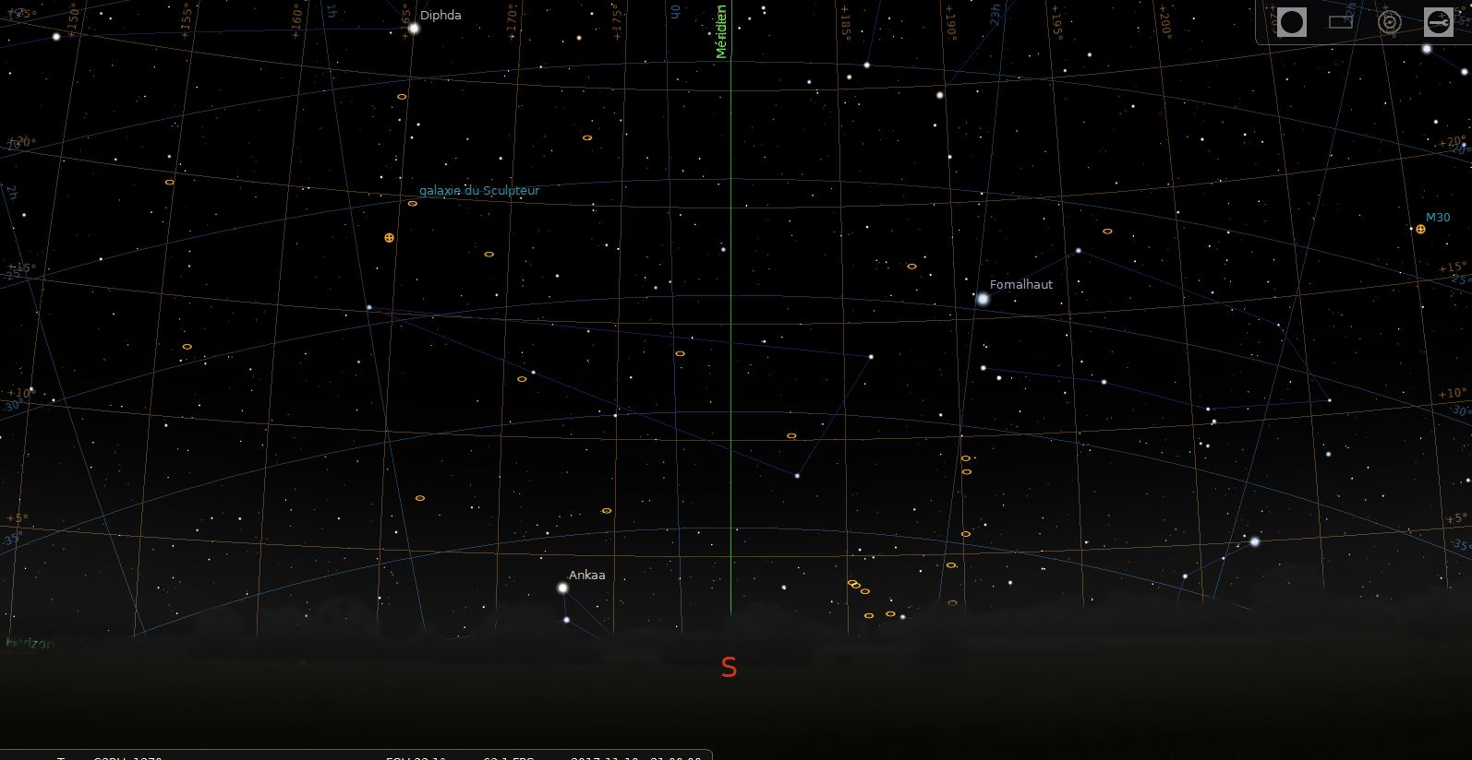
ANY QUESTION ?

