Slide 1
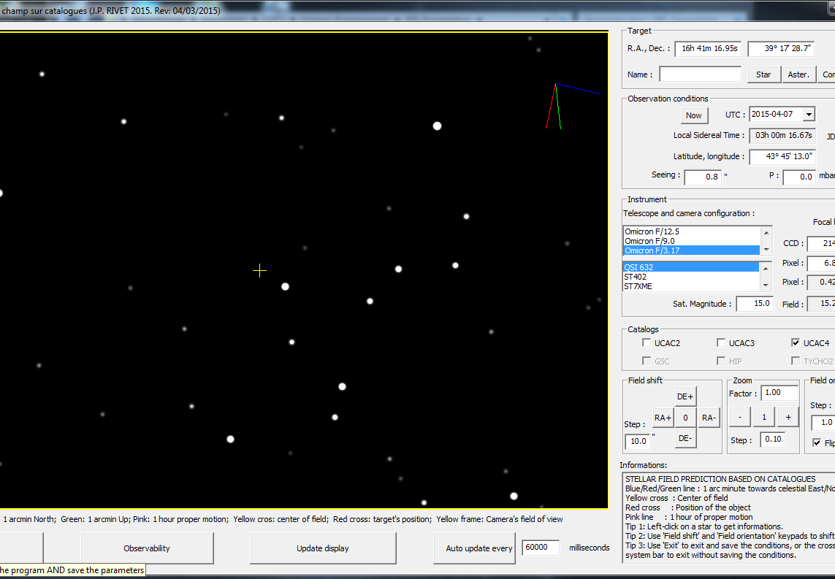


A SOFTWARE FOR
STAR FIELD PREDICTION AND TARGET OBSERVABILITY
ASSESSMENT
Version 02, 15/08/2017
Jean-Pierre Rivet
CNRS, OCA,
Dept. Lagrange
jean-pierre.rivet@oca.eu
© C2PU, Observatoire de la Cote d’Azur,
Université de Nice Sophia-Antipolis
Notes:
Conférence présentée à PARSEC, le 1er octobre 2005.

Slide 2
What are you really observing ?
The “Plot_Field” software is what you need
if you have ever asked one of the following questions
during an observing session:
Am I really observing the right target ?
Which of these spots on this CCD image is my target?
What is the identification and magnitude of this star, just
above my target on this CCD image ?
Is my target observable now ?
Will my target be observable from Mauna Kea
on January 24th, 2021 at 23h52 UT ?

Slide 3

Launching “Plot_Field”
On the Telescope control computer’s desktop,
double left-click on the Plot_Field software icon:

Slide 4
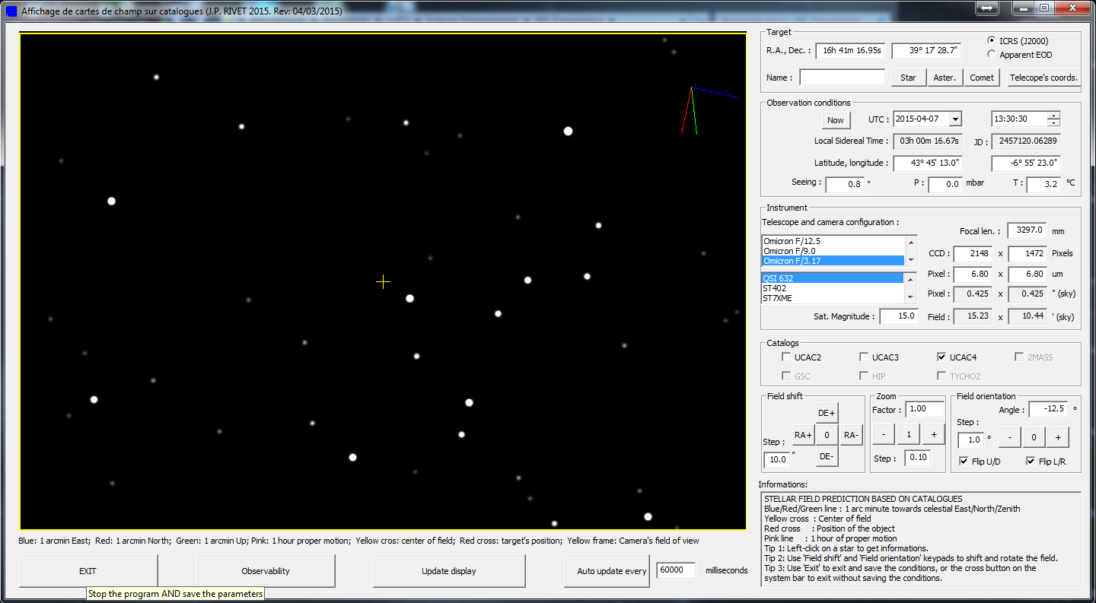
The “Plot_Field” software IHM

Slide 5
The “Plot_Field” software IHM
Display zone
“Observability”
button
“EXIT”
button
“Update display”
button
“Auto Update”
button

Slide 6
The “Plot_Field” software IHM
Target definition
zone
Observing conditions
zone
Instrument definition
zone
Catalogs definition
zone
Geometry definition
zone
Information
zone

Slide 7
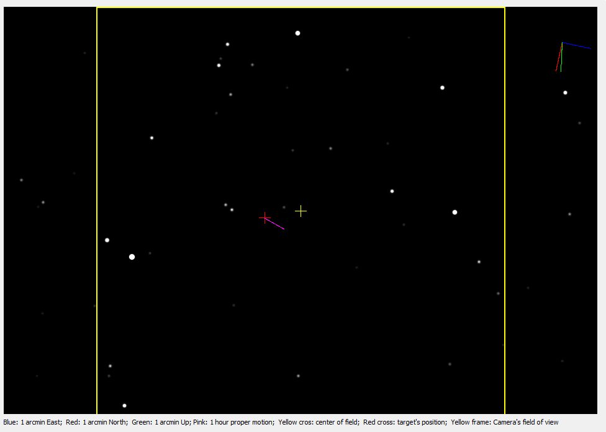
The display zone
1 arcmin towards North
1 arcmin towards East
1 arcmin towards Zenith
Center of field
Target
1 hour proper motion
(asteroids/comets only)
Stars
Field boundary

Slide 8

The target definition zone
Target’s right declination
Type of coordinates
Target’s right ascension
Target’s identifier
Get coordinates from
the telescope
NOTA: input formats:
type 180 for 180° 00’ 00’’
type 145 12 for 145° 12’ 00’’
type 110 21 34 for 110° 21’ 34’
type 91.5 for 91° 30’ 00’’
Target is a comet
Target is an asteroid
Target is a fixed object

Slide 9
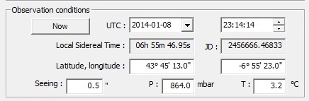
The observing conditions zone
Current date
UTC date
UTC time
True local
sidereal time
UTC Julian date
Latitude
Longitude
Estimated seeing
Temperature
Pressure
NOTA: in normal conditions,
the latitude and longitude fields
are preset to C2PU’s values

Slide 10
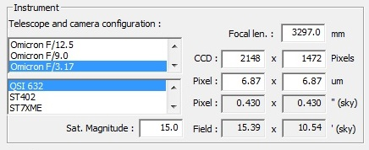
The instrument definition zone
Telescope / focus
selection list
Focal length
CCD size (pix)
Pixels size (μm)
Camera
selection list
Pixels size (″)
Field of view (‘)
Saturation magnitude

Slide 11

The catalog definition zone
Validate UCAC2
catalog
Validate UC3
catalog
Validate UCAC4
catalog
NOTA: in normal conditions,
nothing is to be modified
in this zone

Slide 12
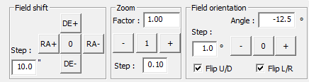
The geometry definition zone
Zoom factor
Field rotation
step (°)
Field orientation
angle
Shift step size (″)
Reset field
orientation angle
Increase field
orientation angle
Decrease field
orientation angle
Keypad to shift the
field of view
Decrease
zoom factor
Increase
zoom factor
Flip image
zoom factor
step
Reset
zoom factor

Slide 13
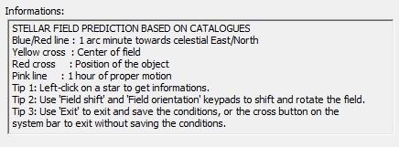
The information zone
Displays contextual
informations

Slide 14
A typical session (I)
Choose the instrumental configuration
select the telescope / focus configuration
select the camera
OR
enter the focal length manually
enter the CCD size in pixels manually
enter the pixels sizes in μm manually

Slide 15
A typical session (II)
Specify the observing conditions
verify the latitude / longitude, and update if needed
enter the atmospheric pressure and temperature manually
enter the estimated seeing value manually
left-click the “Now” button to set date/time to current values
OR
enter the UTC date / time manually using the date / time editors

Slide 16
A typical session (III)
Specify the target
enter the right ascension / declination manually
select the desired type of coordinates (ICRS or apparent EOD)
OR
enter the target’s identifier
left-click on the “Star” or “Aster.” or “Comet” button
OR
left-click on the “Telescope’s cords.” button to obtain the coordinates
and atmospheric conditions from the telescope

Slide 17
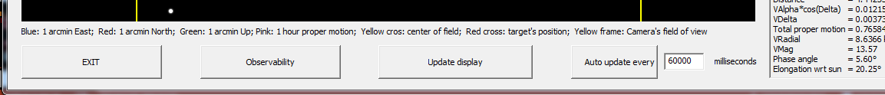
A typical session (IV)
Update the display
left-click on the “Update display” button

Slide 18
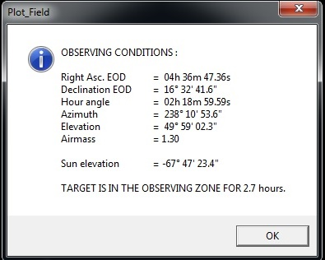
A typical session (V)
Check the observability
left-click on the “Observability” button
An information window pops up

Slide 19
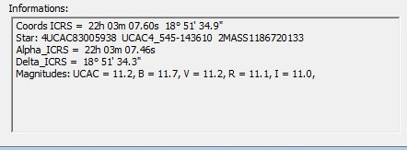
A typical session (VI)
Obtain informations on a field star
put the cursor on the star image
left-click on the star image
The information zone displays informations
on the star, or the current position if no star is found

Slide 20
A typical session (VII)
Exit the program
left-click on the “EXIT” button

Slide 21
END

